Slide 1
TTL Voltage Levels
LOW
HIGH
0 0.8 2 2.4 5 8
Typical choice
Power Supply Range
Ideal: LOW = 0V and HIGH = Power Supply
A non-ideal input will not degrade the output.

Slide 2
The Simplest “Gates”
A
Q
useless
In = A | Out = Q
T | F
F | F
Q = F
In = A | Out = Q
T | T
F | F
Q = A
BUF
NOT
(INV)
In = A | Out = Q
T | F
F | T
Q = opposite of A
In = A | Out = Q
T | T
F | T
Q = T

Slide 7
Multiple Gates: Known Inputs
1
0
0
1

Slide 8
Multiple Gates: Known Inputs
0
A
1
B
1
Z
C
1
D
1
E

Slide 9
Multiple Gates: Expressions
T₁
A
T₆
Q
T₂
T₄
B
C
T₅
T₃

Slide 10
Multiple Gates: Expressions
T₁
T₂
A
T₁₁
T₈
T₁₂
T₃
Q
B
T₇
T₉
T₄
T₁₀
C
T₅
T₆

Slide 11
Boolean Algebra Rules
Green are just like number algebra
Rules with Constants
Idempotent
Complementary
Involution
Commutative
Associative
“factor &”
“factor |”
“distribute &”
“distribute |”
Distributive
& FOIL
| FOIL

Slide 12
Boolean Algebra Rules
Not at all like numbers…
extra & |  |  | extra OR
extra NOT in OR |  |  | extra NOT in &
DeMorgan’s Theorems

Slide 13
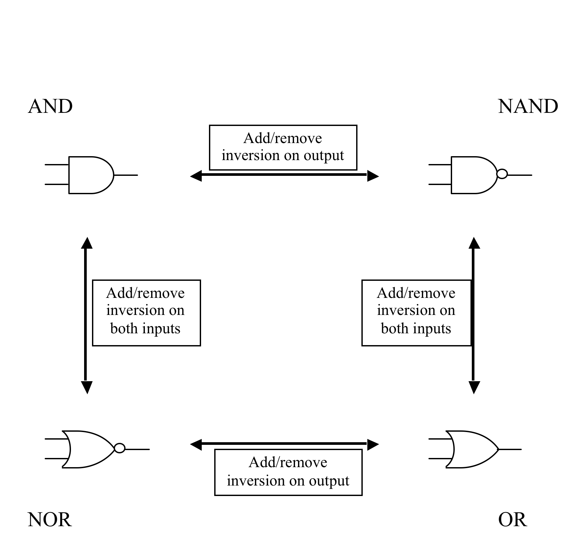
DeMorgan Relationships

Slide 14
DeMorgan Relationships

Slide 15
Calling All NANDs
A
B
C
A
B
C
A
B
C

Slide 16
Calling All NANDs
A
B
C
A
B
C
A
B
C

Slide 17
Calling All NORs?
A
B
C
A
B
C
Sometimes all NORs is better,
sometimes all NANDs is better

