Slide 1
Boolean Simplification
A
T₂
B
T₁
T₃
Q
W
T₄
T₆
U
T₅

Slide 2
Boolean Simplification
Use without naming:
Commutative
Associative
OR 1
Idempotent
Complementary
DeMorgan
“factor”
“OR factor”
“distribute”
“OR distribute”
& FOIL
| FOIL
extra & |  |  | extra OR
extra NOT in OR |  |  | extra NOT in &

Slide 3
Analog Problem into
a Digital Truth Table
Define analog inputs and outputs
Determine the relationship between them
Digitize the inputs (choose specific values that you will round off to)
Digitize the outputs (choose boundaries between ranges)
For each digitized input case, determine the output result
power P, weight W, turbo T
➔Performance R
W | B
1 ton | 0
1.5 ton | 1
P | A
100 hp | 0
200 hp | 1
200 hp/ton
R

Slide 4
Analog Problem into
a Digital Truth Table
For each digitized input case, determine the output result
A | B | C | PT/W Criteria | ≥200 hp/ton? | Q
0 | 0 | 0 | (100)(1)/1=100 | N | 0
0 | 0 | 1 | (100)(2)/1 = 200 | Y | 1
0 | 1 | 0 | (100)(1)/1.5 = 67 | N | 0
0 | 1 | 1 | (100)(2)/1.5 = 133 | N | 0
1 | 0 | 0 | (200)(1)/1 = 200 | Y | 1
1 | 0 | 1 | (200)(2)/1 = 400 | Y | 1
1 | 1 | 0 | (200)(1)/1.5 = 133 | N | 0
1 | 1 | 1 | (200)(2)/1.5 = 267 | Y | 1

Slide 5
Binary → Decimal
11001101₂
= 1×2⁷ + 1×2⁶ + 0×2⁵ + 0×2⁴ + 1×2³ + 1×2² + 0×2¹ + 1×2⁰
= 1×128 + 1×64 + 0×32 + 0×16 + 1×8 + 1×4 + 0×2 + 1×1
= 128 + 64 + 0 + 0 + 8 + 4 + 0 + 1
= 205₁₀
n bits → represent 0 through (2^{n}–1)

Slide 6
Decimal → Binary
132₁₀
132/2 = 66 remainder 0 → = LSB
66/2 = 33 remainder 0
33/2 = 16 remainder 1
16/2 = 8 remainder 0
8/2 = 4 remainder 0
4/2 = 2 remainder 0
2/2 = 1 remainder 0
1/2 = 0 remainder 1 → = MSB
10000100₂

Slide 7
Karnaugh Maps
A | B | X
0 | 0 | 1
0 | 1 | 0
1 | 0 | 0
1 | 1 | 1
B A | 0 | 1
0 | 1 | 0
1 | 0 | 1
A | B | C | D | X
0 | 0 | 0 | 0 | 1
0 | 0 | 0 | 1 | 1
0 | 0 | 1 | 0 | 0
0 | 0 | 1 | 1 | 0
0 | 1 | 0 | 0 | 1
0 | 1 | 0 | 1 | 1
0 | 1 | 1 | 0 | 0
0 | 1 | 1 | 1 | 0
1 | 0 | 0 | 0 | 0
1 | 0 | 0 | 1 | 0
1 | 0 | 1 | 0 | 0
1 | 0 | 1 | 1 | 0
1 | 1 | 0 | 0 | 0
1 | 1 | 0 | 1 | 1
1 | 1 | 1 | 0 | 0
1 | 1 | 1 | 1 | 1
C D A B | 0 0 | 0 1 | 1 1 | 1 0
0 0 | 1 | 1 | 0 | 0
0 1 | 1 | 1 | 0 | 0
1 1 | 0 | 1 | 1 | 0
1 0 | 0 | 0 | 0 | 0
A | B | C | X
0 | 0 | 0 | 1
0 | 0 | 1 | 1
0 | 1 | 0 | 1
0 | 1 | 1 | 0
1 | 0 | 0 | 0
1 | 0 | 1 | 0
1 | 1 | 0 | 1
1 | 1 | 1 | 0
C A B | 0 | 1
0 0 | 1 | 1
0 1 | 1 | 0
1 1 | 1 | 0
1 0 | 0 | 0

Slide 8
Karnaugh Maps
Wrapping around the edges…
C A B | 0 | 1
0 0 | 1 | 1
0 1 | 0 | 0
1 1 | 0 | 0
1 0 | 0 | 1
C D A B | 0 0 | 0 1 | 1 1 | 1 0
0 0 | 1 | 1 | 0 | 1
0 1 | 0 | 0 | 0 | 1
1 1 | 0 | 0 | 0 | 1
1 0 | 1 | 1 | 0 | 1

Slide 9
Karnaugh Maps
Examples
C A B | 0 | 1
0 0 | 0 | 0
0 1 | 1 | 0
1 1 | 1 | 0
1 0 | 0 | 0
C D A B | 0 0 | 0 1 | 1 1 | 1 0
0 0 | 0 | 0 | 0 | 0
0 1 | 0 | 0 | 0 | 0
1 1 | 1 | 0 | 0 | 1
1 0 | 1 | 0 | 0 | 1
C A B | 0 | 1
0 0 | 1 | 0
0 1 | 0 | 0
1 1 | 0 | 0
1 0 | 1 | 0
C D A B | 0 0 | 0 1 | 1 1 | 1 0
0 0 | 1 | 1 | 0 | 1
0 1 | 1 | 1 | 0 | 0
1 1 | 1 | 1 | 0 | 0
1 0 | 1 | 1 | 0 | 1

Slide 10
Karnaugh Maps
Examples
C D A B | 0 0 | 0 1 | 1 1 | 1 0
0 0 | 0 | 0 | 1 | 0
0 1 | 1 | 1 | 1 | 1
1 1 | 1 | 1 | 0 | 0
1 0 | 0 | 0 | 0 | 0

Slide 11
Multiplexers
DATA Inputs:
I₀
I₁
I₂
I₃
D₀
D₁
D₂
D₃
B A
MUX
Q
SELECT Inputs

Slide 12
Multiplexers
B | A | Q
0 | 0 | 0
0 | 1 | 1
1 | 0 | 1
1 | 1 | 0
DATA Inputs:
I₀
I₁
I₂
I₃
D₀
D₁
D₂
D₃
B A
MUX
Q
SELECT Inputs

Slide 13
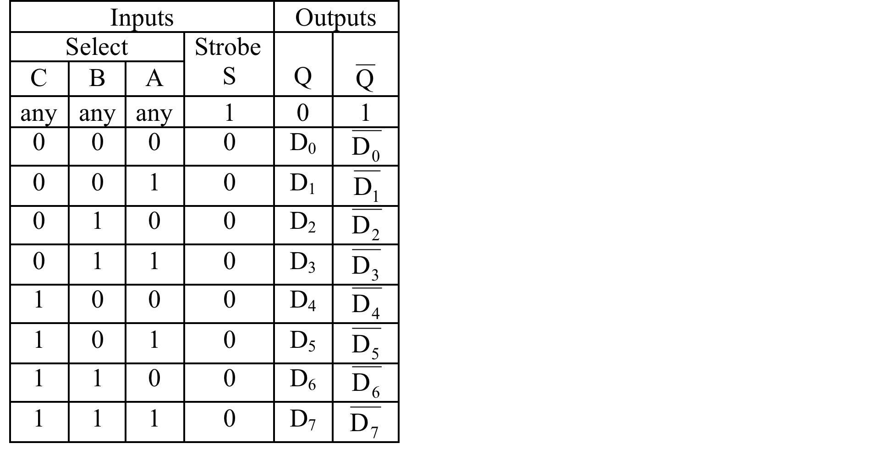
74151/74251 Multiplexer
        Data Inputs
        Select Inputs
        Vcc
16 15 14 13 12 11 10 9
Vcc
D₄
D₅
D₆
D₇
A
B
C
C | B | A | Q
0 | 0 | 0 | 0
0 | 0 | 1 | 1
0 | 1 | 0 | 1
0 | 1 | 1 | 0
1 | 0 | 0 | 1
1 | 0 | 1 | 1
1 | 1 | 0 | 0
1 | 1 | 1 | 1
74151/74251
1-of-8 Multiplexer
D₃
D₂
D₁
D₀
Q
Q
S
GND
1 2 3 4 5 6 7 8
        Ground
        Data Inputs
        Outputs
        Strobe

Slide 14
74153 Multiplexer
        Data Inputs
        Strobe
16 15 14 13 12 11 10 9
Vcc
2S
A
2D₃
2D₂
2D₁
2D₀
2Q
74153
Dual 1-of-4 Multiplexer
1S
B
1D₃
1D₂
1D₁
1D₀
1Q
GND
1 2 3 4 5 6 7 8
        Data Inputs

Slide 15
MUX Input Doubling
(with a 74151)
C B A
w | x | y | z | Q
0 | 0 | 0 | 0 | 1
0 | 0 | 0 | 1 | 1
0 | 0 | 1 | 0 | 0
0 | 0 | 1 | 1 | 0
0 | 1 | 0 | 0 | 0
0 | 1 | 0 | 1 | 1
0 | 1 | 1 | 0 | 0
0 | 1 | 1 | 1 | 1
1 | 0 | 0 | 0 | 1
1 | 0 | 0 | 1 | 0
1 | 0 | 1 | 0 | 0
1 | 0 | 1 | 1 | 0
1 | 1 | 0 | 0 | 1
1 | 1 | 0 | 1 | 1
1 | 1 | 1 | 0 | 1
1 | 1 | 1 | 1 | 0
w x y z
D₀=1
D₁=0
D₂=z
D₃=z
Vcc
D₄
D₅
D₆
D₇
A
B
C
74151/74251
1-of-8 Multiplexer
D₄=z
D₅=0
D₃
D₂
D₁
D₀
Q
Q
S
GND
D₆=1
D₇=z

Slide 16
MUX Combination Doubling
(with a 74153)
Gnd
Vcc
C | B | A | X
0 | 0 | 0 | 0
0 | 0 | 1 | 1
0 | 1 | 0 | 1
0 | 1 | 1 | 0
1 | 0 | 0 | 0
1 | 0 | 1 | 0
1 | 1 | 0 | 1
1 | 1 | 1 | 1
Vcc
2S
A
2D₃
2D₂
2D₁
2D₀
2Q
74153
Dual 1-of-4 Multiplexer
1S
B
1D₃
1D₂
1D₁
1D₀
1Q
GND
Vcc
Gnd
X

Slide 17
MUX Input Doubling on 74153
(same truth table)
on MUX: B A R
as given:
C | B | A | Q
0 | 0 | 0 | 0
0 | 0 | 1 | 1
0 | 1 | 0 | 1
0 | 1 | 1 | 0
1 | 0 | 0 | 0
1 | 0 | 1 | 0
1 | 1 | 0 | 1
1 | 1 | 1 | 1
Vcc
2S
A
2D₃
2D₂
2D₁
2D₀
2Q
D₀=R
74153
Dual 1-of-4 Multiplexer
D₁=R
D₂=0
1S
B
1D₃
1D₂
1D₁
1D₀
1Q
GND
D₃=1
1 0 R R Q

Slide 18
MUX Quadrupling
 | B | A
L | M | N | P |  | Q | D_{i}
0 | 0 | 0 | 0 |  | 1 | 1D₀
0 | 0 | 0 | 1 |  | 0 | 1D₀
0 | 0 | 1 | 0 |  | 1 | 1D₁
0 | 0 | 1 | 1 |  | 0 | 1D₁
0 | 1 | 0 | 0 |  | 0 | 1D₂
0 | 1 | 0 | 1 |  | 0 | 1D₂
0 | 1 | 1 | 0 |  | 1 | 1D₃
0 | 1 | 1 | 1 |  | 1 | 1D₃
1 | 0 | 0 | 0 |  | 0 | 2D₀
1 | 0 | 0 | 1 |  | 0 | 2D₀
1 | 0 | 1 | 0 |  | 0 | 2D₁
1 | 0 | 1 | 1 |  | 1 | 2D₁
1 | 1 | 0 | 0 |  | 0 | 2D₂
1 | 1 | 0 | 1 |  | 1 | 2D₂
1 | 1 | 1 | 0 |  | 1 | 2D₃
1 | 1 | 1 | 1 |  | 0 | 2D₃
L
P
+5V
N
P
P
Vcc
2S
A
2D₃
2D₂
2D₁
2D₀
2Q
74153
Dual 1-of-4 Multiplexer
1S
B
1D₃
1D₂
1D₁
1D₀
1Q
GND
L
M
+5V
Main
Output
Q
P

