Slide 1
Springs/Oscillations/Fluids

Slide 2
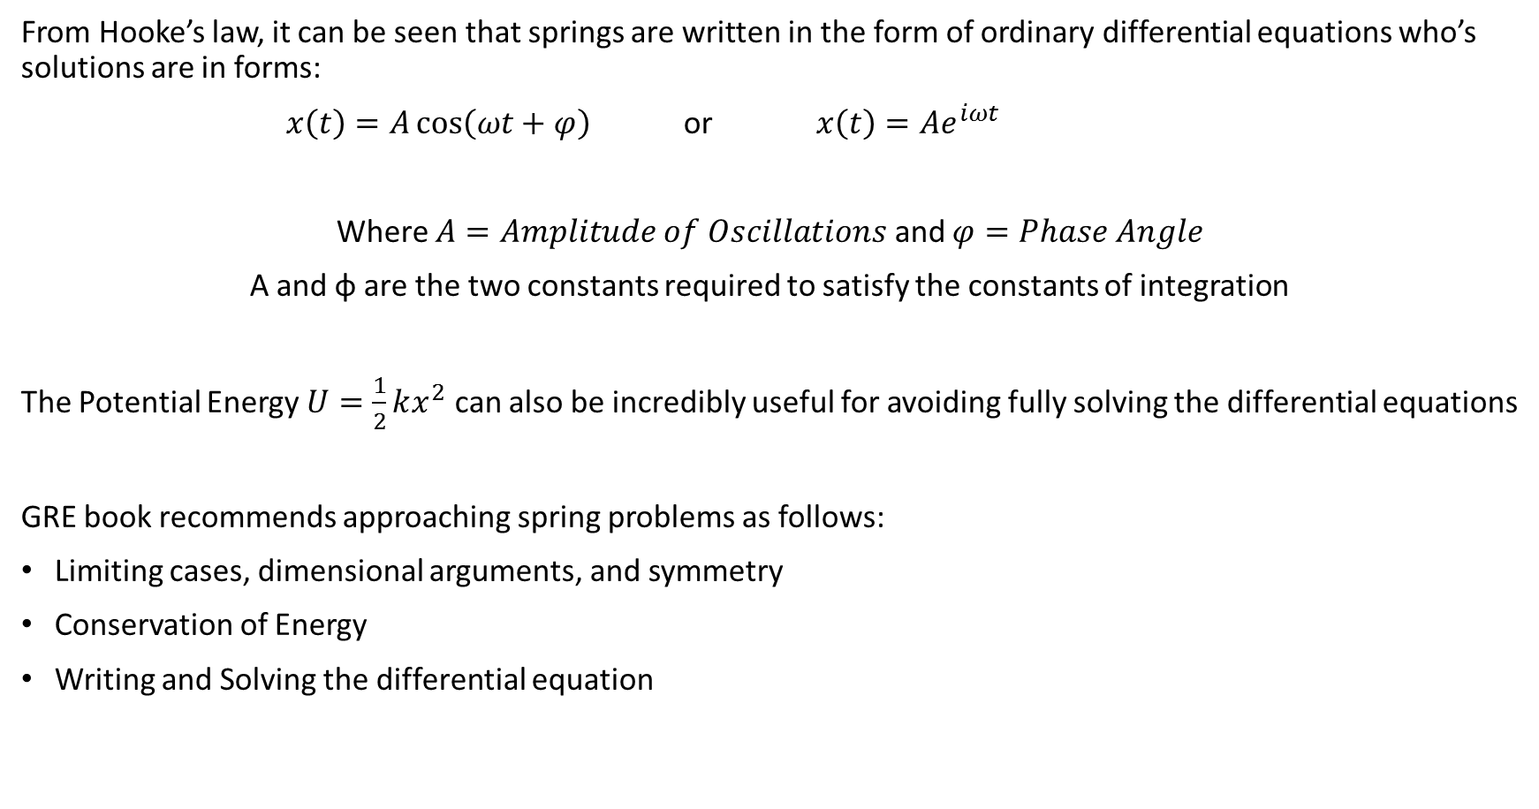
Springs
From Hooke’s law, it can be seen that springs are written in the form of ordinary differential equations who’s solutions are in forms:
$x\left(t\right)=A\cos\left(ωt+φ\right)$ or $x\left(t\right)=Ae^{iωt}$
Where $A=Amplitude of Oscillations$ and $φ=Phase Angle$
A and φ are the two constants required to satisfy the constants of integration
The Potential Energy $U=\frac{1}{2}kx^{2}$ can also be incredibly useful for avoiding fully solving the differential equations
GRE book recommends approaching spring problems as follows:
Limiting cases, dimensional arguments, and symmetry
Conservation of Energy
Writing and Solving the differential equation

Slide 3
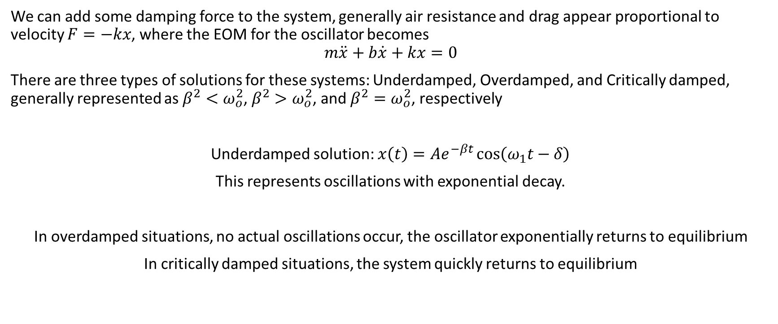
Dampened Oscillators
We can add some damping force to the system, generally air resistance and drag appear proportional to velocity $F=−kx$, where the EOM for the oscillator becomes
$$m\ddot{x}+b\dot{x}+kx=0$$
There are three types of solutions for these systems: Underdamped, Overdamped, and Critically damped, generally represented as $β^{2}<ω_{o}^{2}$, $β^{2}>ω_{o}^{2}$, and $β^{2}=ω_{o}^{2}$, respectively
Underdamped solution: $x\left(t\right)=Ae^{−βt}\cos\left(ω_{1}t−δ\right)$
This represents oscillations with exponential decay.
In overdamped situations, no actual oscillations occur, the oscillator exponentially returns to equilibrium
In critically damped situations, the system quickly returns to equilibrium

Slide 4

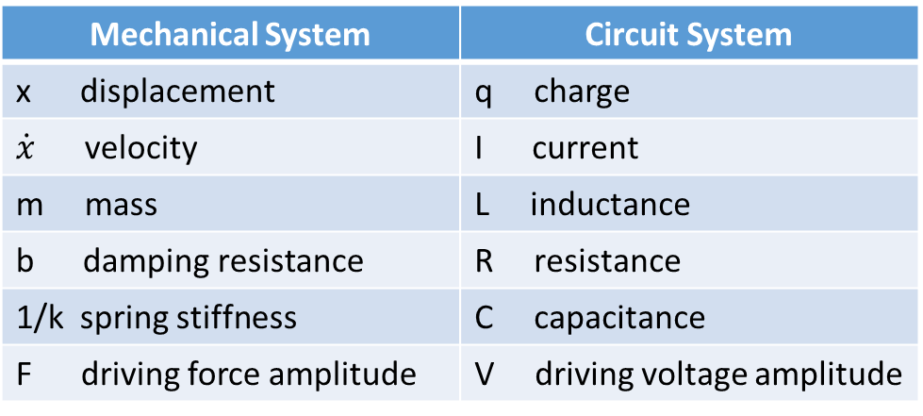
Driven Oscillator and Circuit Analog
We can also add a driving force to the system:
$$m\ddot{x}+b\dot{x}+kx=A\cos\left(ωt\right)$$
The amplitude of oscillation is maximized when driving frequency equals resonant frequency $ω_{R}^{2}=ω_{o}^{2}−2β^{2}$
A circuit system is comparable to a mechanical system
Mechanical System | Circuit System
x displacement | q charge
$\dot{x}$ velocity | I current
m mass | L inductance
b damping resistance | R resistance
1/k spring stiffness | C capacitance
F driving force amplitude | V driving voltage amplitude

Slide 5
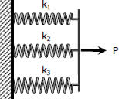

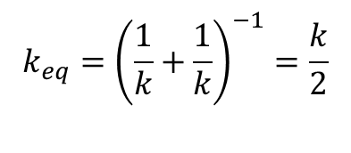

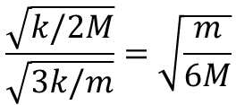
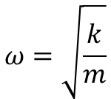
Problem
m
M
$$k_{eq}={\left(\frac{1}{k}+\frac{1}{k}\right)}^{−1}=\frac{k}{2}$$
$$k_{eq}=k+k+k=3k$$
$$ω=\sqrt{\frac{k}{m}}$$
$$\frac{\sqrt{k/2M}}{\sqrt{3k/m}}=\sqrt{\frac{m}{6M}}$$

Slide 6

Fluids
Bernoulli’s principle:
$$\frac{v^{2}}{2}+gz+\frac{p}{ρ}=Constant$$
So for pipes of different diameters
$$v_{1}a^{2}=v_{2}b^{2}$$
$$\frac{v_{1}^{2}}{2}+gz_{1}+\frac{p_{1}}{ρ}=\frac{v_{2}^{2}}{2}+gz_{2}+\frac{p_{2}}{ρ}$$
$$p_{2}=\frac{ρv_{1}^{2}}{2}\left(1−\frac{a^{4}}{b^{4}}\right)+p_{1}$$

Slide 7

Buoyant Force
$$F=ρVg$$

Slide 8
Moment of Inertia

Slide 9
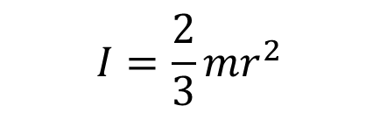
First simple example:
Rotation of a thin spherical shell, with radius r, about an axis through the center
y
$$I=\frac{2}{3}mr^{2}$$
x
r
z

Slide 10
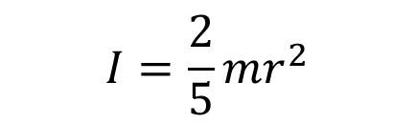
First simple example:
Rotation of a sphere, with radius r, about an axis through the center
y
$$I=\frac{2}{5}mr^{2}$$
x
r
z

Slide 11

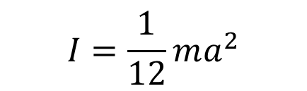

Second Example:
A uniform rod of length a and negligible thickness rotating about its center
y
y
$$I=\frac{1}{12}ma^{2}$$
$$−\frac{a}{2}$$
$$\frac{a}{2}$$
x
x
z

Slide 12
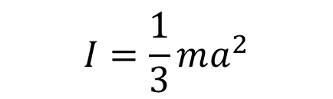
Third simple example:
Rotation of a rod with length a about its endpoint
y
y
$$I=\frac{1}{3}ma^{2}$$
$$−\frac{a}{2}$$
$$\frac{a}{2}$$
x
z

Slide 13
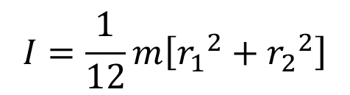
y
$$I=\frac{1}{12}m\left[{r_{1}}^{2}+{r_{2}}^{2}\right]$$
x
r₂
r₁
z

Slide 14
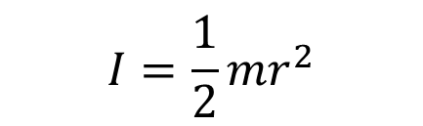
y
$$I=\frac{1}{2}mr^{2}$$
x
r
z

Slide 15

Parallel Axis Theorem
$$I_{new}=I_{com}+mh^{2}$$
com
h

Slide 16
Orbital Motion/Centripetal Motion/Drag Force

Slide 17
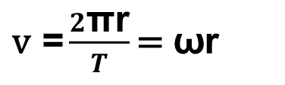
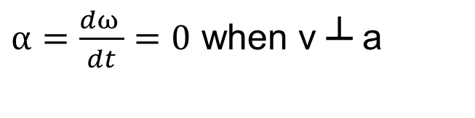
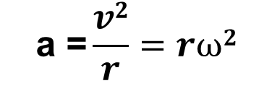
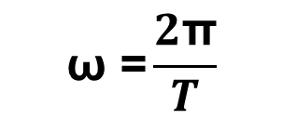
Centripetal Motion
$$\text{ω}\text{ =}\frac{2\text{π}}{T}$$
v
$\text{v}\text{ =}\frac{2\text{π}\text{r}}{T}\text{= }\text{ω}$r
F_{c}
$$\text{a}\text{ =}\frac{v2}{r}=rω2$$
ω, angular velocity
T, period of rotation
r, radius
α, angular acceleration
$α=\frac{dω }{dt}=0$ when v ┴ a

Slide 18


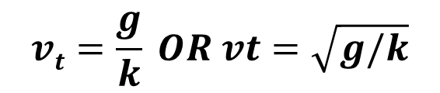
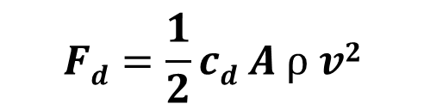
Drag Force
F_{d}
$$Fd=k m v$$
$$Fd=k m v2$$
$$vt=\frac{g}{k} OR vt=\sqrt{g/k}$$
mg
$$Fd=\frac{1}{2}cd A ρ v2$$
c_{d}, drag coefficient
ρ, density of medium
A, cross-sectional area of object
v, speed

Slide 19
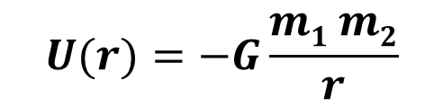
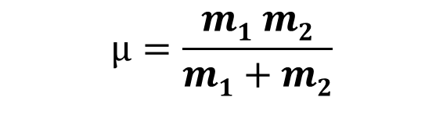
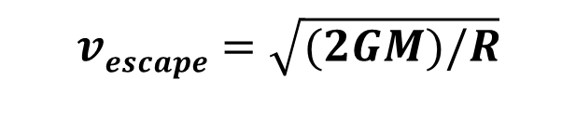
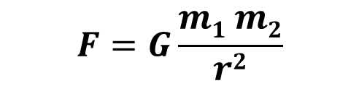
Orbital Motion
$$F=G\frac{m1 m2}{r2}$$
G=6.67408*10⁻¹¹ m^3 kg^-1 s^-2
$$U(r)=−G\frac{m1 m2}{r}$$
$$μ=\frac{m1 m2}{m1+m2}$$
$$vescape=\sqrt{(2GM)/R}$$

Slide 20



Kepler’s 1st Law
b
$$\frac{x2}{a2}+\frac{y2}{b2}=1$$
a
$$rmin=a(1−ε)$$
$$rmax=a(1+ε)$$

Slide 21
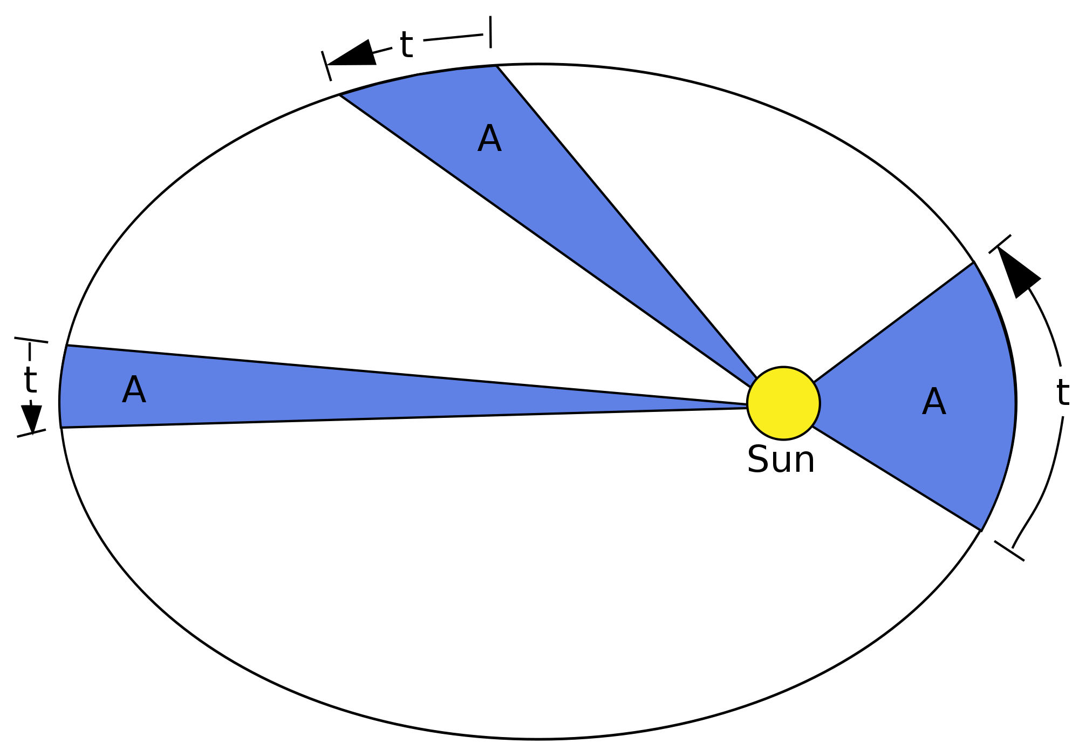
Kepler’s 2nd Law

Slide 22
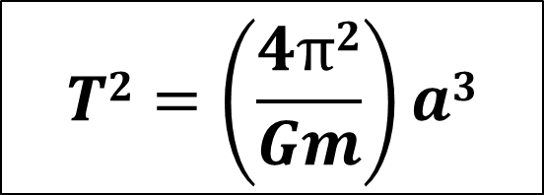
Kepler’s 3rd Law
$$T2=\left(\frac{4π2}{Gm}\right)a3$$

Slide 23
Lagrangian and Hamiltonian Mechanics

Slide 24
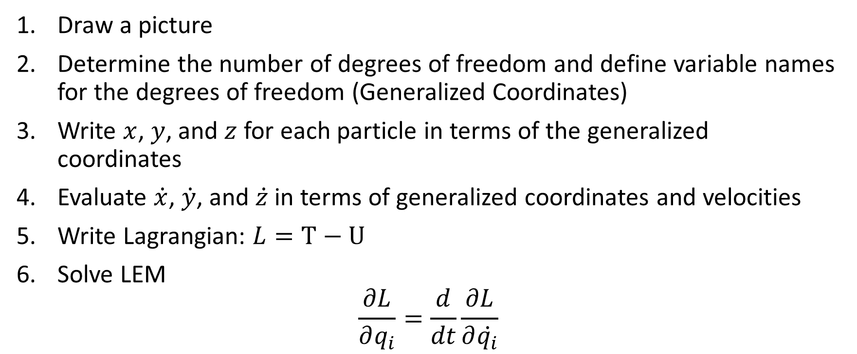
Lagrangian Equations of Motion: How to
Draw a picture
Determine the number of degrees of freedom and define variable names for the degrees of freedom (Generalized Coordinates)
Write $x$, $y$, and $z$ for each particle in terms of the generalized coordinates
Evaluate $\dot{x}$, $\dot{y}$, and $\dot{z}$ in terms of generalized coordinates and velocities
Write Lagrangian: $L=T−U$
Solve LEM
$$\frac{∂L}{∂q_{i}}=\frac{d}{dt}\frac{∂L}{∂\dot{q_{i}}}$$

Slide 25
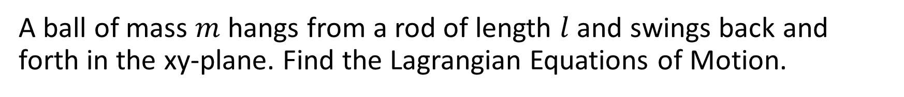
Example Problem
A ball of mass $m$ hangs from a rod of length $l$ and swings back and forth in the xy-plane. Find the Lagrangian Equations of Motion.

Slide 26


1. Draw a picture
$$l$$
$$m$$

Slide 27


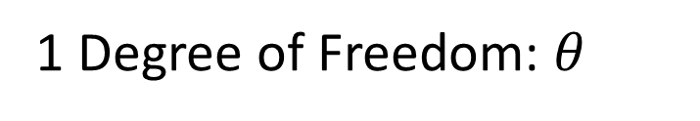



2. Determine the number of degrees of freedom and define variable names for the degrees of freedom (Generalized Coordinates)
$$y$$
$$x$$
1 Degree of Freedom: $θ$
$$l$$
$$θ$$
$$m$$

Slide 28



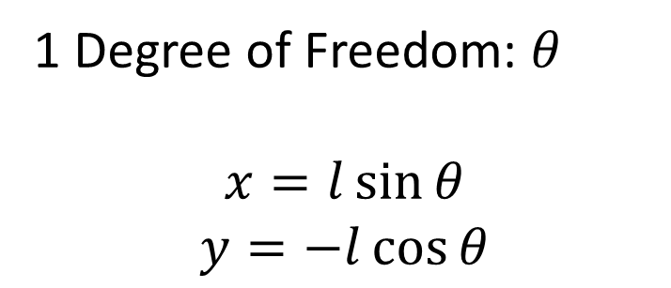


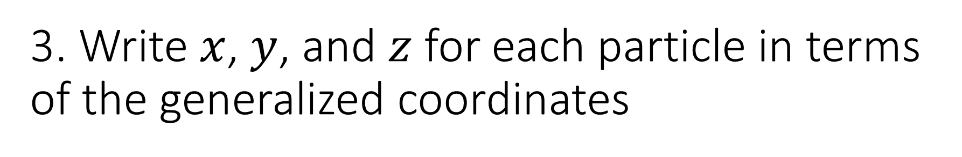
3. Write $x$, $y$, and $z$ for each particle in terms of the generalized coordinates
$$y$$
$$x$$
1 Degree of Freedom: $θ$
$$x=l\sin{θ}$$
$$y=−l\cos{θ}$$
$$l$$
$$θ$$
$$m$$

Slide 29

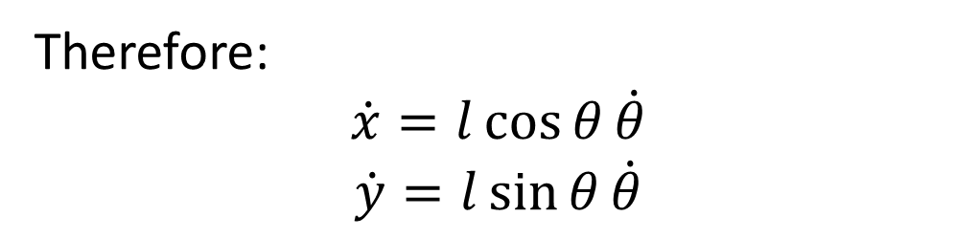
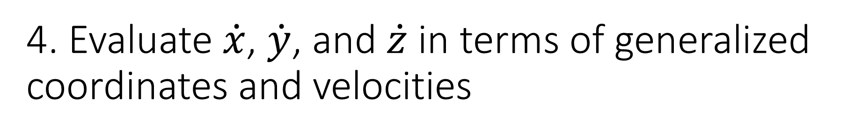
4. Evaluate $\dot{x}$, $\dot{y}$, and $\dot{z}$ in terms of generalized coordinates and velocities
Recall:
$$x=l\sin{θ}$$
$$y=−l\cos{θ}$$
Therefore:
$$\dot{x}=l\cos{θ}\dot{θ}$$
$$\dot{y}=l\sin{θ}\dot{θ}$$

Slide 30
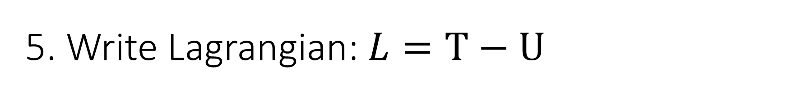

5. Write Lagrangian: $L=T−U$
Kinetic Energy ($T$)
$$T=\frac{1}{2}m\left({\dot{x}}^{2}+{\dot{y}}^{2}\right)$$
$$T=\frac{1}{2}m\left({(l\cos{θ}\dot{θ})}^{2}+{(l\sin{θ}\dot{θ})}^{2}\right)$$
$$T=\frac{1}{2}ml^{2}{\dot{θ}}^{2}$$
Potential Energy ($U$)
$$U=mgy$$
$$U=−mgl\cos{θ}$$
Lagrangian ($L$)
$$L=\frac{1}{2}ml^{2}{\dot{θ}}^{2}+mgl\cos{θ}$$

Slide 31
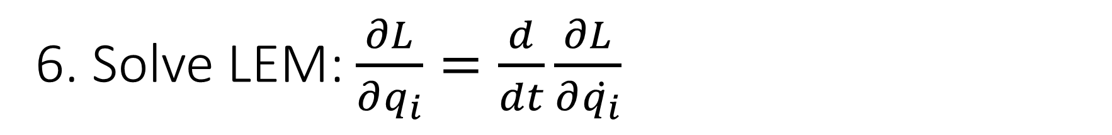

6. Solve LEM: $\frac{∂L}{∂q_{i}}=\frac{d}{dt}\frac{∂L}{∂\dot{q_{i}}}$
Recall: $L=\frac{1}{2}ml^{2}{\dot{θ}}^{2}+mgl\cos{θ}$
Therefore:
$$\frac{∂L}{∂θ}=−mgl\sin{θ}$$
$$\frac{∂L}{∂\dot{θ}}=ml^{2}\dot{θ}$$
$$\frac{d}{dt}\frac{∂L}{∂\dot{q_{i}}}=ml^{2}\ddot{θ}$$

Slide 32

Solution
We note
$$\ddot{θ}=−\frac{g}{l}\sin{θ}$$

Slide 33
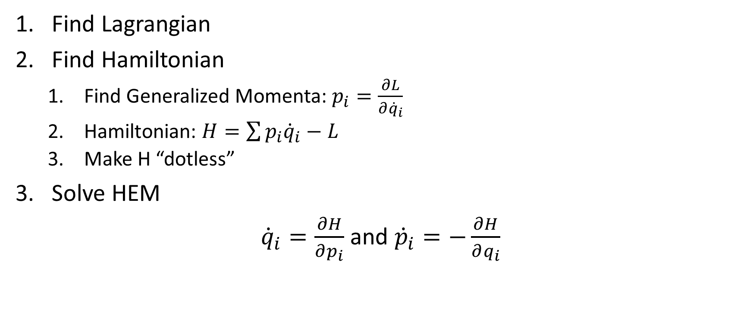
Hamiltonian Equations of Motion: How To
Find Lagrangian
Find Hamiltonian
Find Generalized Momenta: $p_{i}=\frac{∂L}{∂{\dot{q}}_{i}}$
Hamiltonian: $H=\sum{p_{i}{\dot{q}}_{i}}−L$
Make H “dotless”
Solve HEM
${\dot{q}}_{i}=\frac{∂H}{∂p_{i}}$ and ${\dot{p}}_{i}=−\frac{∂H}{∂q_{i}}$

Slide 34

1. Find Lagrangian
$$L=\frac{1}{2}ml^{2}{\dot{θ}}^{2}+mgl\cos{θ}$$

Slide 35
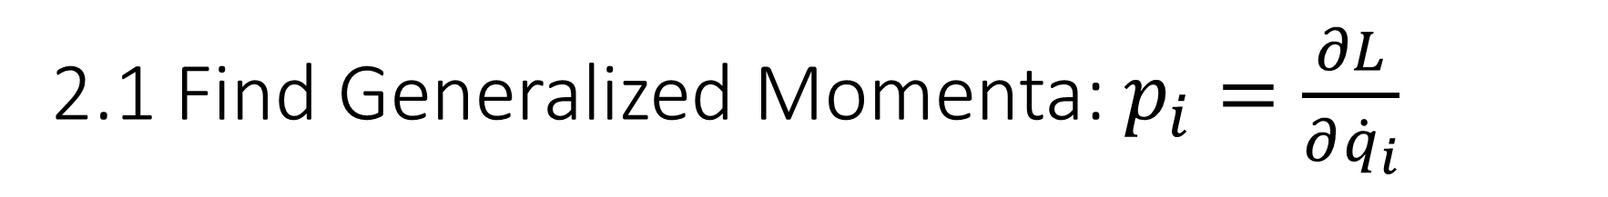

2.1 Find Generalized Momenta: $p_{i}=\frac{∂L}{∂{\dot{q}}_{i}}$
$$L=\frac{1}{2}ml^{2}{\dot{θ}}^{2}+mgl\cos{θ}$$
Note: $p_{i}=\frac{∂L}{∂{\dot{q}}_{i}}$
Therefore,
$$p_{θ}=ml^{2}\dot{θ}$$

Slide 36
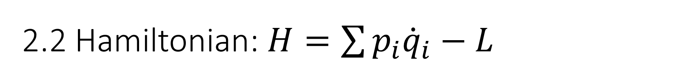

2.2 Hamiltonian: $H=\sum{p_{i}{\dot{q}}_{i}}−L$
Recall:
$L=\frac{1}{2}ml^{2}{\dot{θ}}^{2}+mgl\cos{θ}$ and $p_{θ}=ml^{2}\dot{θ}$
Therefore,
$$H=ml^{2}\dot{θ}\dot{θ}−\frac{1}{2}ml^{2}{\dot{θ}}^{2}−mgl\cos{θ}$$
$$H=\frac{1}{2}ml^{2}{\dot{θ}}^{2}−mgl\cos{θ}$$

Slide 37

2.3 Make H “dotless”
Recall:
$$H=\frac{1}{2}ml^{2}{\dot{θ}}^{2}−mgl\cos{θ}$$
Making $H$ “dotless”: $p_{θ}=ml^{2}\dot{θ}$ -> $\dot{θ}=\frac{p_{θ}}{ml^{2}}$
$$H=\frac{1}{2}ml^{2}{(\frac{p_{θ}}{ml^{2}})}^{2}−mgl\cos{θ}$$
$$H=\frac{1}{2}\frac{{p_{θ}}^{2}}{ml^{2}}−mgl\cos{θ}$$

Slide 38

3. Solve HEM
Hamiltonian: $H=\frac{1}{2}\frac{{p_{θ}}^{2}}{ml^{2}}−mgl\cos{θ}$
Solution: ${\dot{q}}_{i}=\frac{∂H}{∂p_{i}}$ and ${\dot{p}}_{i}=−\frac{∂H}{∂q_{i}}$
Therefore,
$\dot{θ}=\frac{p_{θ}}{ml^{2}}$ and ${\dot{p}}_{θ}=−mgl\sin{θ}$

Slide 39

Note
Note: $p_{θ}=lmv=l^{2}m\dot{θ}$ -> ${\dot{p}}_{θ}=l^{2}m\ddot{θ}$
$$l^{2}m\ddot{θ}=−mgl\sin{θ}$$
$$\ddot{θ}=−\frac{g}{l}\sin{θ}$$
(Same as Lagrangian)

Slide 40
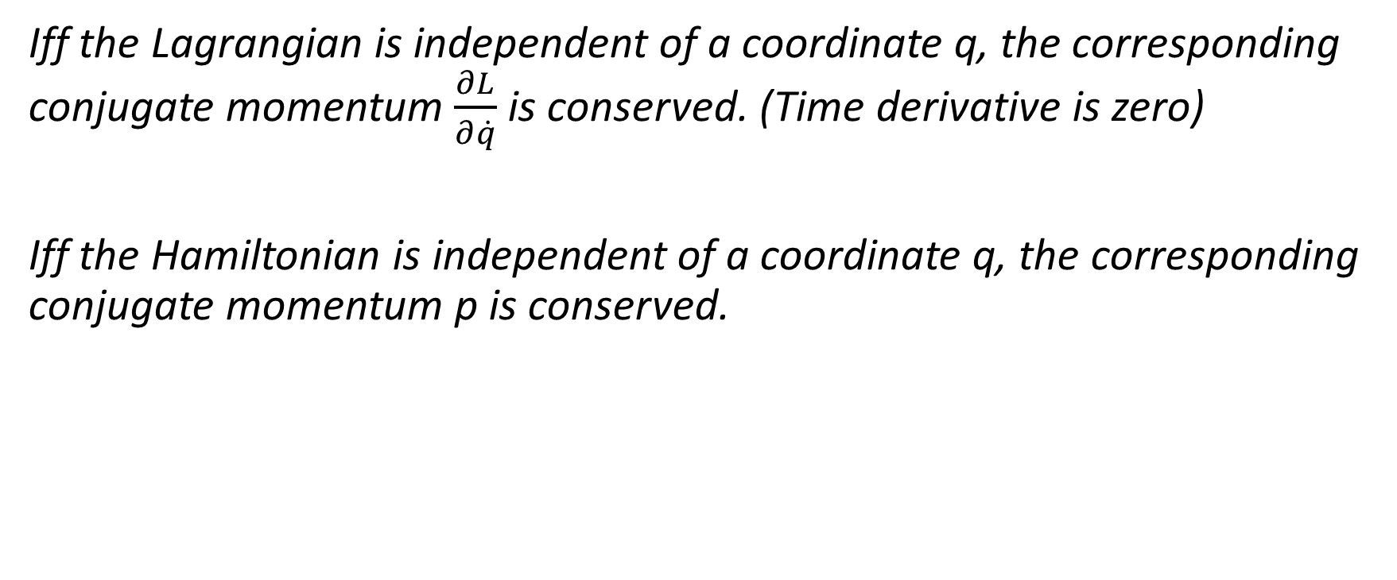
Other Notes
Iff the Lagrangian is independent of a coordinate q, the corresponding conjugate momentum $\frac{∂L}{∂\dot{q}}$ is conserved. (Time derivative is zero)
Iff the Hamiltonian is independent of a coordinate q, the corresponding conjugate momentum p is conserved.

