Slide 1













Basic vector analysis
Cartesian
$$\overset{⃑}{r}=r "vector"$$
Always Start with your r and r’ definitions in Cartesian because cylindrical and spherical coordinates do not add and subtract easily.
$$\hat{r}=r "\text{unit} \text{vector}\text{" }\text{or} \text{the} \text{direction} \text{of} \overset{⃑}{r}$$
r$=\text{magnitude} \text{of} \overset{⃑}{r}$
$$\overset{⃑}{r}=(X\hat{i}+Y\hat{j}+Z\hat{k})$$
$$\overset{⃑}{r′}=(X′\hat{i}+Y\hat{′j}+Z′\hat{k})$$
$$\overset{⃑}{ℛ}=(\left(X−X^{′}\right)\hat{i}+\left(Y−Y^{′}\right)\hat{j}+{(Z−Z}^{′})\hat{k})$$
Cylindrical
Use cylindrical coordinates in cases where there is a line, ring, disk, or cylinder of charge
$$\overset{⃑}{r}=(s,φ,z)$$
s$=\sqrt{x^{2}+y^{2}}$
$φ=tan^{−1}(\frac{y}{x})$
$$z=z$$
Sphrerical
Use spherical in cases where there is a point charge, shell of charge, or sphere of charge.
$$\overset{⃑}{r}=(r,ϴ,φ)$$
$$r=\sqrt{x^{2}+y^{2}+z^{2}}$$
$$ϴ=tan^{−1}\sqrt{x^{2}+y^{2}}/z$$
$$φ=tan^{−1}(\frac{y}{x})$$

Slide 2
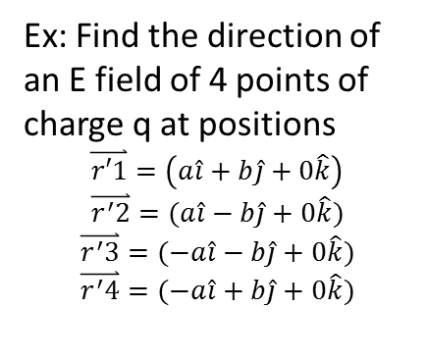
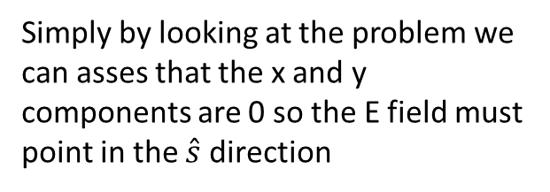
Symmetry
Basic Electric field symmetries assuming constant charge density:
Sphere: variable in r
Infinite line: variable in s
Finite Cylinder: dependant on s and z
Infinite plane: constant
In many problems certain axis and parameters can be eliminated via symmetric arguments
Ex: Find the direction of an E field of 4 points of charge q at positions
$\overset{⃑}{r′1}=\left(a\hat{i}+b\hat{j}+0\hat{k}\right)$
$$\overset{⃑}{r^{′}2}=(a\hat{i}−b\hat{j}+0\hat{k})$$
$$\overset{⃑}{r^{′}3}=(−a\hat{i}−b\hat{j}+0\hat{k})$$
$$\overset{⃑}{r^{′}4}=(−a\hat{i}+b\hat{j}+0\hat{k})$$
Symmetry involves a rotation, translation, or reflection about an axis resulting in the shape looking identical.
z
Symmetry can also result in components cancelling which can make a problem easier to deal with
x
Simply by looking at the problem we can asses that the x and y components are 0 so the E field must point in the $\hat{s}$direction
y

Slide 3

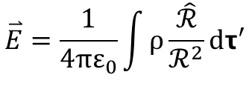
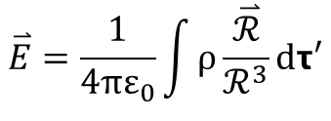
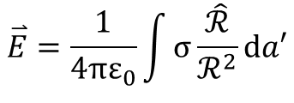
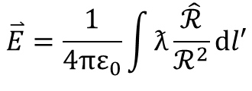
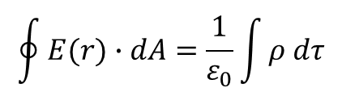
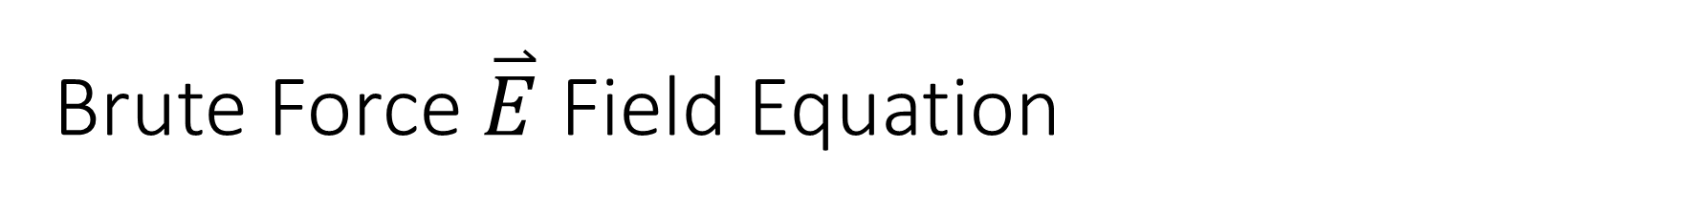
Brute Force $\overset{⃑}{E}$ Field Equation
$$\overset{⃑}{E}=\frac{1}{4πε_{0}}\int{ρ\frac{\overset{⃑}{ℛ}}{ℛ^{3}}}dτ′$$
$$\overset{⃑}{r}=r\hat{r}$$
$$\overset{⃑}{E}=\frac{1}{4πε_{0}}\int{ρ\frac{\hat{ℛ}}{ℛ^{2}}}dτ′$$
3D shape
$$\overset{⃑}{E}=\frac{1}{4πε_{0}}\int{σ\frac{\hat{ℛ}}{ℛ^{2}}}da′$$
2D shape
$$\overset{⃑}{E}=\frac{1}{4πε_{0}}\int{ƛ\frac{\hat{ℛ}}{ℛ^{2}}}dl′$$
1D shape
Gauss’s Law Integral form
$$\oint{E(r)∙dA}=\frac{1}{ε_{0}}\int{ρ dτ}$$

Slide 4





Standard E Field Solutions
Point Charge
$$\overset{⃑}{E}=\frac{1}{4πε_{0}}\frac{q}{r^{2}}\hat{r}$$
Infinite Plane
$$\overset{⃑}{E}=\frac{σ}{{2ε}_{0}}\hat{n}$$
Cylinder/Line
$$\overset{⃑}{E}=\frac{ƛ}{{2πε}_{0}s}\hat{s}$$
a
Spherical surface (Ex):
b
$$\overset{⃑}{E}=\frac{α(a^{4}−b^{4})}{4ε_{0}r^{2}}\hat{r}$$
$$ρ(r)=αr$$

Slide 5
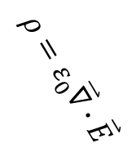
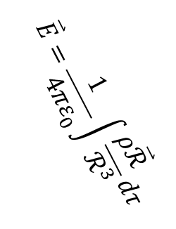
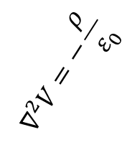
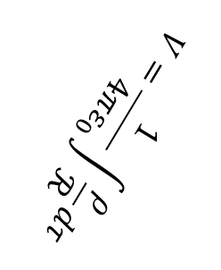

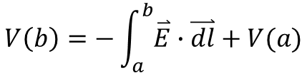

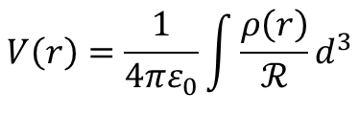




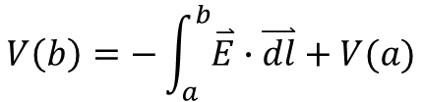
Electric Potentials
$$E=−∇V$$
$$ρ$$
$$V\left(b\right)=−\int_{a}^{b}{\overset{⃑}{E}∙\overset{⃑}{dl}+V(a)}$$
$$∇^{2}V=−\frac{ρ}{ε_{0}}$$
$$ρ=ε_{0}\overset{⃑}{∇}∙\overset{⃑}{E}$$
$$V=\frac{1}{4πε_{0}}\int{\frac{ρ}{ℛ}dτ}$$
$$\overset{⃑}{E}=\frac{1}{4πε_{0}}\int{\frac{ρ\overset{⃑}{ℛ}}{ℛ^{3}}}dτ$$
$$∇^{2}V=−\frac{ρ}{ε_{0}}$$
$$E=−∇V$$
$$V\left(r\right)=\frac{1}{4πε_{0}}\int{\frac{ρ\left(r\right)}{ℛ}}d^{3}$$
$$\overset{⃑}{V}$$
$$\overset{⃑}{E}$$
$$V\left(b\right)=−\int_{a}^{b}{\overset{⃑}{E}}∙\overset{⃑}{dl}+V(a)$$

Slide 6

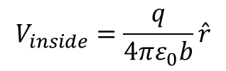
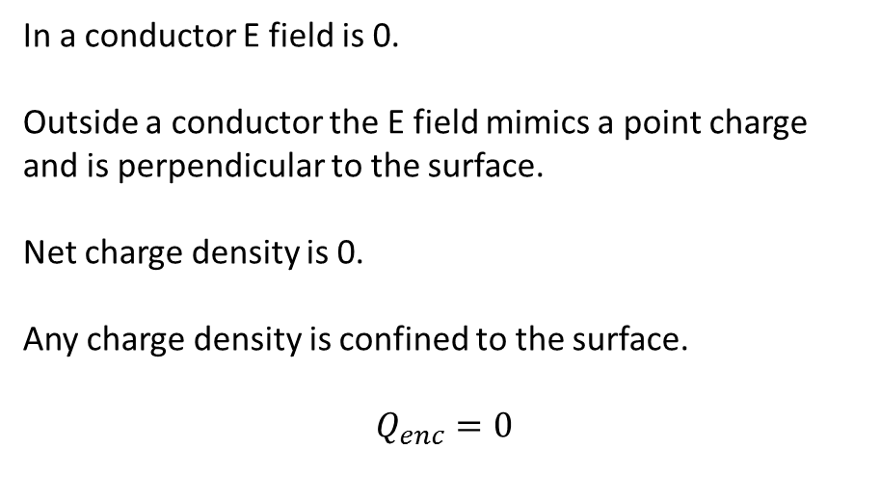
Conductors
In a conductor E field is 0.
Outside a conductor the E field mimics a point charge and is perpendicular to the surface.
Net charge density is 0.
Any charge density is confined to the surface.
$$Q_{enc}=0$$
a
$$V_{outside}=\frac{q}{4πε_{0}r}\hat{r}$$
q
b
$$V_{inside}=\frac{q}{4πε_{0}b}\hat{r}$$

Slide 7
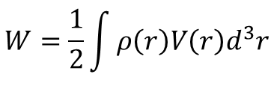
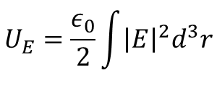

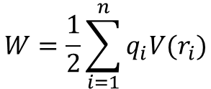
Work and Energy
$$W=\frac{1}{2}\sum_{i=1}^{n}{q_{i}V(r_{i})}$$
$$W=\frac{1}{2}\int{ρ\left(r\right)V\left(r\right)d^{3}r}$$
$$U_{E}=\frac{ε_{0}}{2}\int{{\left|E\right|}^{2}d^{3}r}$$
$$W=U_{2}−U_{1}$$

Slide 8

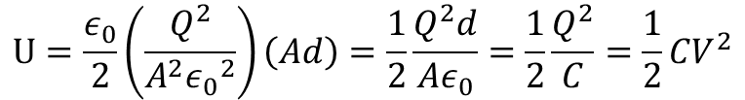

Capacitors
$$Q=CV$$
$$Q=V×\frac{Aε_{0}}{d}$$
$$U=\frac{ε_{0}}{2}\left(\frac{Q^{2}}{A^{2}{ε_{0}}^{2}}\right)\left(Ad\right)=\frac{1}{2}\frac{Q^{2}d}{Aε_{0}}=\frac{1}{2}\frac{Q^{2}}{C}=\frac{1}{2}{CV}^{2}$$
Q+
A
d
Q-

Slide 9
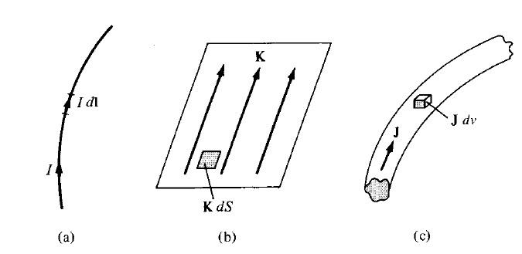
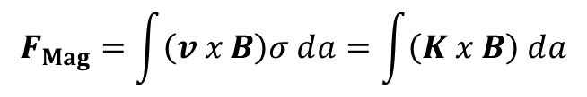
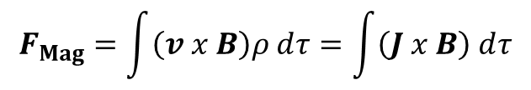
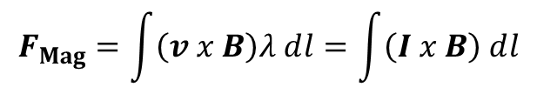



Magnetostatics
$F_{Mag} =q⁢\left(v ⁢x⁢ B\right)$
(Point charge)
$$F_{Mag}=\int{\left(v⁢ x ⁢B\right)⁢λ⁢ⅆl}=\int{\left(I⁢ x ⁢B\right)⁢ⅆl}$$
$$F_{Mag}=\int{\left(v⁢ x ⁢B\right)⁢σ⁢ⅆa}=\int{\left(K⁢ x ⁢B\right)⁢ⅆa}$$
$$F_{Mag}=\int{\left(v ⁢x ⁢B\right)⁢ρ⁢ⅆτ}=\int{\left(J⁢ x ⁢B\right)⁢ⅆτ}$$
$$F_{Mag} = ↑$$
$$B=X ⁢X ⁢X$$

Slide 10



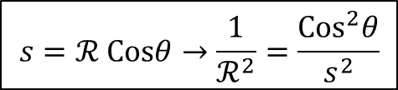
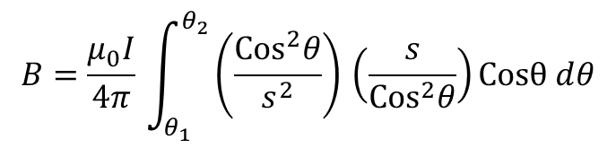
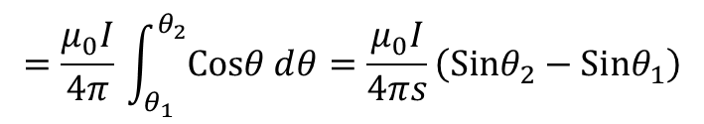
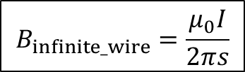




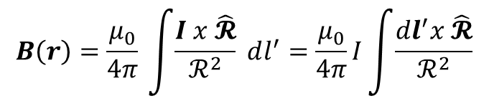




Steady Currents and Biot-Savart Law
$$∇.J=−\frac{∂ρ}{∂t}$$
Continuity equation
$$∇.J=0$$
For steady currents
r
I
$$B⁢\left(r\right)=\frac{μ_{0}}{4⁢π}⁢\int{\frac{I⁢ x ⁢\hat{𝓡}}{ℛ^{2}}⁢ⅆl^{′}}=\frac{μ_{0}}{4⁢π}⁢I⁢\int{\frac{dl^{′}⁢x ⁢\hat{𝓡}}{ℛ^{2}}}$$
$$\text{ℛ}$$
Example
d$l$’
Find the magnetic field a distance s from a long straight wire carrying a steady current I
P
$$l^{′}=s ⁢tan⁢θ → dl^{′}=\frac{s}{{Cos}^{2}⁢θ}⁢dθ$$
s
$$θ$$
$$\text{ℛ}$$
$\left|dl^{′}x ⁢\hat{𝓡}\right|=dl^{′}⁢ Sin⁢α=dl^{′}⁢ Cos⁢θ$
$$α$$
$l$’
d$l$’
$$s=ℛ ⁢Cos⁢θ→\frac{1}{ℛ^{2}}=\frac{{Cos}^{2}⁢θ}{s^{2}}$$
$$B=\frac{μ_{0}⁢I}{4⁢π}⁢\int_{θ_{1}}^{θ_{2}}{\left(\frac{{Cos}^{2}⁢θ}{s^{2}}\right)⁢\left(\frac{s}{{Cos}^{2}⁢θ}\right)⁢Cosθ⁢ⅆθ}$$
$$=\frac{μ_{0}⁢I}{4⁢π}⁢\int_{θ_{1}}^{θ_{2}}{Cos⁢θ⁢ⅆθ}=\frac{μ_{0}⁢I}{4⁢πs}⁢\left(Sin⁢θ_{2}−Sin⁢θ_{1}\right)$$
$$B_{infinite_⁢wire}=\frac{μ_{0}⁢I}{2⁢π⁢s}$$

Slide 11
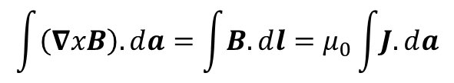
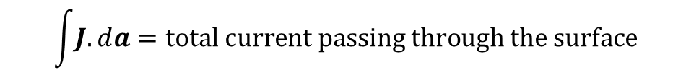
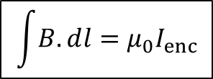

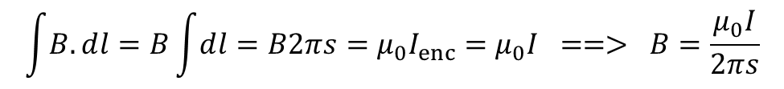

Ampere’s Law
$$\int{\left(∇x⁢B\right).ⅆa}=\int{B.ⅆl}=μ_{0}⁢\int{J.ⅆa}$$
$$∇ x⁢ B=μ_{0}⁢J$$
$$⁢\int{J.ⅆa}=total current passing through the surface$$
$$\int{B.ⅆl}=μ_{0}⁢I_{enc}$$
Example
Find the magnetic field a distance s from a long straight wire carrying a steady current I
B
s
$$\int{B.ⅆl}=B⁢\int{ⅆl}=B⁢2⁢π⁢s=μ_{0}⁢I_{enc}=μ_{0}⁢I ==> B=\frac{μ_{0}⁢I}{2⁢π⁢s}$$
$$I$$

Slide 12
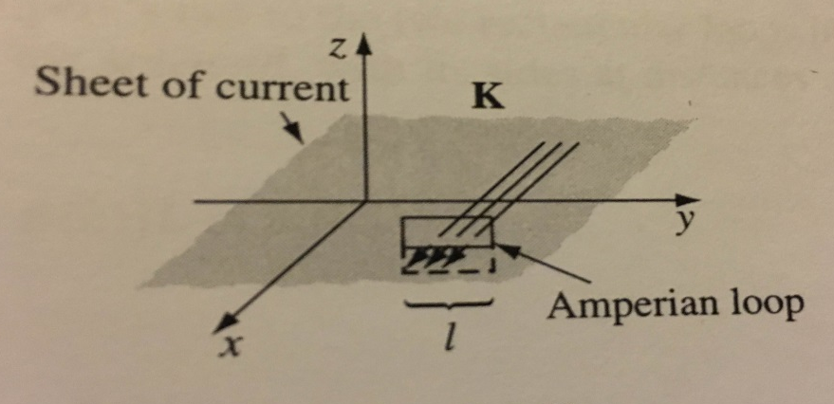
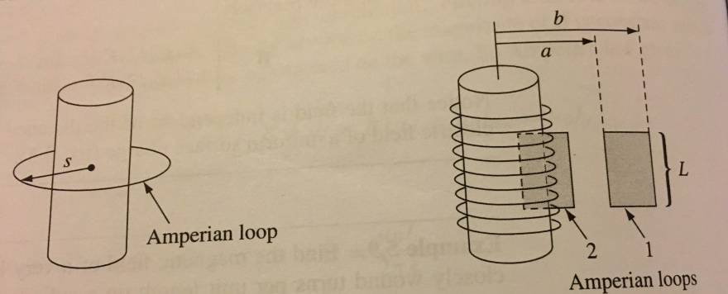




B-Field for different shapes
$$Magnetic field of an infinite uniform surface current K=k⁢\hat{x}$$
$$B= \left(\frac{μ_{0}}{2}\right)⁢k⁢\hat{y}⁢ for ⁢z<0$$
$$−\left(\frac{μ_{0}}{2}\right)⁢k⁢\hat{y} ⁢ for⁢ z>0$$
$$Magnetic field of a very long solenoid with K=n I$$
$$B={ μ}_{0}⁢nI ⁢\hat{z} ⁢ inside ⁢the⁢ solenoid$$
$0⁢ outside ⁢the⁢ coil$

Slide 13
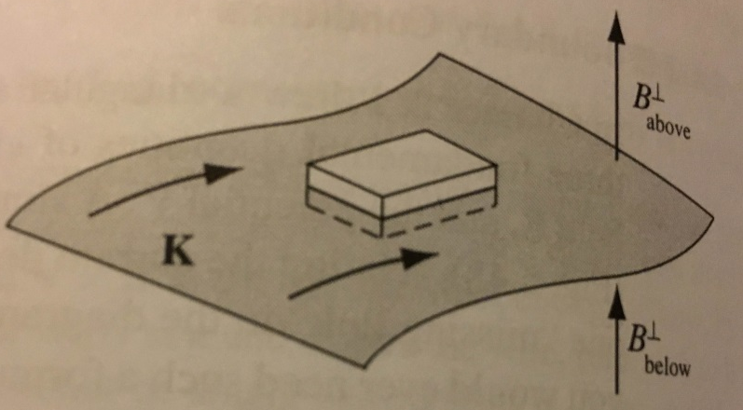
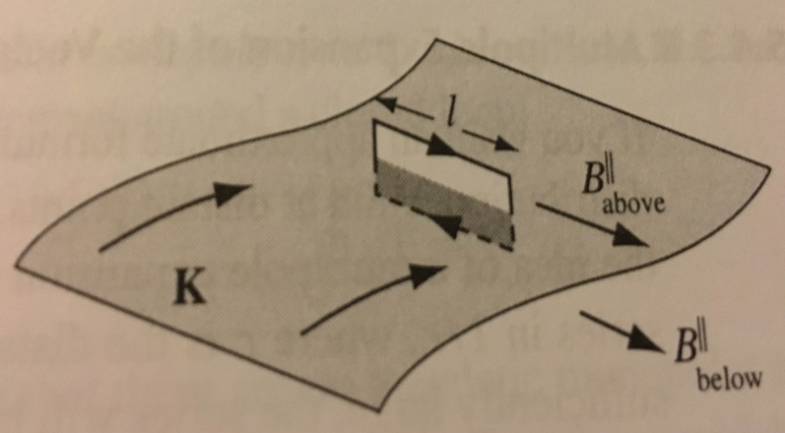


Boundary Conditions
$${B^{perp}}_{above}={B^{perp}}_{below}$$
$${B^{||}}_{above}−{B^{||}}_{below}=μ_{0}⁢K$$

Slide 14




Other stuff to know
$$∇.B=0$$
$$W_{mag}=0$$
$$m=I⁢a$$
(Magnetic dipole moment)
Here $a$is the vector area of the loop

Slide 15
Maxwell’s Equations
Equation | Name
$$∇∙\vec{E}=\frac{ρ}{ε0}$$ | Gauss’ Law
$$∇×\vec{E}=−\frac{d\vec{B}}{dt}$$ | Faraday’s Law
$$∇∙\vec{B}=0$$ | No-Name Law/ Gauss’ Law for B-fields
$$∇×\vec{B}=μ0 \vec{J}+μ0ε0\frac{d\vec{E}}{dt}$$ | Ampere’s Law
$ρ−$ volume charge density (C/m³)
J -- current density (A/m²)

Slide 16
Faraday’s Law
$$∇×\vec{E}=−\frac{d\vec{B}}{dt}$$
According to Stokes’ Theorm ….
$$\int{(∇×\vec{E}})∙ds=\int{\vec{E}}∙dl=\frac{−ⅆφ_{B}}{ⅆt}$$
$$φ_{B}=\oint{B⋅ⅆS}$$
$$ε=−\frac{dφ_{B}}{dt}$$
**Induced currents always oppose changes in magnetic field
Lenz’s Law (emf)
Notes:
A changing magnetic flux through a closed loop of wire creates a potential, a current

Slide 17

Inductors: Loop of Wire
A loop of current produces current in any nearby loops.
$$φ_{B}=LI$$
For a magnetic field produced by wires themselves
$$ξ=−L\frac{ⅆI}{ⅆt}$$
Notes:
Changing current in one current loop produces B-field that affects the second//vice versa. Both will have same inductance

Slide 18
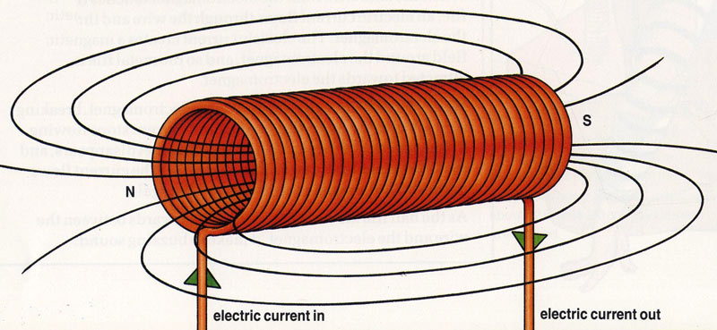
Inductors: Solenoid
$$L=\frac{μ0N^{2}A}{l}$$
$N$- number of turns
A- cross-sectional area
l- length

Slide 19
Electric Dipoles
Dipole moment of two point charges
$$\vec{p}=qr_{1}−qr_{2}=qd$$
Dipole moment- collection of charges
$$\vec{p}=\sum_{i}{q_{i}d_{i}}$$
Electric potential from dipole moment
$V\left(\vec{r}\right)=\frac{1}{4πε_{0}}\frac{\vec{p}⋅\hat{r}}{r^{2}}$
r₁
-q
r₂
+q
d
**Note V→1/r² and E→ 1/r³

Slide 20
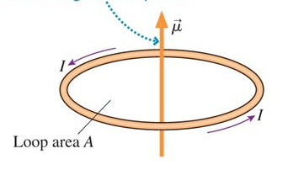
Magnetic Dipoles
Remember:
--no magnetic monopoles
--cannot be decomposed like E dipoles
Dipole moment of two point charges
$$\vec{m}=IA$$
m- magnetic dipole moment (Am²)
A- vector normal to surface (area)

Slide 21

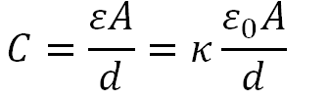
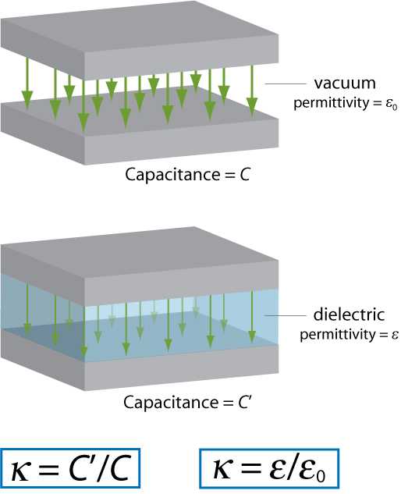
Matter Effects - Dielectrics
Materials that can be polarized in an applied field and thus slightly cancel the electric field. Parameterized by making the substitution:
is the dielectric constant
Most common: insulator placed between two plates, capacitance becomes

Slide 22
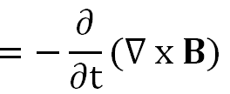

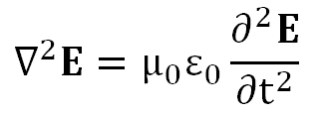
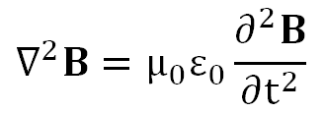
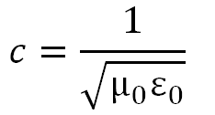
Electromagnetic waves - Wave Equation
Assuming vacuum
Similarly
And

Slide 23
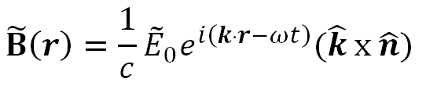


Electromagnetic waves - Wave Equation
Wave solutions have the explicit form
Where is the propagation vector describing the direction in which the wave travels and is the polarization vector of the electric field only.
Rule for notation: calculate everything in the complex formalism and then take the real part
Fine for superpositions, since the real part of a sum is the sum of the real parts, but it’s more complicated for products.

Slide 24
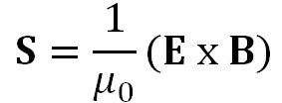


Electromagnetic waves - Poynting Vector
Flux of energy of the wave
Intensity of the wave is often easier to deal with because of extremely high frequencies

Slide 25




Electromagnetic waves - Radiation
Larmor formula: An accelerating point charge radiates total power
Only holds for small velocities.
Oscillating dipole with dipole moment
And intensity
Falls off like and the means no radiation occurs along the dipole axis

Slide 26



Electromagnetic waves - Radiation
Integrate over a sphere of radius r gives the total power
Analogous formula for the magnetic dipole radiation
Where is the average magnetic dipole moment.

