Slide 1
Statistical Thermodynamics
Gabriel Ponce
Bilal Kousar
Dan Finn
Andrew Shopes
Phys 229

Slide 2







General Terminology
KEY
E or U = internal energy
Q = heat added
W = work (done by the system)
S = entropy
m = mass
c = specific heat
Omega = number of micro states
Definitions
Conservation
of Energy
Work
Heat
Entropy
Specific Heat

Slide 3


Ideal gases
Equation of state for ideal gas
Symbol | Name | Units
P | Pressure | P = F/A ,atm,
V | Volume | L , m^3
n | # of Mole | 1/Na
R | Gas Constant | 8.3145 J/(mol*K)
N | # of molecules | 1+
K | Boltzmann constant | 1.38065*10^-23 J/K
T | Temperature | Kelvin
Internal energy of
monoatomic molecule

Slide 4
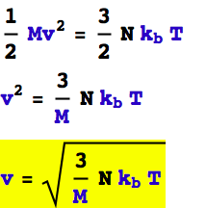
Ideal gases
KEY
E or U = internal energy
Q = heat added
W = work (done by the system)
S = entropy
m = mass
c = specific heat
Omega = number of micro states
To find Vrms,
Set kinetic energy = internal energy

Slide 5


Important Thermodynamic Processes
Isobaric
Constant pressure dP=0 [barometer]
Isothermal
constant T, dT=0
Isochoric
constant V, dV=0 [choros = space]
Adiabatic (isolated process)
dQ=0, no exchange between the system and its surroundings.
For Adiabatic Expansion,
the expressions to the right are equal to a constant
Adiabatic constant

Slide 6
Important Thermodynamic Processes (cont.)
Reversible
proceeds in infinitesimal step such that each step can be reversed.
I.E. adding an infinitesimal amount of heat
Quasistatic
process that happens infinitely slow such that the system is always at equilibrium
All Reversible processes are Quasistatic, but some quasistatic processes can be non-reversible
Isentropic aka revisable adiabatic
All Adiabatic processes that are reversible must have a dS=0
Warning, the GRE is known to simply say “adiabatic” and mean reversible adiabatic
Free Expansion
This is an adiabatic process and NOT reversible in which the gas does no work
PV=P’V’ ….. dU=0, dQ=0
Therefore NkT=Constant
Recall
Adiabatic constant

Slide 7



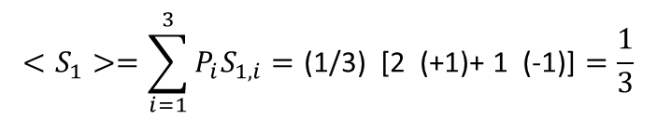




Statistical Mechanics
Methodology
Specify the macrostate and accessible microstates of the system
Choose the ensemble
Calculate the mean values and other statistical values
Macrostate
Microstates
3 non interacting spins in magnetic field B
$$Etotal=−μB , N=3$$
$$E=−μB , \text{Ω}\text{ = 3,} \text{P}\text{s} \text{= 1/}\text{Ω}$$
$$E=−μB ⁢E=μB$$
Statistical properties
$$<Q>=\sum_{i=1}^{3}{P_{i}⁢ Q_{i}}$$
$$<S_{1}>=\sum_{i=1}^{3}{P_{i}⁢S_{1,i}}=\text{(1/3) [2 (+1)+ 1 (−1)]}=\frac{1}{3}$$
(Average value of spin 1)
$$P_{1,↑}=\frac{2}{3}$$
$$P⁢\left(2,↑|1,↑\right)=\frac{1}{2}$$
(Probability that if spin 1 is up then spin 2 is also up)
$$P⁢\left(2↑and⁢1↑\right)=P_{1,↑}∗P_{2,↑}=\frac{2}{3}∗\frac{2}{3}=\frac{4}{9}$$

Slide 8

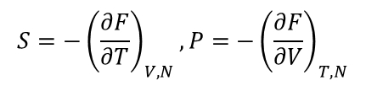



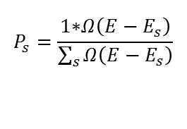
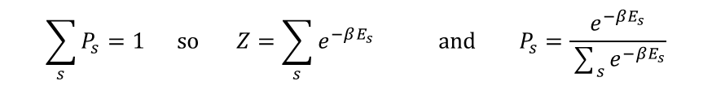
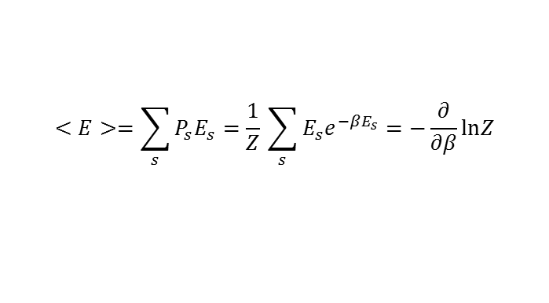
Canonical Ensemble (fixed T, V, and N)
The system of interest is in contact with heat bath, which is sufficiently large that it’s not affected by the smaller system
$$E_{total}=E_{b}+E_{s}⁢ where ⁢E_{s}⁢<<E$$
Macrostate: E, V, N
Microstates: For a given microstate of the system the heat bath can be in any of the large number of microstates such that the total energy is E
Number of microstates of heat bath =
$$Ω⁢\left(E−E_{s}\right)$$
Statistical properties: Probability that the system is in microstate s with energy $E_{s}$ is given by
$$P_{s}=\frac{1⁢∗⁢Ω⁢\left(E−E_{s}\right)}{\sum_{s}{Ω⁢\left(E−E_{s}\right)}}$$
$P_{s}$ is decreasing function because the larger the value of $E_{s}$, the less the $E_{b}$ is
$$P_{s}=\frac{1}{Z}⁢e^{−β⁢E_{s}} ⁢\left(Boltzmann⁢ distribution\right)⁢, where ⁢β=\frac{1}{K⁢T}⁢ and ⁢Z=sum⁢ over ⁢states ⁢or ⁢partition⁢ function$$
$$\sum_{s}{P_{s}}=1 ⁢so ⁢Z=\sum_{s}{e^{−β⁢E_{s}}⁢ and ⁢P_{s}}=\frac{e^{−β⁢E_{s}}}{\sum_{s}{e^{−β⁢E_{s}}}}$$
Now since we have the probability distribution, we can find mean values and other stats
$$<E>=\sum_{s}{P_{s}⁢E_{s}}=\frac{1}{Z}⁢\sum_{s}{E_{s}⁢e^{−β⁢E_{s}}}=−\frac{∂}{∂β}ln⁢Z$$
similarly
$<E^{2}> =\frac{1}{Z}⁢\frac{∂^{2}Z}{∂β^{2}},{ C}_{v}=\frac{∂<E>}{∂T}=$ [<E²>-<E>²]
$$S=−{\left(\frac{∂F}{∂T}\right)}_{V,N},P=−{\left(\frac{∂F}{∂V}\right)}_{T,N}$$
$$Free⁢ energy=F=−K⁢ T ⁢ln⁢Z$$
$$Aside: S=k⁢ln⁢Ω$$

Slide 9
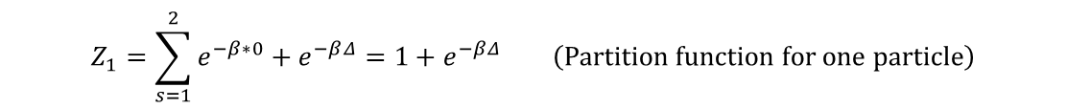


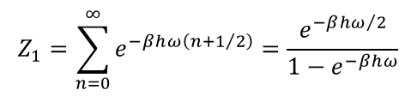

Partition Function Example
Consider a system consisting of two distinguishable particles. Each particle can be in one of the two microstates with single particle energies 0 and ∆. The system is in equilibrium with a heat bath at temperature T. What are the thermodynamic properties of the system?
Microstates:
$$\left(0,0\right),\left(0,Δ\right),\left(Δ,0\right),\left(Δ,Δ\right)$$
$$Z_{2}=\sum_{s=1}^{4}{e^{−β⁢E_{s}}}=1+e^{−β⁢Δ}+e^{−β⁢Δ}+e^{−2⁢β⁢Δ}={\left(1+e^{−β⁢Δ}\right)}^{2}⁢ \left(Partition ⁢function ⁢for ⁢two ⁢particles\right)$$
$$Z_{1}=\sum_{s=1}^{2}{e^{−β∗0}}+e^{−β⁢Δ}=1+e^{−β⁢Δ }⁢\left(Partition ⁢function⁢ for⁢ one ⁢particle\right)$$
$$Z_{2}={Z_{1}}^{2}⁢ and ⁢in ⁢general⁢{ Z}_{n}={Z_{1}}^{n}⁢ for ⁢distinguishable ⁢particles$$
So since $Z_{2}$ is related to $Z_{1}$ so we can consider the statistical properties of the system consisting of one particle with $Z_{1}$
$$P_{1}=\frac{e^{−β∗0}}{Z_{1}}=\frac{1}{1+e^{−β⁢Δ}}⁢ \left(probability ⁢that ⁢a ⁢particle⁢ has⁢ energy⁢ 0\right) ,$$
$$P_{2}=\frac{e^{−β⁢Δ}}{Z_{2}}=\frac{e^{−β⁢Δ}}{1+e^{−β⁢Δ}}$$
$$<e>=\sum_{s=1}^{2}{P_{s}⁢ε_{s}}=\frac{Δ⁢e^{−β⁢Δ}}{1+e^{−β⁢Δ}}⁢ and<E>=2<e> and ⁢in⁢ general⁢ for⁢ N⁢ distinguishable⁢ particles <E>=N<e>$$
Partition function of simple harmonic oscillator :
$$ε_{n}=\left(n+\frac{1}{2}\right)⁢h⁢ω$$
$$Z_{1}=\sum_{n=0}^{∞}{e^{−β⁢h⁢ω⁢\left(n+1/2\right)}}=\frac{e^{−β⁢h⁢ω/2}}{1−e^{−β⁢h⁢ω}}$$

Slide 10
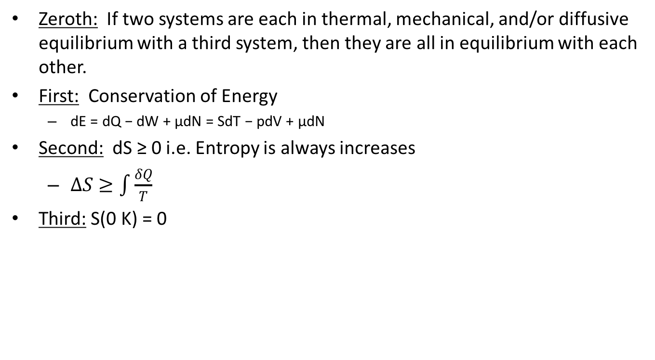
Law of Thermodynamics
Zeroth: If two systems are each in thermal, mechanical, and/or diffusive equilibrium with a third system, then they are all in equilibrium with each other.
First: Conservation of Energy
dE = dQ − dW + μdN = SdT − pdV + μdN
Second: dS ≥ 0 i.e. Entropy is always increases
$∆S≥\int{\frac{δQ}{T}}$
Third: S(0 K) = 0

Slide 11

Heat Capacity
Isochoric → $C_{p}=\frac{1}{n}{\left(\frac{dQ}{dT}\right)}_{p}$
$C_{p}=\frac{5}{2}Nk_{B}$
Isobaric → $C_{V}={\left(\frac{1}{n}\frac{δQ}{δT}\right)}_{V}$
$C_{V}=\frac{3}{2}Nk_{B}$
$γ=\frac{C_{P}}{C_{V}}=\frac{5}{3}$

Slide 12
Einstein and Debye
Einstein
Each particle is a simple harmonic oscillator
Used for low temperature systems
Debeye
Considered the density of states instead of assuming atoms have same E
Found correct behavior as T → 0
where

Slide 13

Practical Use of Specific Heat
$$ΔQ=nC_{V}ΔT$$
$$nC_{V}ΔT$$
$$\int{nC_{V}∂T}=\int{∂Q}$$

Slide 14
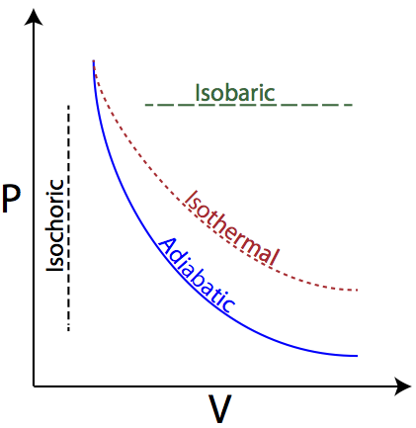
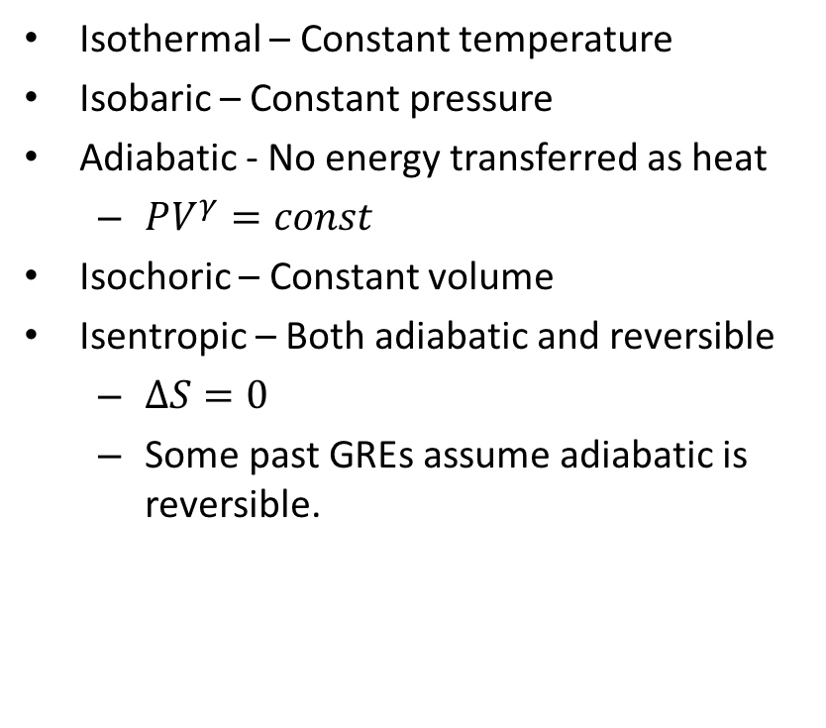
P-V Diagrams
Isothermal – Constant temperature
Isobaric – Constant pressure
Adiabatic - No energy transferred as heat
$PV^{γ}=const$
Isochoric – Constant volume
Isentropic – Both adiabatic and reversible
$∆S=0$
Some past GREs assume adiabatic is reversible.

Slide 15
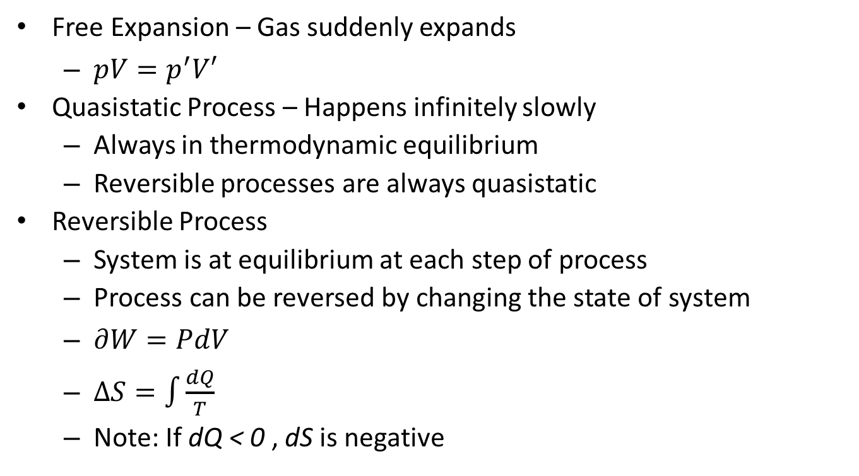
More Terminology for P-V
Free Expansion – Gas suddenly expands
$pV=p^{′}V′$
Quasistatic Process – Happens infinitely slowly
Always in thermodynamic equilibrium
Reversible processes are always quasistatic
Reversible Process
System is at equilibrium at each step of process
Process can be reversed by changing the state of system
$∂W=PdV$
$∆S=\int{\frac{dQ}{T}}$
Note: If dQ < 0 , dS is negative

Slide 16
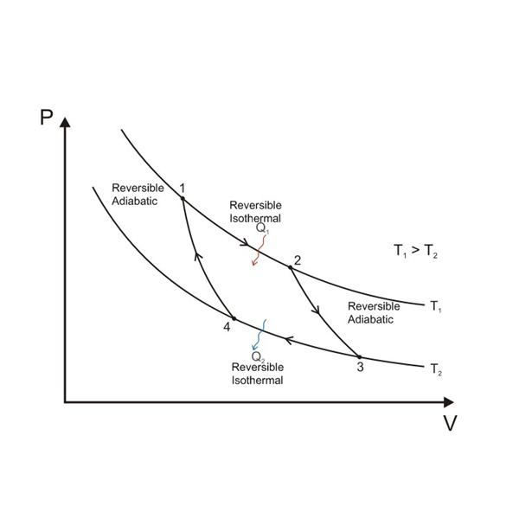
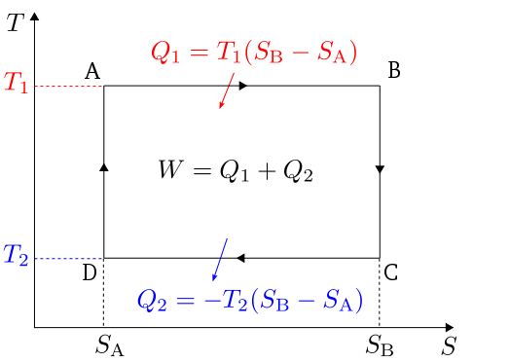
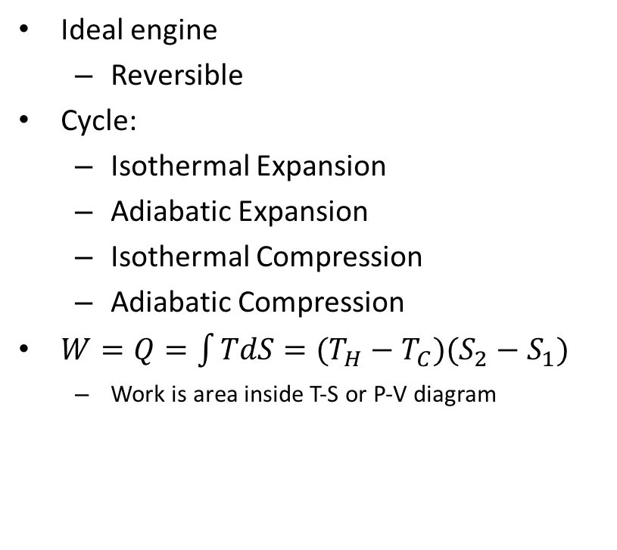
Carnot Engine
Ideal engine
Reversible
Cycle:
Isothermal Expansion
Adiabatic Expansion
Isothermal Compression
Adiabatic Compression
$W=Q=\int{TdS=(T_{H}−T_{C})(S_{2}−S_{1})}$
Work is area inside T-S or P-V diagram

Slide 17

Efficiency
$$e=\frac{W}{Q_{h}}=\frac{Q_{h}−Q_{c}}{Q_{h}}=1−\frac{T_{c}}{T_{h}}$$

Slide 18
Helmholtz Free Energy
Thermodynamic potential that measures maximum reversible work obtainable from a closed system at a constant temperature
U= Internal Energy
S=Entropy
For the isothermal change from one state to another:
We can then describe the system as spontaneous (F<0), at equilibrium (F=0), and Nonspontaneous (F>0)

Slide 19

Gibbs Free Energy and Enthalpy
Thermodynamic potential calculates maximum reversible work from a closed system at a constant temperature and pressure
$$G=U−TS+pV$$
The same concepts in Helmholtz energy apply here
$$G=∆U−T∆S+p∆V$$
Enthalpy is the measurement of the total energy of a thermodynamic system
$$H=U+pV$$

Slide 20
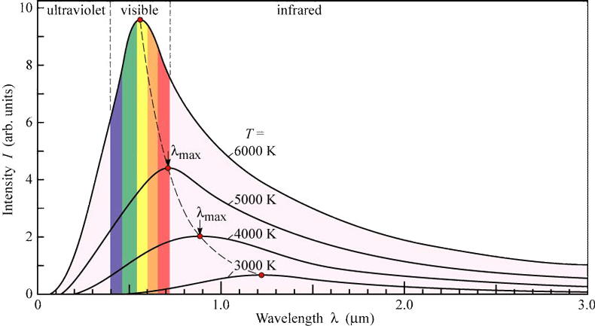


Blackbodies
Total power emitted by a blackbody:
$$P=σεAT^{4}$$
Using Wein’s displacement Law:
$$λ_{max}=\frac{2.9∗{10}^{−3} m∗K}{T}$$
Planck distribution for intensity of light emitted by a blackbody.
$I\left(f,T\right)=\frac{2hf^{3}}{c^{2}}∗\frac{1}{e^{\frac{hf}{kT}}−1}$

Slide 21
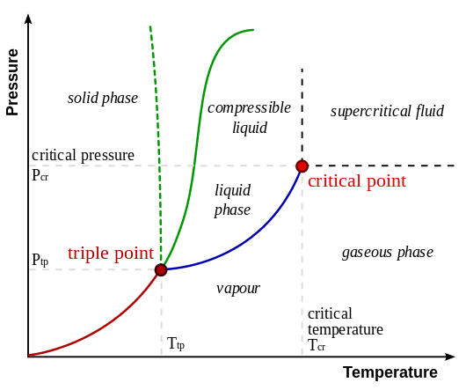
Phase Diagram
Triple Point: Point at which the T and p of a substance cause a thermodynamic equilibrium in which all three phases coexist.
Critical point: Point at which liquid and vapor phases coexist, past which a supercritical fluid exists.

