Slide 1
Relativity, Mathematics, Statistics, & Lab Methods to know for the GRE

Slide 2
Special Relativity
Main Concepts and Equations

Slide 3
Main Concepts
Reference Frames
Velocity Addition
Lorentz Transformations
Relativistic collisions
Minkowski diagrams

Slide 4
Reference Frames
“Stationary” Frame:
“Moving” Frame:
Experiences time normally
At speeds approaching c stationary objects move through time more slowly
Views objects approaching c as compressing
Stationary objects appear to stretch and elongate
Fast moving objects appear to experience time more slowly
Within their reference frame moving objects experience time normally.

Slide 5


Velocity Addition
Classically: $v=v_{1}+v_{2}$
Example Problem:
A ship travelling at .8c launches a projectile at .6c relative to it, what is the speed of the projectile to a stationary observer?
Einstein Velocity addition: $v=\frac{v_{1}+v_{2}}{1+\left(\frac{v_{1}v_{2}}{c^{2}}\right)}$

Slide 6



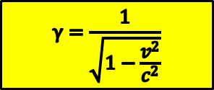





Basic Relativistic Conversions
$$γ=\frac{1}{\sqrt{1−\frac{v^{2}}{c^{2}}}}$$
Key relationships:
At .5c:
At 3/5c:
At 4/5c:
$$γ=1.155$$
$$γ=1.25$$
$$γ=1.512$$
Time Dilation
Relativistic Mass
$$∆t′=γ∆t$$
$$m=γm_{0}$$
Relativistic Momentum
Length Contraction
p$=γm_{0}\overset{⃑}{v}$
$$∆x′=\frac{∆x }{γ}$$
Relativistic Kinetic Energy
$$E_{k}=(γ−1)m_{0}c^{2}$$

Slide 7









Lorentz Transformations
Assuming a body moving with a velocity in the x direction:
$t′=γ(t−\frac{vx}{c^{2}}$)
$$t=γ(t^{′}+\frac{vx^{′}}{c^{2}})$$
The Lorentz transformations are derived from the following equation which is always true
$$x′=γ(x−vt)$$
$$x=γ(x^{′}+vt′)$$
$$c^{2}t^{2}−x^{2}−y^{2}−z^{2}={c′}^{2}{t′}^{2}−{x′}^{2}−{y′}^{2}−{z′}^{2}$$
$$y^{′}=y$$
$$y=y′$$
$$z^{′}=z$$
$$z=z′$$

Slide 8


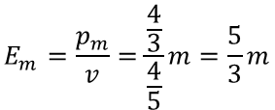

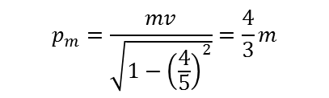




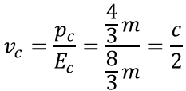
Relativistic Collisions
Key Terms:
$$E_{rest}={γm}_{0}c_{2}$$
Example Question:
A particle of mass m is moving at 4/5c, collides inelastically with another particle of equal mass at rest.
Find its composite mass and velocity.
p$=γm_{0}\overset{⃑}{v}$
$$E_{m}=\frac{p}{v}$$
$$E_{tot}=E_{m}+E_{rest}$$
$$E_{m}=\frac{p_{m}}{v}=\frac{\frac{4}{3}}{\frac{4}{5}}m=\frac{5}{3}m$$
$$p_{m}=\frac{mv}{\sqrt{1−{\left(\frac{4}{5}\right)}^{2}}}=\frac{4}{3}m$$
$${E_{tot/c}=E}_{rest}+E_{m}=\frac{8}{3}m$$
$$v_{c}=\frac{p_{c}}{E_{c}}=\frac{\frac{4}{3}m}{\frac{8}{3}m}=\frac{c}{2}$$
$${m_{c}}^{2}={E_{c}}^{2}−{p_{c}}^{2}$$
$$m_{c}=\frac{4}{\sqrt{3}}m$$

Slide 9
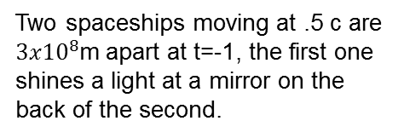

Minkowski Diagrams
Two spaceships moving at .5 c are ${3x10}^{8}$m apart at t=-1, the first one shines a light at a mirror on the back of the second.
t’
t
t’
1s
1s
x’
x’
x
$$3x{10}^{8}$$
-1s
-1s

Slide 10
Mathematics

Slide 11
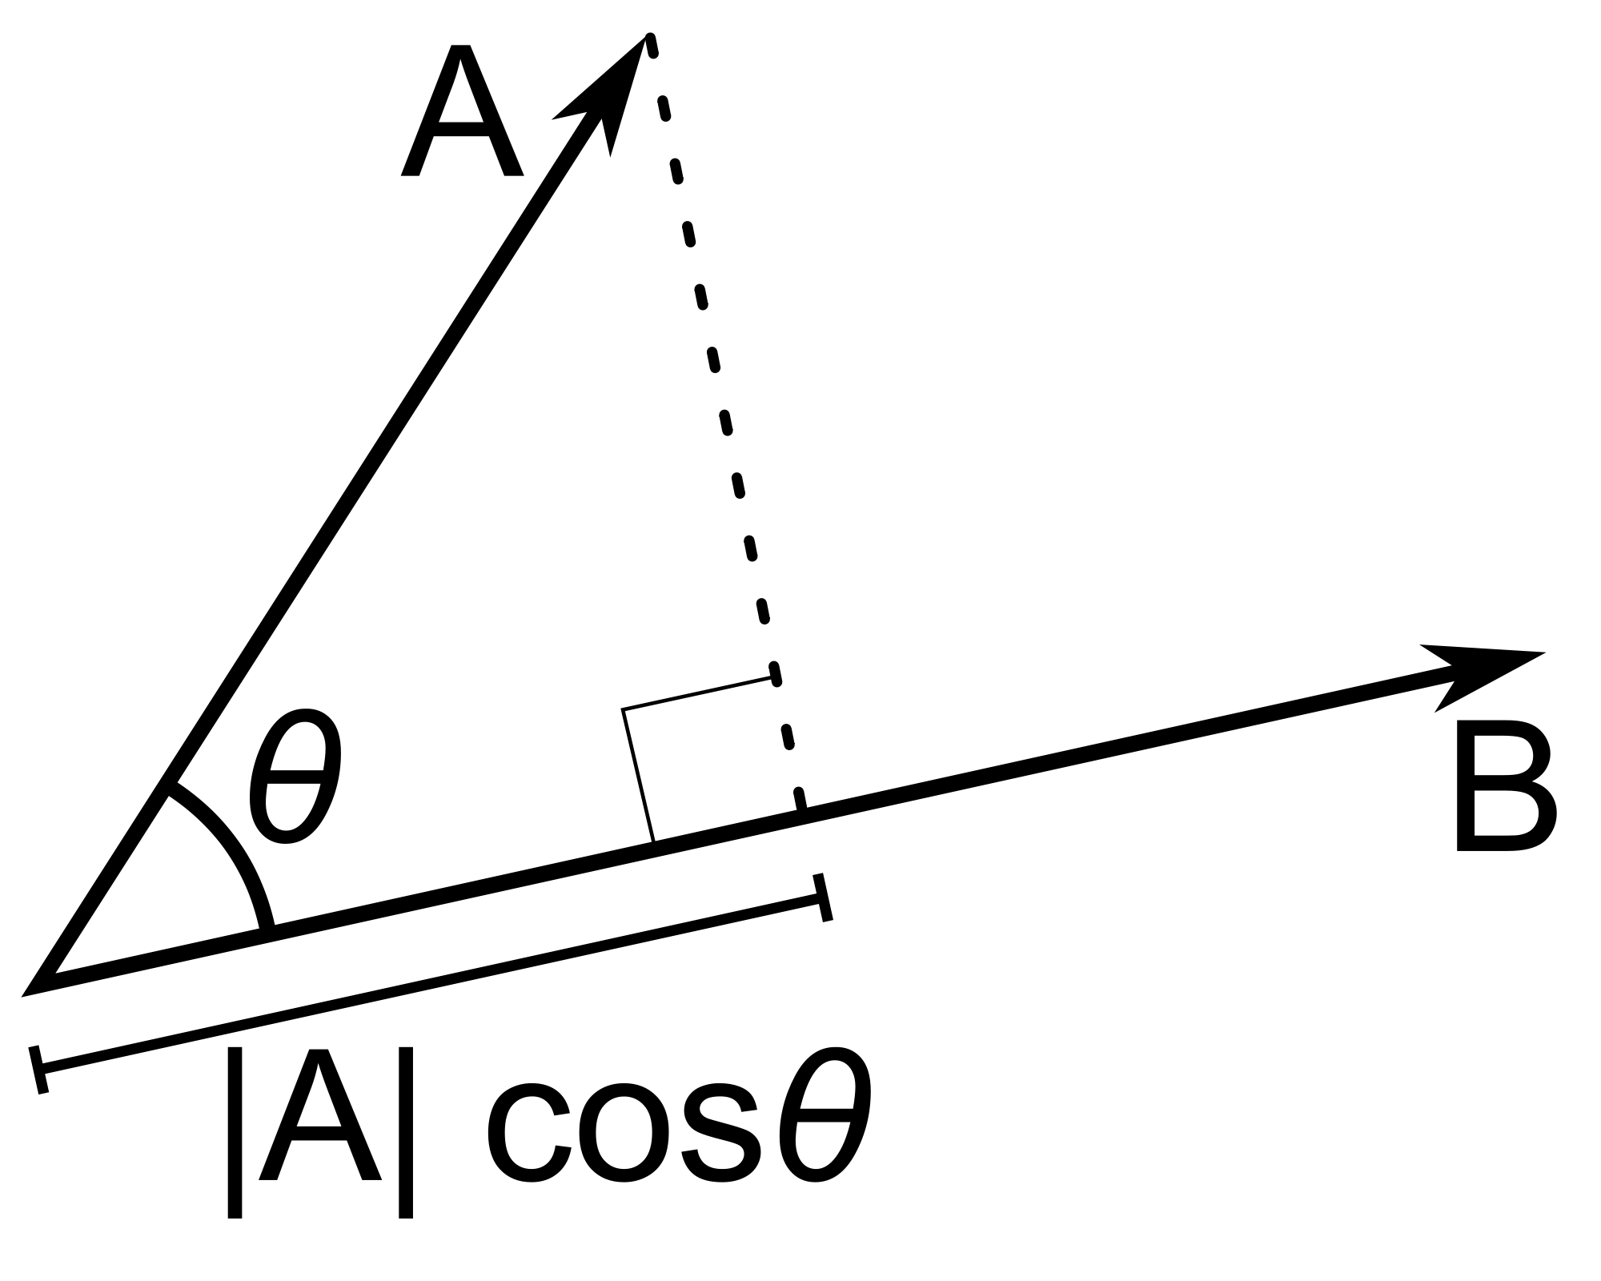
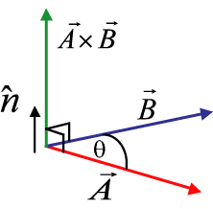
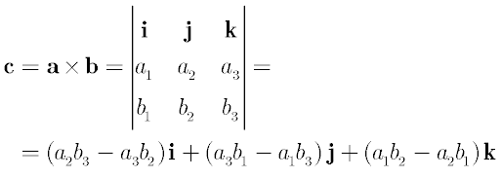
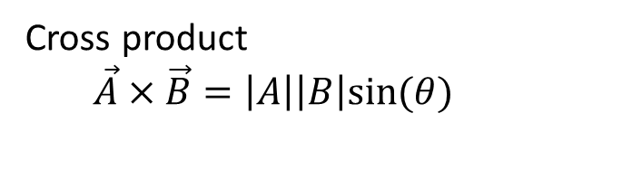


Dot & Cross Product Identities
Dot Product
$$\vec{A}∙\vec{B}=\left|A\right|\left|B\right|cos⁡(θ)$$
Cross product
$\vec{A}×\vec{B}=\left|A\right|\left|B\right|sin⁡(θ)$
$\vec{A}∙\vec{B}=A_{x}B_{x}$+$A_{y}B_{y}$+$A_{z}B_{z}$
Yields a scalar quantity
Yields a vector

Slide 12

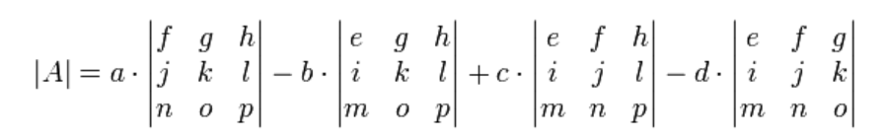

Matrices & Determinants
Det$\left[\begin{matrix}a & b \\ c & d\end{matrix}\right]=ad−bc$

Slide 13
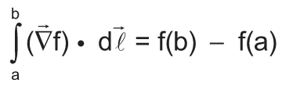
Gradient Theorem
Interpretation: if you were to measure how high a building was by measuring one floor and counting the total floors and adding them, or by simply taking a measurement of the altitude at the top subtracted from that at the bottom, you expect to get the same answer.

Slide 14

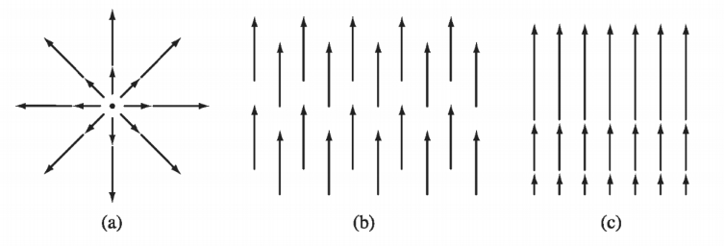
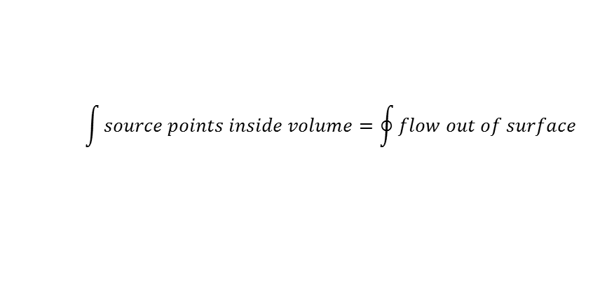
Green’s Divergence Theorem /
Gauss’ Law
The divergence measures how much the function spreads out over time
$$\int{source points inside volume}=\oint{flow out of surface}$$
(a) & (c) show positive divergence

Slide 15

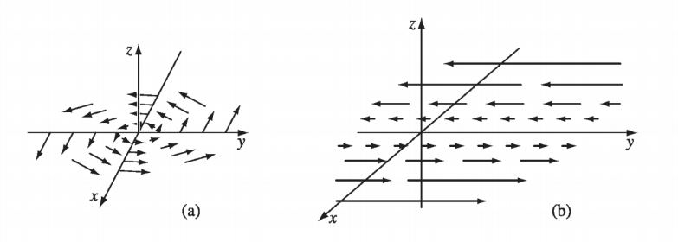
Stoke’s Theorem of Curl (Flux)
Curl over a region or surface is equal to the value of the function at the boundary
Curl measures how much rotation there is in the medium
Both images have nonzero curl

Slide 16
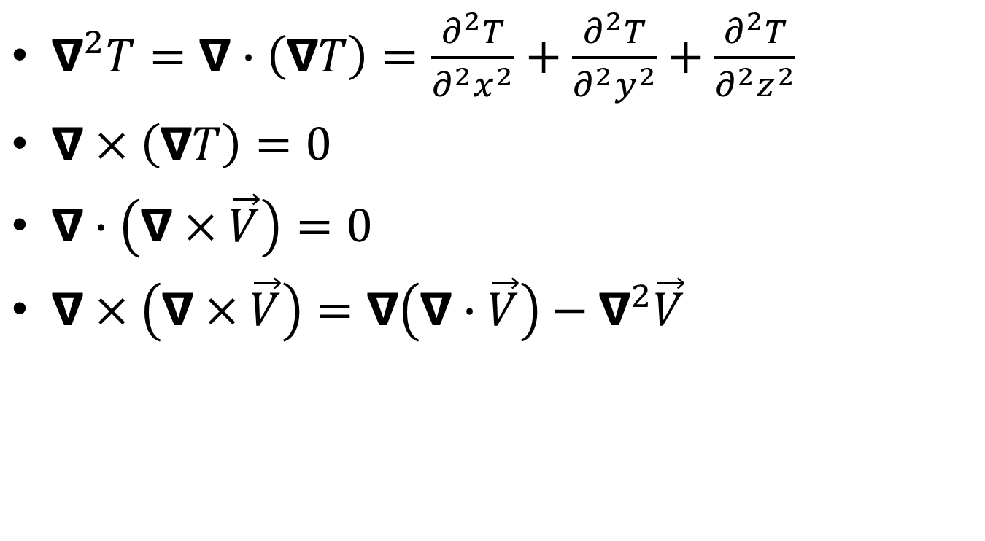
Laplacian- divergence of the gradient
$∇^{2}T=∇∙\left(∇T\right)=\frac{∂^{2}T}{∂^{2}x^{2}}+\frac{∂^{2}T}{∂^{2}y^{2}}+\frac{∂^{2}T}{∂^{2}z^{2}}$
$∇×\left(∇T\right)=0$
$∇∙\left(∇×\vec{V}\right)=0$
$∇×\left(∇×\vec{V}\right)=∇\left(∇∙\vec{V}\right)−∇^{2}\vec{V}$

Slide 17
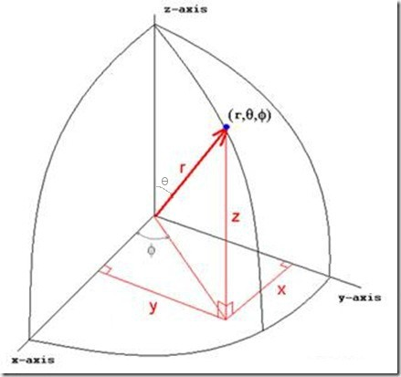
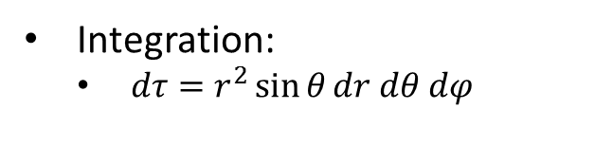
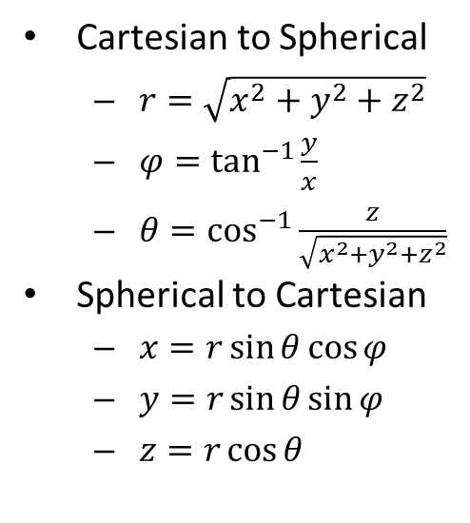
Coordinate Systems: Spherical
Cartesian to Spherical
  $r=\sqrt{x^{2}+y^{2}+z^{2}}$
  $φ=\tan^{−1}{\frac{y}{x}}$
  $θ=\cos^{−1}{\frac{z}{\sqrt{x^{2}+y^{2}+z^{2}}}}$
Spherical to Cartesian
  $x=r\sin{θ}cos{φ}$
  $y=r\sin{θ}\sin{φ}$
  $z=r\cos{θ}$
Integration:
  $dτ=r^{2}\sin{θ}dr dθ dφ$

Slide 18
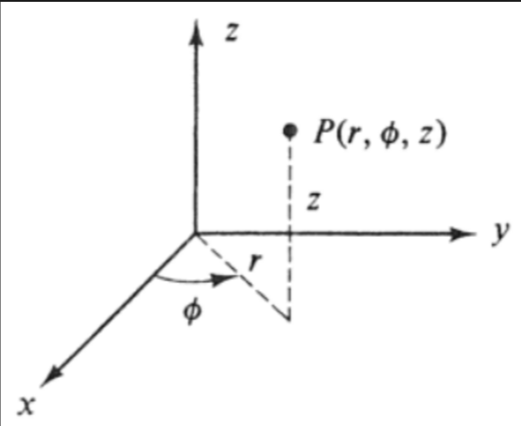
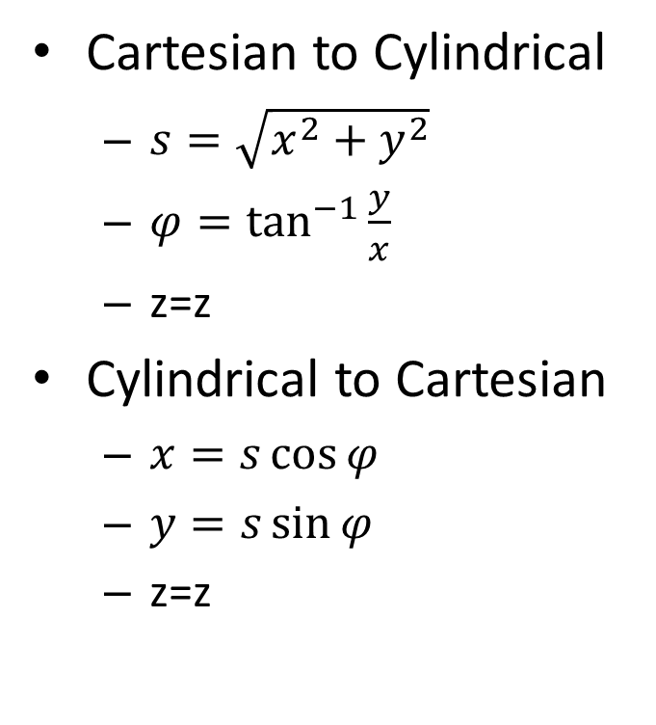
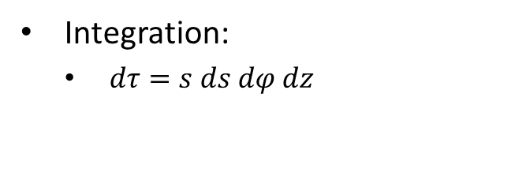
Coordinate Systems: Cylindrical
Cartesian to Cylindrical
  $s=\sqrt{x^{2}+y^{2}}$
  $φ=\tan^{−1}{\frac{y}{x}}$
  z=z
Cylindrical to Cartesian
  $x=s\cos{φ}$
  $y=s\sin{φ}$
  z=z
Integration:
  $dτ=s ds dφ dz$

Slide 19
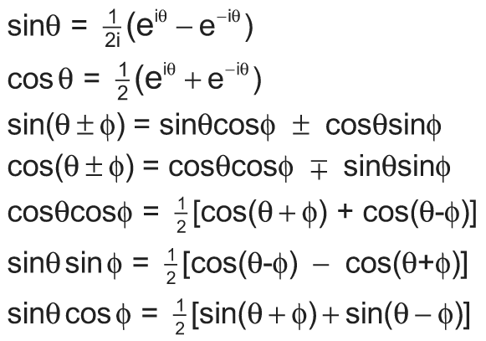

Trig Identities
$$e^{iθ}=\cos{θ+i\sin{θ}}$$

Slide 20




Fourier series
Fourier series are the expansion of a periodic function into sin and cos terms.
The sin and cos terms are orthogonal, so they do not contribute at the same terms.

Slide 21
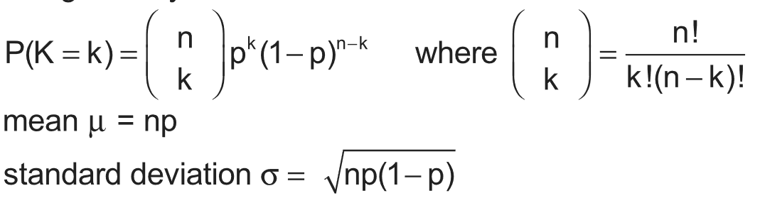
Binomial distribution
For situations with discrete binary outcomes (Y/N, probability p of Y)
The probability of k successes over n trials is

Slide 22
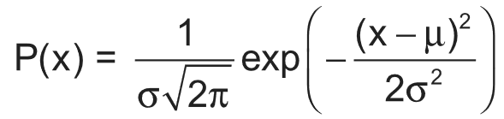
Gaussian distribution
A continuous normalized probability distribution about a mean, shaped like a bell. The normalization constant is in front.

Slide 23
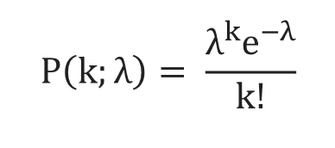

Poisson distribution
A discrete probability distribution of events happening at a known rate and independent probability of one another. (ex. radioactive decay)
If λ is the expected number of events in a given time period, the probability of k events is, with mean λ and standard deviation $\sqrt{λ}$.

Slide 24

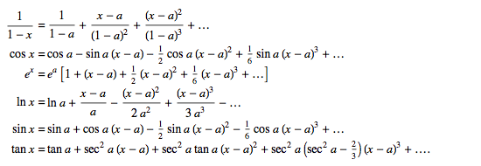
Taylor series
The approximation of a function f(x) at x = a is represented by
Some common
Taylor series:

Slide 25
Lab Methods

Slide 26
Lab Methods
Dimensional Analysis→ GRE asked for the slope of a plot in terms of fundamental constant, just look at dimensions of the ratio y/x.
Log Plots: Never show zero on the axes, A straight line on log-log plot corresponds to y=ax^{b}, A straight line on a log-linear plot corresponds to an exponential growth law, y=C. 10^{bx}

Slide 27
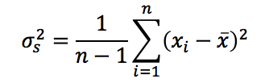
Statistics
Estimate of spread: Sample Variance
Uncertainty : uncertainty of 10% means
Precise measurement: small variance
Accurate measurement: Closer to the true value

Slide 28
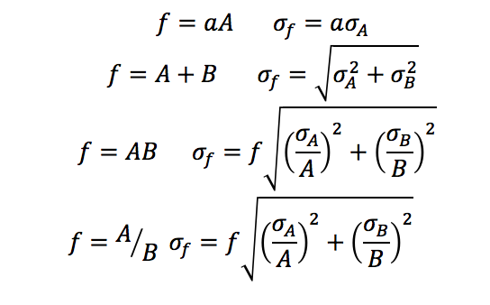
Error Propagation

Slide 29
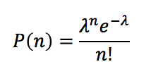


Poisson Processes
For large N
How rare the process is, if λ is small, likely to observe no events
Notes:
Probability of counting events in a fixed time, random occurrence

Slide 30
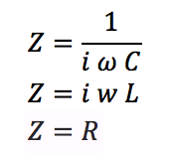
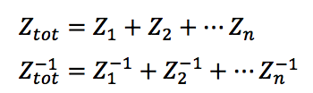
Electronics
Capacitor
Inductor
Resistor
Series
Parallel

Slide 31
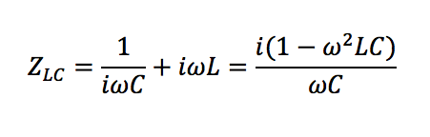

One Inductor and Capacitor Circuit
The numerator vanishes when , the resonant frequency

Slide 32
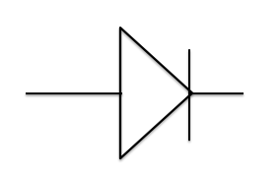
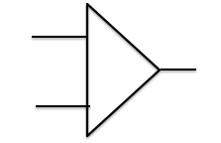
Advance Circuit Elements
Diode: Doesn’t follow Ohm’s law, current only flows one direction
Op-amp: Two inputs one output, output proportional to the difference of input voltages

Slide 33
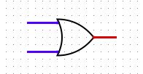

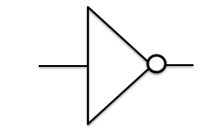
Logic Gates
Or gate (A+B) And gate(A.B)
True either A or B is true True if both A & B are true
False when both A &B are false False otherwise
The inputs can be inverted using a NOT gate
Notes:
Talk about digital circuitry where V=0 low V=1 High

Slide 34
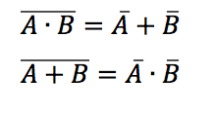
Inverting output of AND and OR gates give NAND and NOR gates
All basic logic gates can be constructed from the combination of these two gates
De Morgan’s Laws in Boolean Algebra:

Slide 35
Interactions of Charged Particles with Matter
Range: Nuclei are stopped faster than the electrons, energy loss/length is much higher for nuclei than for electrons
Path Shape: Nuclei tend to travel is straight line
Energy Loss: Nuclei lose energy exclusively due to collisions, rather than by emitting radiation.

Slide 36

Photon Interactions
Photoabsorption(photoelectric): Photon completely absorbed by an atom, and an electron is emitted.
Compton Scattering: Photon scatters off an atomic electron, the wider the scattering angle, the more energy it loses to the electron.
Compton Wavelength

Slide 37
Lasers
The process of photons from decaying excited states being absorbed by other excited states, called stimulated emission, starts a chain reaction, the product of which is an exponentially large number of photons, all with exactly the same frequency and phase, this is laser light.

Slide 38
Types of Lasers
Solid-state lasers: (Nd-YAG)
Collisional Gas Lasers: (He-Ne)
Molecular Gas Lasers: (CO₂)

Slide 39
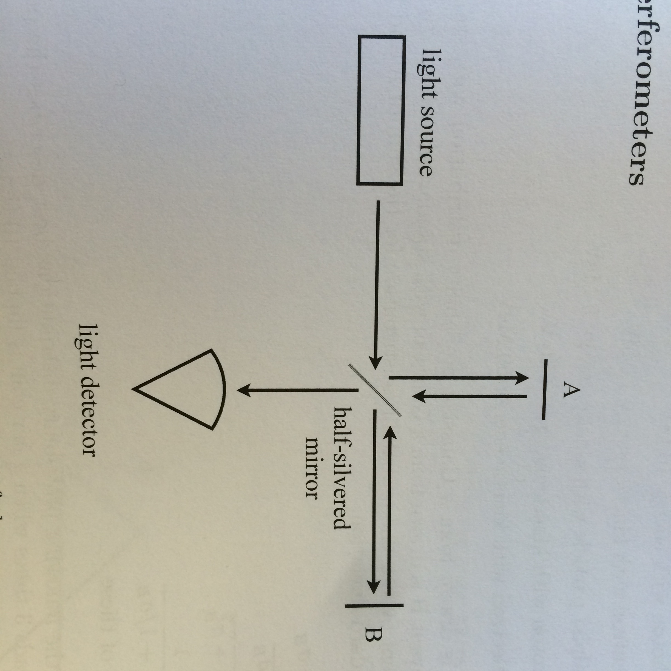
Interferometer
Notes:
Dsin(theta)=mlambda

