Slide 1
QM with Atomic Physics
By Downs, Finn, Steidle, Ume, & Yao

Slide 2
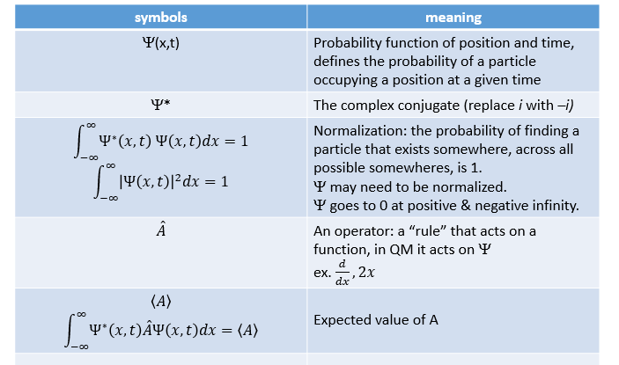
Formalism

Slide 3
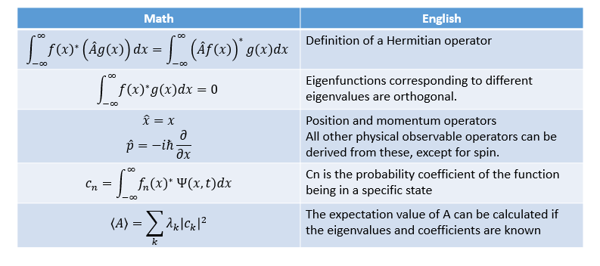
If a function f(x) operated on by operator returns c*f(x), then f(x) is an eigenfunction of that operator, with eigenvalue c.

Slide 4
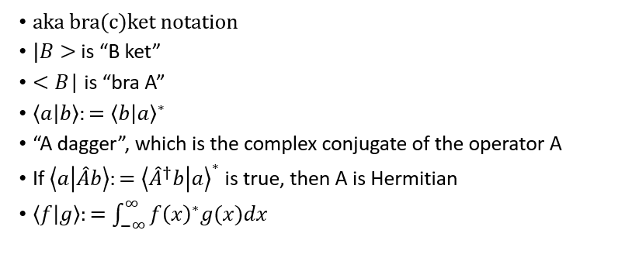
Dirac delta notation

Slide 5
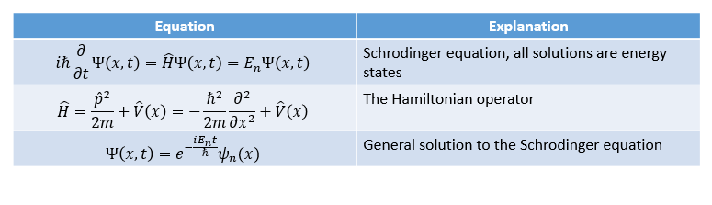
Schrodinger equation

Slide 6
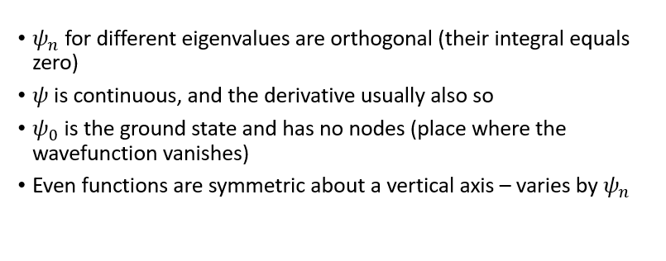
What to know about the wavefunction

Slide 7
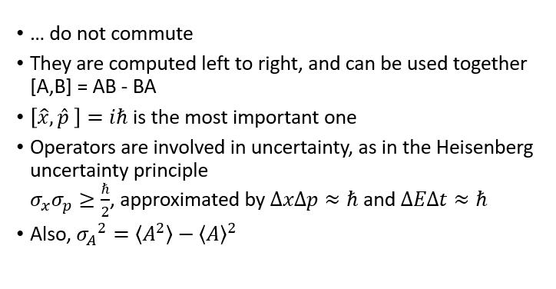
Operators

Slide 8
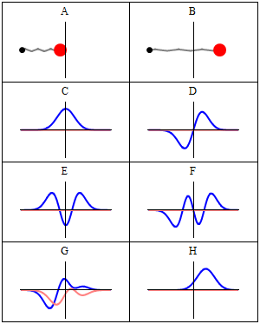







Quantum Harmonic Oscillator
1D
.
Horizontal axis is position, and the vertical axis is the real part (blue) or imaginary part (red) of the wavefunction. C, D, E, F, but not G, H, are energy eigenstates. H is acoherent state—a quantum state that approximates the classical trajectory.

Slide 9
Quantum Harmonic Oscillator 3D

Slide 10

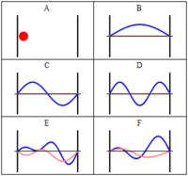


Infinite Square Well
Horizontal axis is position, and the vertical axis is the real part (blue) and imaginary part (red) of the wavefunction. The states (B,C,D) are energy eigenstates, but (E,F) are not.

Slide 11

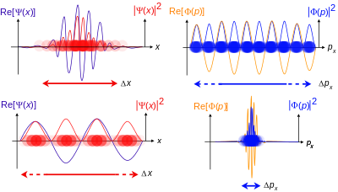


Free Particle
Increasing amounts of wavepacket localization, meaning the particle becomes more localized.

Slide 12

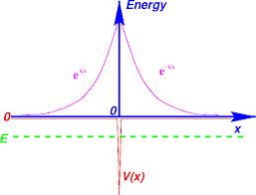



Delta Function

Slide 13

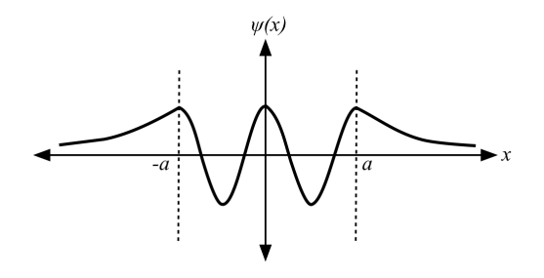
Finite Square Well
Wave function inside the well turning to decaying exponentials outside the well.

Slide 14



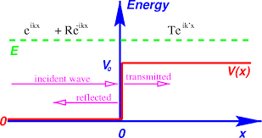
Scattering States: Reflection/Transmission

Slide 15


Three Dimensions
Momentum Operator:

Slide 16


Hamiltonian in 3D

Slide 17


Different Coordinates Commute with Each Other

Slide 18



Spherical Wave Function
Spherical Wave function: Product of angular and radial part
Separate into radial and angular part and normalize each piece separately

Slide 19
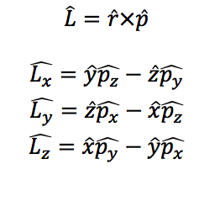
Angular Momentum

Slide 20


Something to Remember For GRE

Slide 21


Spherical Coordinates

Slide 22
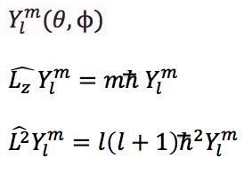

Eigenfunction and Eigenvalues

Slide 23
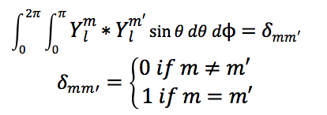

Some Facts
Orthonormal:
The ϕ dependence is always in the form
Dependence of θ is complicated and will be provided

Slide 24
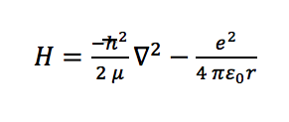
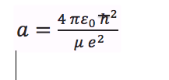
Hydrogen Atom
Hamiltonian:
Bohr Radius

Slide 25


Energy States
Ground state energy (Hydrogen):
n state energy:

Slide 26

Rydberg’s Formula

Slide 27
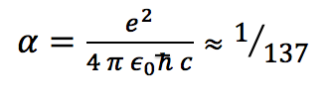
Useful for GRE

Slide 28
Spin
Spin is a characteristic of a particle, and doesn’t change!
Spin operators obey same commutation relations as angular momentum operators.
Spin can either be an integer or half-integer.
For GRE, only really need to know spin-½
Adding spins is not trivial:
For system of two particles (spin s and spin s’)

Slide 29
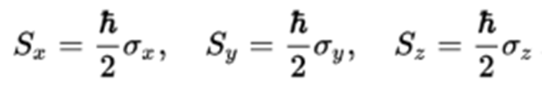
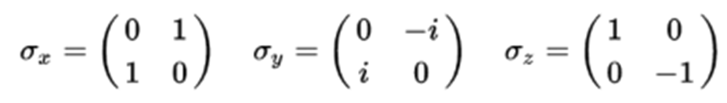
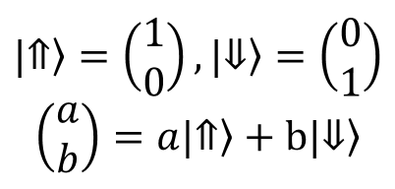
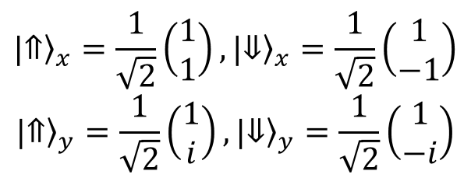
Spin-1/2

Slide 30
Spin and the wavefunction
Can think of total wavefunction as a product of a spatial wavefunction and a spin wavefunction
Spin operators always commute with spatial operators
If particle has spin-0, it only has a spatial wavefuntion
Note: the Hamiltonian can act on both the spin and spatial wavefunctions!

Slide 31
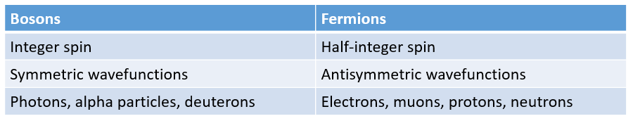


Bosons and fermions
Pauli exclusion principle:
no 2 identical fermions can occupy the same quantum state
For identical particles…
symmetric wavefunctions:
antisymmetric wavefunctions:

Slide 32

Approximation Methods in QM
Variation principle
Approx. ground state E of system when Hamiltonian known
For a normalized wavefunction:
Use trial wavefunction with adjustable parameter, calculate and minimize with respect to parameter
Adiabatic theorem
For particle in nth eigenstate of H, if H is slowly changed to H’, then particle will end up in the corresponding eigenstate
Note: will not have to apply variation principle on GRE!!

Slide 33



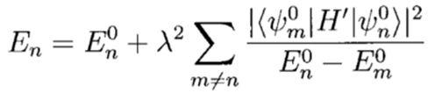
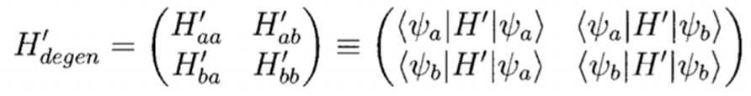
Time-independent perturbation theory
. , know energies and eigenfunctions of H0, so can compute corrections
First-order:
Second-order:
  If there is a degeneracy, denominator = 0
  Diagonalize the perturbation in the subspace of degenerate states!

Slide 34
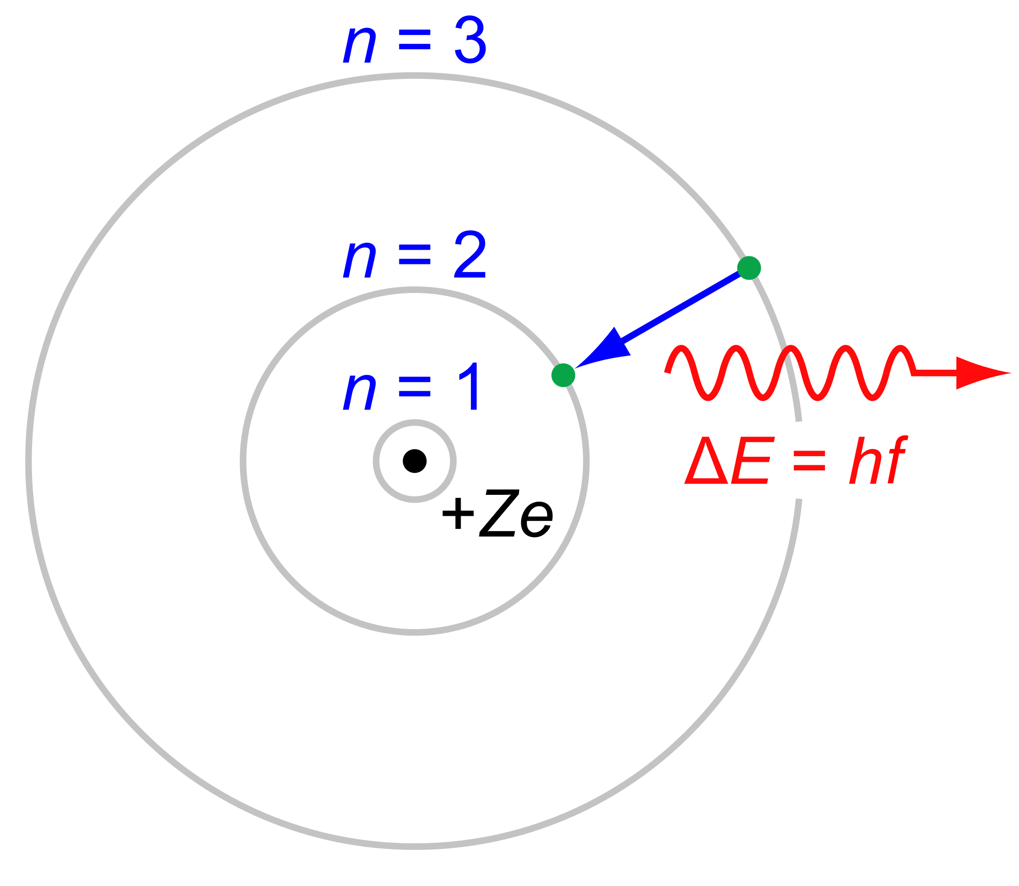
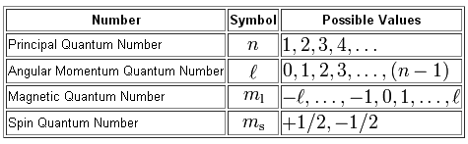
Atomic Review
Bohr Model
  Electrons move in classical circular orbits, called energy shells or energy levels.
  Angular Momentum - L=n*ħ where n=1,2,3…
  Electrons do not radiate as they move around the nucleus.
    Classically the electron would radiate and spiral into the proton.
Angular Momentum
L=mvr

Slide 35
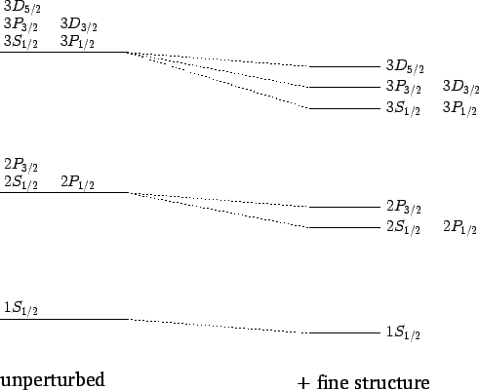
Perturbations to the Hydrogen Atom
Fine Structure
  Replacing the electron KE term in the Hamiltonian with the correct relativistic form.
  Spin-Orbit coupling between electron’s orbital angular momentum and its spin.
Lamb Shift
  Splits the 2s and 2 level with j=½.
Spin-Spin Coupling
  Ground state of hydrogen splits.
  Depends on spins of e and p.
Useful Calculation Tip
  J²=(L+S)²
  =L²+2L٠S+S²
  L۰S=½(J²-L²-S²)

Slide 36
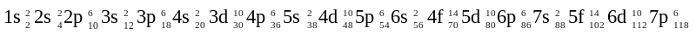
Shell Model and Electronic Notation
Orbitals
  s→ l = 0
  p→ l = 1
  d→ l = 2
  f → l = 3
L=nħ L²=l(l+1)ħ² |L|=ħ√2
Shells fill in order, preferring smaller values of l until Argon.
Noble gases are chemically inert because they have totally filled electron shells.
  Alkali metals have one “extra” electron
  Halogens have one fewer electron

Slide 37
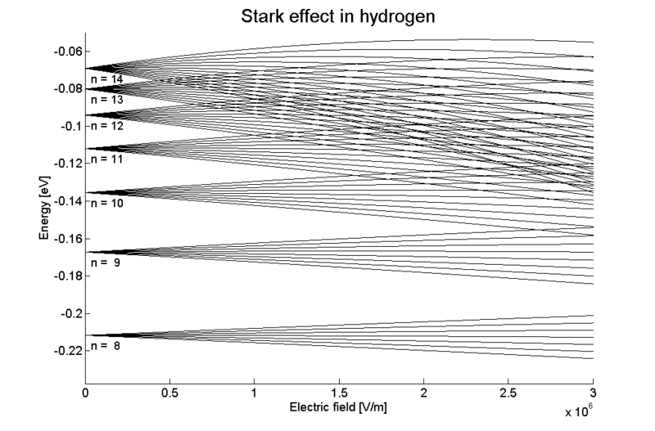
Stark Effect
Splitting of degenerate energy levels caused by E-field.
Change in Hamiltonian in a uniform electron field is given by,
  ΔH=eE⠂r
There is no change in the ground state energy
First states to show a first-order shift are n=2 states.
  States with m=±1 are unaffected, but 2s and 2p states with m=0 are split.
Energy splitting must be given of the form,
  ΔE=ke|E|d , where d is some length (usually d=a₀), and k is an undetermined constant.

Slide 38
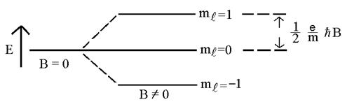
Zeeman Effect
Splitting of degenerate energy levels caused by B-field.
Change in Hamiltonian in a magnetic field is given by,
  ΔH=(e/2m)*(L+2S)∙B
  e/2m is the electron’s classical gyromagnetic ratio.
  2 in front of spin operator is because the quantum gyromagnetic ratio is twice the classical value.

Slide 39
Selection Rules
No transitions occur unless,
  Δm=±1 or 0
    Conservation of the z-component of angular momentum
    Photon Spin = 1 ⟶ l = -ħ, 0, ħ
  Δ l = ±1
Decay Pattern Example:
  3s ➝ 2p ➝ 1s

Slide 40
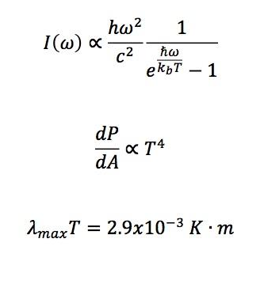
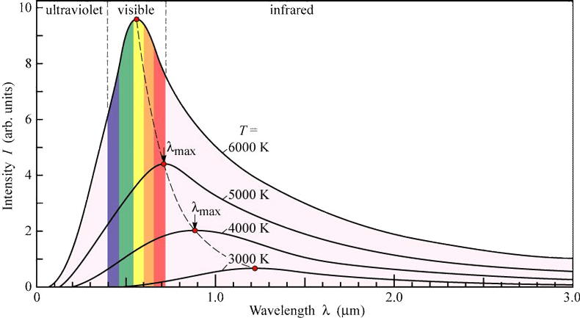
Blackbody Radiation

