Slide 1
Selected Topics

Slide 2
The standard Model

Slide 3
Standard Model
Reconciles quantum mechanics with relativity
Each particle has a corresponding antiparticle

Slide 4
Types of Particles
Fermions
Spin of ½ integer
Follow Fermi-Dirac statistics
Pauli Exclusion Principle
Bosons
Integer spin
Follow Bose-Einstein statistics
Responsible for 4 fundamental forces

Slide 5
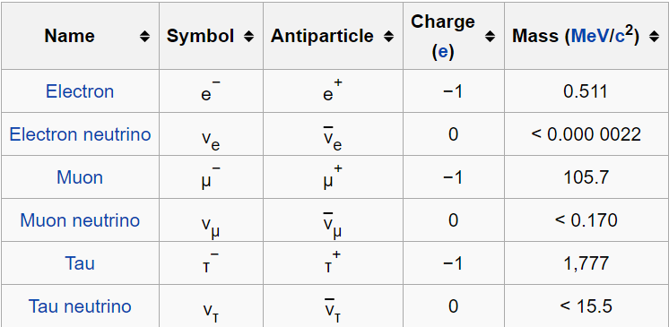
Fermions: Leptons
Don’t interact via strong force

Slide 6
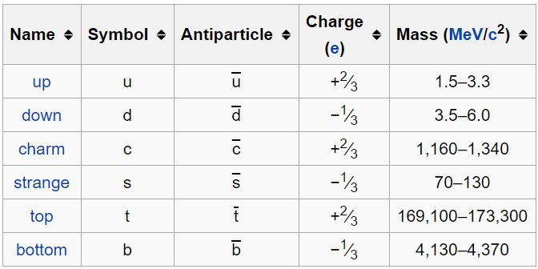
Fermions: Quarks
Interact via strong force
Cannot exist in unbound states
Have 6 “flavors”

Slide 7
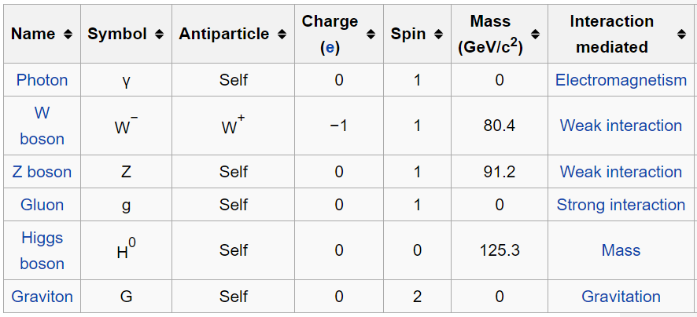
Bosons

Slide 8
Ways to describe a particle
Color
Strong nuclear force reactions
Red, green, blue
Flavor
Quarks, up- or down-type
Generation
Quarks
1) u,d
2) c, s
3) t, b

Slide 9

Decay: Which force is responsible?
Strong Force
Lifetimes around ${10}^{−23}s$
Electromagnetic Force
Lifetime of ${10}^{−18}s$ to ${10}^{−16}s$
Generally a photon is emitted
Weak Force
Lifetime of ${10}^{−10}s$ to ${10}^{−8}s$
Generally a neutrino is emitted
Beta decay

Slide 10
Recent discoveries

Slide 11
Higgs Boson
Responsible for giving mass to all matter
Spontaneous symmetry breaking
Theorizes supersymmetry
Every particle has a superpartner with the same charge, but a difference in spin by 1/2

Slide 12
Neutrinos
Have mass!
Observed by studying neutrino oscillations
Emitted neutrinos detected as different “flavor”
Less than 1/1000th mass of the electron

Slide 13
Nuclear physics: bound states

Slide 14
Composite Particles
Composite particles are made up of elementary particles
Composites: protons, neutrons, pions
Composites of composites: atomic nuclei, atoms, molecules
In quantum field theory, protons and neutrons are “teeming seas of quarks and gluons constantly popping in and out of existence”
Gluons – bosons that carry force that binds quarks together

Slide 15
Quark Model and Bound States
At low energies – where nuclear physics applicable:
Proton – bound state of two up quarks and a down quark (uud)
Total charge of 2(2/3)-1/3=+1
Neutron – bound state of two down quarks and an up quark (udd)
Total charge of 2(-1/3)+2/3=0
Due to confinement, there are no free quarks in nature. They instead collect into bound states, like protons and neutrons.
All of these bound states are color-neutral (color singlets).

Slide 16
Heavier bound states
Can be formed by colliding particles at higher and higher energies
Some can be considered excited states of nucleons.
ex: first excited state of proton has same quark content but can be considered a distinct particle as much heavier

Slide 17
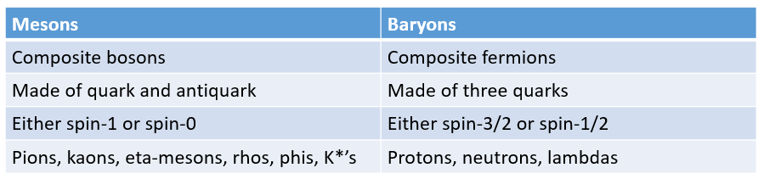
Mesons and Baryons
Bound states of quarks generally fall into two categories:
Color introduced to explain quark content of some baryons
Baryon of three identical quarks violates Pauli exclusion principle as supposed to be a fermion but has symmetric wavefunction – fixed by putting quarks in antisymmetric color state (color singlet)

Slide 18
Sample Problem
Without the hypothesis of quark color, the quark model would be unable to explain the existence of which of the following spin-3/2 baryons? You may assume the quarks have zero relative orbital angular momentum. (#91 from first practice exam in textbook)
udd
uud
uuu
uds
all of the above baryons are allowed

Slide 19

Decay
X = atomic symbol
Z = atomic number (number of protons)
A = atomic mass number (number of protons and neutrons)
Neutron decay:
Free neutrons decay (lifetime of about 15 min), but in nuclei, interactions with protons prevent this from happening immediately.
Useful to remember: typical nuclear diameters are femtometers

Slide 20
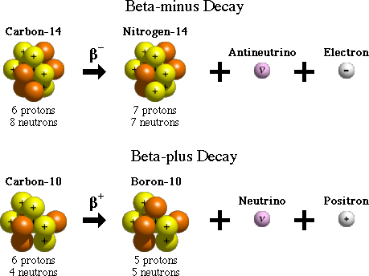


Beta decay

Slide 21
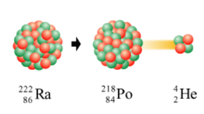

Alpha decay
As nuclei get bigger, electromagnetic force starts to cancel strong force

Slide 22
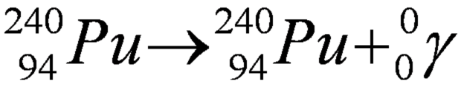
Gamma decay
The emission of photons from an excited state of a nucleus
Does not change the composition of the nucleus

Slide 23
Fission and Fusion
Fission – process in which large nuclei break apart
Fusion – process in which small nuclei join together
Requires extreme temperatures and pressures
Can release large amounts of energy
Sun and hydrogen bomb are powered by fusion reactions
Genesis of heavy elements in early universe: light nuclei fused as result of supernovas up to iron (most stable nucleus). Heavier nuclei become more and more unstable – past lead all nuclei will eventually decay.

Slide 24
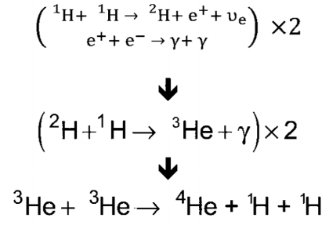
Fusion in the Sun

Slide 25
Symmetry and conservation laws

Slide 26
Conservation laws
Everything that can happen will, unless forbidden by symmetry or conservation law.
An electron, as the lightest free negatively charged particle, can’t decay due to conservation of charge. As the proton is heavier than the positron, why doesn’t it decay?
Conservation of baryon number:
Baryons get baryon number +1, anti-baryons get -1, all else get 0
Why is an extra neutrino always produced in beta decay?
Conservation of lepton number:
Three separate conservations laws: electron number, muon number, tau number
Lepton and its associated neutrino given lepton number +1, corresponding antiparticles get -1, other stuff gets 0

Slide 27

Using these laws: decay modes of muon
Conservation of mu number:
Muon has mu number of +1, so need lighter particle with mu number of +1 among decay products (mu neutrino)

Slide 28
Using these laws: decay modes of muon
Conservation of charge:
Muon has charge of -1, so need lighter particle with charge -1 among the decay products (electron)

Slide 29
Using these laws: decay modes of muon
Conservation of electron number:
Muon has electron number of zero and already have electron with electron number +1, so need a neutral particle with electron number of -1 (anti-electron neutrino)
This is one decay mode. All other decay modes must contain extra pairs of particles with net charge and lepton number of 0 (dominant decay mode has smallest number of decay products)

Slide 30
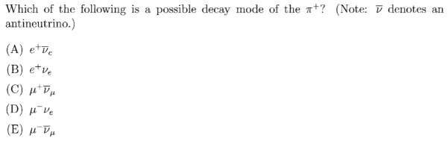
Sample Problem

Slide 31
Discrete Symmetry Operations
P (parity): reverses orientation of space; takes config. to mirror image
C (charge conjugation): exchanges particles and antiparticles
T (time-reversal)
All Lorentz-invariant local quantum field theories must be symmetric under the combined action of these operations (CPT theorem)
However, Standard Model doesn’t respect each of these individually

Slide 32
Crystal structure

Slide 33
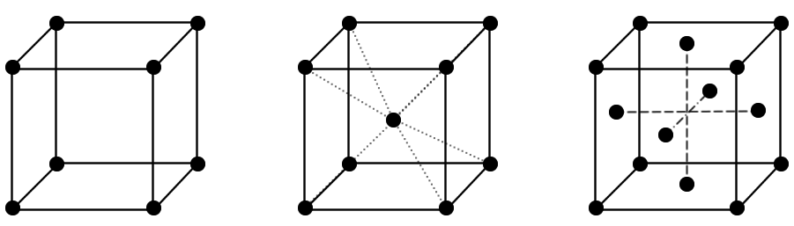
Crystal Lattice: Unit Cells
Repetition – infinite structure
Tessellate in all directions to build crystals
Conventional unit cells (main three):

Slide 34
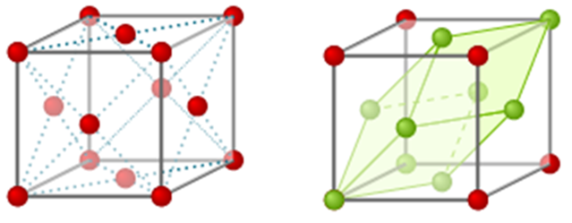
Crystal Lattice: Primitive Cells
Conventional unit cell isn’t always the smallest repeating pattern
Smallest = least number of atoms
Conventional unit cell (FCC)
Primitive unit cell (FCC)

Slide 35
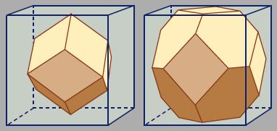
GRE Material
Given the primitive cell volume:
Find the volume of the conventional unit cell
Find the inter-atomic distance

Slide 36
Reciprocal Lattice Structures
Fourier transform of the original lattice
Also called the dual lattice
Primitive unit cell for reciprocal lattice
Called the (first) Brillouin zone
BCC/FCC lattices swap primitive unit cells

Slide 37
Electron theory

Slide 38
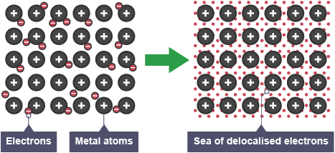
Electron Theory of Metals
Electrons in a crystal structure (metallic solids) are delocalized

Slide 39
Fermi Energy
Classical mechanics: at 0 K, no motion, zero energy
BUT, electrons are quantum particles (fermions)
Pauli exclusion principle – can have two electrons with zero momentum, all others are moving

Slide 40
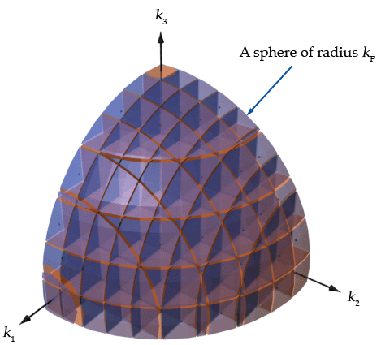
Fermi Energy
At 0 K, Electrons fill up a sphere in p-space
Fermi wave vector

Slide 41
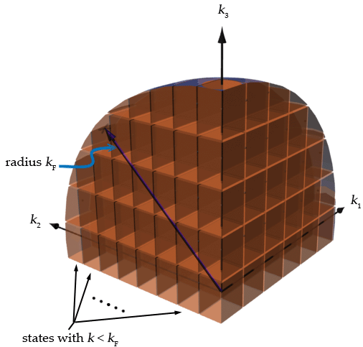
Fermi Energy
k_{f} can be put in terms of the number density of electrons n
Using E_{F} from before
Know the power laws

Slide 42
Other Derivations
Density of states: number of possible free electron states at given energy E
Integrate for total number of electrons N

Slide 43
conductors

Slide 44
Semiconductors
Definition: Materials that are not as conductive as metals and have resistivity which decreases as temperature increases.
Common example: Silicon

Slide 45
Semiconductors
The conductivity of a semiconductor is due to impurities within a lattice structure. Creating this impurities is known as “doping.”

Slide 46
Semiconductors
One type of doping is called n-doping, where some Silicon atoms are replaced with atoms that have more electrons in their valence shell, such as Phosphorus.

Slide 47
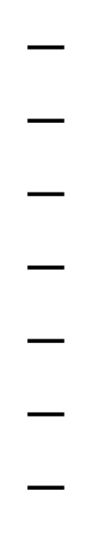

Semiconductors
Now, apply an electric potential across this lattice and see how the electrons in the conduction band are free to move away from the negative end and toward the positive end.
$$−$$
$$−$$
$$−$$
$$−$$
$$−$$
$$−$$
$$−$$
$$+$$
$$+$$
$$+$$
$$+$$
$$+$$
$$+$$
$$+$$

Slide 48
Semiconductors
Another type of doping is called p-doping, where some Silicon atoms are replaced with atoms that have less electrons in their valence shell, such as Boron.

Slide 49
Semiconductors
Since there are less electrons in the valence shell, the lattice now contains many “electron holes,” which can be thought of as positively-charged particles, even though they are not.

Slide 50
Semiconductors
With a potential applied across the lattice, these electron holes “move” toward the negative end. This movement is due to nearby electrons filling the holes as they move toward the positive end.
$$−$$
$$−$$
$$−$$
$$−$$
$$−$$
$$−$$
$$−$$
$$+$$
$$+$$
$$+$$
$$+$$
$$+$$
$$+$$
$$+$$

Slide 51
Superconductors
These are phenomena of quantum mechanics in which a material is cooled to extreme temperatures, and its electrical resistance becomes zero, giving it infinite conductivity.

Slide 52


Superconductors
One result of cooling a material into a superconductor is the expulsion of magnetic fields within the conductor- even if the field is present before the cooling begins. This is known as the Meissner Effect.
Temperature
$$i$$
$$B$$
Critical temperature

Slide 53
Superconductors
Superconductivity can be explained by Cooper Pairs. A Cooper Pair is the result of two electrons bound together over several nanometers. They are known to be bound because the energy of the pair is lower than the Fermi energy (Fermi energy = energy of a single fermion at absolute zero).
E
e
e
Free electrons
e
e
Cooper pair

Slide 54
Superconductors
It is important to keep in mind that although a Cooper Pair is composed of two fermions, it is in fact a boson. What this means is that these pairs have full-integer spins and can therefore occupy the same state. In other words, they can superimpose on one another.

Slide 55
aSTROPHYSICS

Slide 56
The Scale Factor a(T)
A(T) = Scale factor
= wavelength of photon
= wavelength at T
Or
The scale factor denotes the distance to a location in space
The ratio of scale factors shows how much a photon is redshifted from the change in the shape of space.
Assuming space is only expanding, A(t) will always be an increasing value thus an initial wavelength would only be able to increase which, as expected, would mean the object is moving away from Earth.

Slide 57
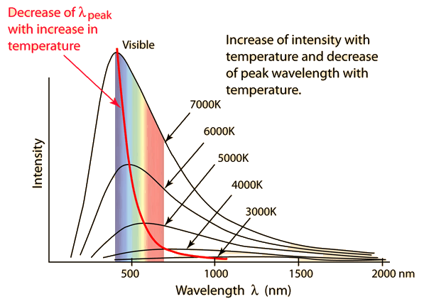
Black-Body Spectrum i.e. The Cosmic Microwave Background
Wein’s Displacement law:
As the universe expands by a factor of 2, the observed wavelength doubles from Earth’s perspective
From Wein’s Displacement law, the Black-bodies cool down by a factor of 2

Slide 58
The Hubble Law
V = velocity
H = Hubble parameter
D = Distance to object
This is used to scale and account for the expansion of the universe.
Although the Hubble parameter changes over time, this law can be assumed to be linear in small periods of time.
Note: If a galaxy is twice as far away, GRE students must know it appears to be moving twice as fast away from Earth.

Slide 59
Cosmological Redshift
This definition uses Z(Today) = 0
Thus positive values of Z are in the past and negative values denote the future.
Important Note: If a galaxy is at “redshift = 5”,
This means the ratio of the wavelengths is equal to 6.

Slide 60
Doppler vs. Cosmological Redshift
Note: If the question is asking about the distances between galaxies, use cosmological redshift.
This is because cosmological redshift is due to the expansion of the universe versus the relative motion.

