Slide 1
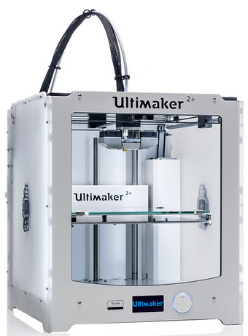
3D printing
in the ISC
This is the “Ultimaker 2+” printer, available in ISC 226 for qualified physics student use on “relevant” projects.

Slide 2
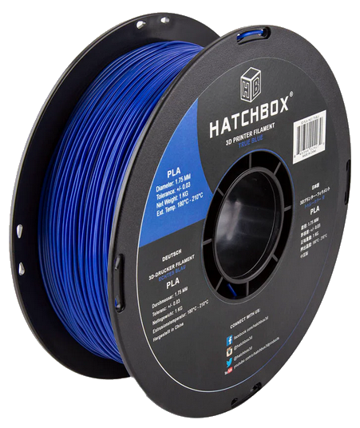
Plastic is stored on the back, as a spool of “filament”.
Filament is a long cylinder with a diameter of about 2 mm.
This spool is about 2 pounds.
The material is usually “PLA” (polylactic acid).

Slide 3
Other plastics can be used… like
ABS, Nylon, PETG, resin
PLA is cheap
PLA is relatively environmentally friendly
PLA is “food safe”
PLA prints with fewer thermal issues
PLA is brittle and less robust
(recall brittle is not the opposite of strong,
brittle is the opposite of stretchy)

Slide 4
While printing, a motor pushes filament through a tube called a Bowden.

Slide 5
It’s heated to around 400 °F in this nozzle.
It becomes a thick liquid and gets pushed out like toothpaste.

Slide 6
While printing, the nozzle is within a millimeter of this glass “bed”.
The bed is also “hot” (about 150 °F), and the plastic sticks to it and starts to cool.
The printed plastic is hardish, but still a little sticky…

Slide 7
After printing one layer, the bed lowers a little bit, and then the next layer is added on top of the first layer.
And so on…

Slide 8
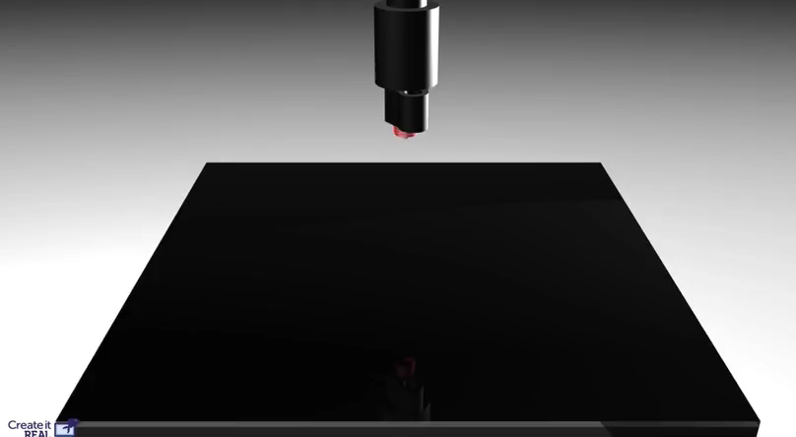
I think this is a chess piece…
Animation adapted from “Create it REAL”/YouTube.

Slide 9
Design Process
Consider whether you even need to make something… perhaps we already have that widget!
Do not design screws, threaded pegs, or threaded holes.
Do not design pieces that will experience a lot of force.
Do not design pieces that will live in vacuum.

Slide 10
Design Process
Make careful measurements of the already existing thing that your new part(s) will connect with.
When possible, consult the manufacturers documents!
Use a caliper.
Use millimeters, not inches.

Slide 11
Design Process
Draw/design the thing you need. Use paper.
Use simple shapes if possible.
Make your piece smaller!
Consider the ways that “additive” manufacturing is different than traditional “subtractive” manufacturing
(more on that in a moment…)
Make your piece smaller! Again!

Slide 12
Design Process
Convert to a digital version
Use AutoDesk Fusion 360, or Trimble Sketchup
Both are free.
Fusion 360: Harder to learn.
Sketchup: Harder to edit
When done drawing, convert to or “save as” an STL (“stereolithography”) file.

Slide 13
Design Technique
Each new layer must have something to rest on.
Good No Nope
No Maybe No
70°?

Slide 14
Design Technique
Parts are stronger when they print sideways.
Strong Weak ????

Slide 15
Design Technique
Don’t let your vision of the “actual” orientation influence your choices about design/printing orientation.
Yes
No
Yes
Side View
Side View
Top View

Slide 16
Design Technique
Printed sizes are never perfect. The faster you print, the larger the resulting piece will be.
Top View of peg…
Your drawing said this
Slow Print gave this
Fast Print gave this
0.5+ mm?

Slide 17
Design Technique
The same is true for holes… there is more plastic there than you expected…
Your drawing said this
But you got this

Slide 18
Design Technique
Pegs and Holes must ALWAYS have clearance when designed.
Printed (red) peg in printed (blue) hole.
The as-drawn diameter of hole must be at least 1 mm* larger than the peg!

Slide 19
Finishing Technique
What if you mess up?
You can sand or file the results if something is still too large…
But sanding/filing is slow
It’s irregular
It ruins the surface finish/makes it “dusty”

Slide 20
Cura/ “Slicing” Software
Takes in an STL file
Converts it to a G-code file → Save to an SD card!!
G-code is lossy! G-code only saves info about
  how the 3D printer should move its motors, not
  what the original design is supposed to look like
Cura settings: printer type, speed, infill, support, “adhesion”, printing line width, wall thickness

Slide 21
Cura settings…
Printer type: Ultimaker II+
Speed 60 mm/s
Infill 8 to 20%
Support Yes/No with sub-options
Line width 0.4 mm
Layer height 0.10 to 0.15 mm
Adhesion None, Skirt, Brim
Wall thickness 3 or 4 lines

Slide 22
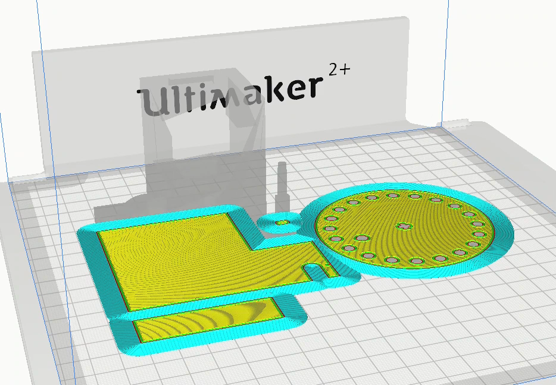
Cura Preview

Slide 23
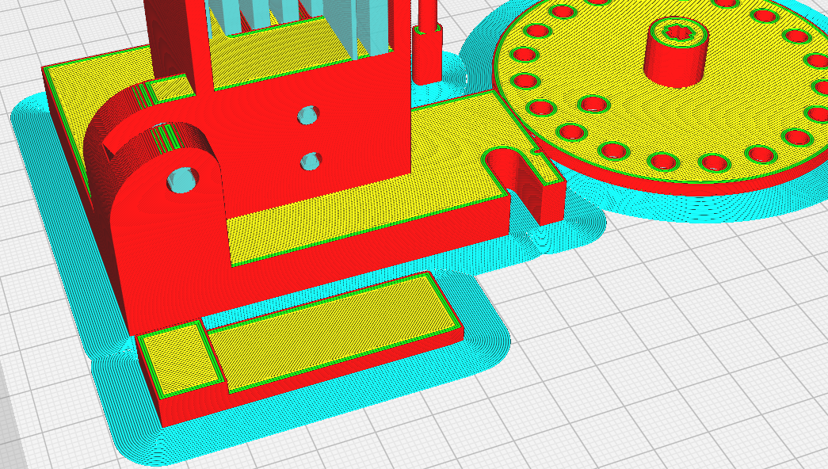
Cura Preview
This is “Adhesion”… it’s extra stuff printed to make sure the bottom sticks better to the glass while the top is still printing. This is showing the “brim” type.

Slide 24
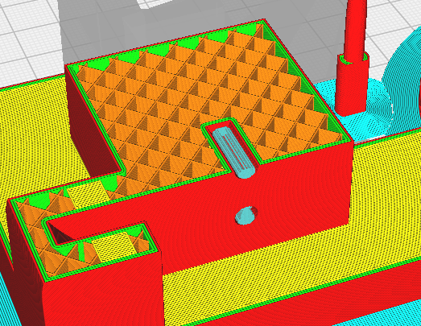
Cura Preview
This is “Infill”… it’s internal webbing to help stiffen the outer shell or skin.
This is showing 20% infill.
This is one kind of “support” structure. It’s extra stuff that prints so that higher layers have something to rest on.
It’s supposed to be easy to remove after printing.

Slide 25
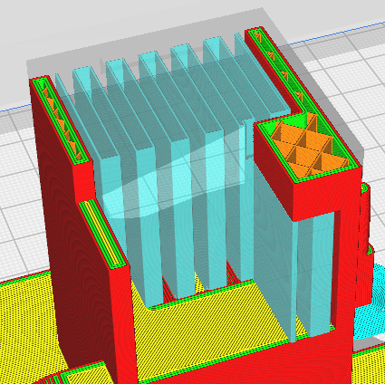
Cura Preview
This is more support structure.
This is more infill.
This is “inner wall”
This is “outer wall”
This is “ceiling”

Slide 26
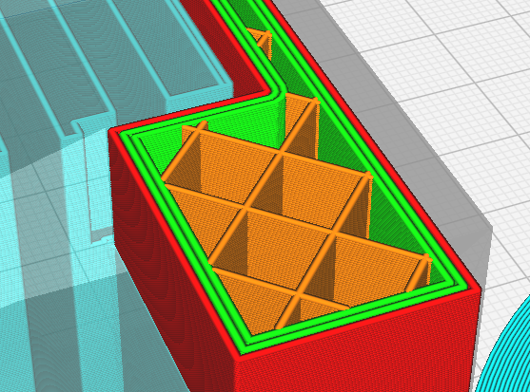
Cura Preview
This show a wall thickness of three “lines” (2 green + 1 red).
Cura shows the outer wall line as red, and inner wall lines as green.
Layer Height… this
is about 0.12 mm
This is “line width”.
This model used 0.4 mm

Slide 27
Printing Issues
Why can’t I use this in vacuum?
All plastic outgasses… it keeps emitting a small amount of hydrocarbons forever.
But PLA is better than most plastics.
But the layering traps air:
Side View
Even if you print with 100% infill (i.e., “solid”), the best you can actually get is this… there’s a lot of trapped air that will eventually ruin the vacuum.

Slide 28
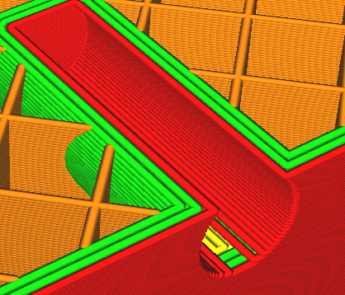
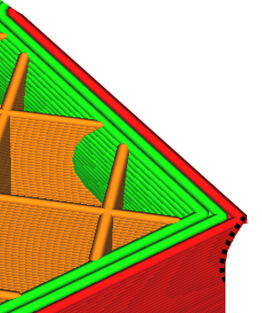
Need (small) Threaded Holes?
Just print a smooth hole with a diameter that’s a wee bit smaller than the diameter of the thread.
Then, push the screw in while letting it turn, and the screw will cut its own permanent threads into the plastic…

Slide 29
Physical Dangers
Burns from touching the print nozzle or hot plastic.
Trying to use a razor to remove a job while it’s still too warm…
Can cut yourself.
Can send a broken razor corner into your eye!
Can ruin the print or the printer!
Reaching into the machine while it’s moving...
Can trap and crush your hand.

Slide 30
Want to become certified?
To use the Physics printer in ISC 226:
Read the tutorial here, then take a test from Dr. Pogo:
https://www.geneseo.edu/~pogo/3DPrinting/3D.html
Written test: can take multiple times… 80% is passing.
Practical test: like a “road” test after the written test.

Slide 31
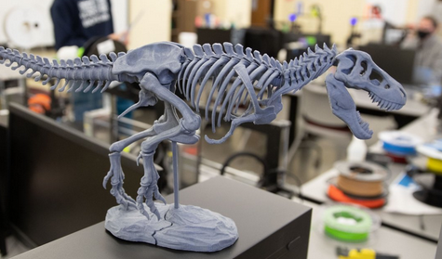
Want to do more?
Need more help?
CIT’s 3D printing lab in South Hall 341
“Geneseo Experimental Space”
https://www.geneseo.edu/cit/experimental-space

