Slide 1
Simulating Physics Behavior…
The rotation rate was set using the “eyeball” method… I just tried to make it look right.
Most Powerpoint slides are “cartoons” like this one, not measurably accurate simulations.
This slide has 3 animations.
This motion path “gets” its acceleration by using the “smooth” start property.

Slide 2

This slide has 4 animations.
Rolling = Linear + rotational motion:
Δt = 2 s
L = 7.036 in (measured)
D = 1.13 in, or r = 0.565 in
a = 2L/Δt² = 3.518 in/s²
α = a/r = 6.227 rad/s²
Δθ = ½αΔt² = 12.454 rad = 713.5°
ω_{final} = αΔt = 12.454 rad/s = 713.5º/s
PowerPoint keeps trying to adjust my second motion path so the two don’t really line up!
Use arrow keys at high zoom to adjust.
This “free fall” portion is not actually accelerating…but it should be!

Slide 3
This slide has 2 animations.
The two blocks have significant “white” sections attached to them.
The strings don’t lengthen or contract… they are non-animated!
The green block drags a white region over top of the horizontal string to keep it from becoming visible after the block passes.
The blue block pushes a white section over the vertical string for the same reason.

Slide 4
This slide has 2 animations.
Δt = 2 s
L = 3.59 in (measured)
D = 2.90 in, or r = 1.45 in
a = 2L/Δt² = 1.795 in/s²
α = a/r = 1.238 rad/s²
Δθ = ½αΔt² = 2.476 rad = 141.9°
ω_{final} = αΔt = 2.476 rad/s = 141.9°/s
This slide combines some of the earlier features.
The green “paper tab” has a significant invisible section that the rotation axis is correct.
In the “real” experiment, L was much larger than D. So, to match that experiment better, we would probably draw a much smaller wheel. If D = 1.00 inches as drawn, then the results would be a = 1.795 in/s², α = 3.59 rad/s², Δθ = ½αΔt² = 7.18 rad = 411.4º (i.e., more than one full turn), and ω_{final} = αΔt = 7.18 rad/s = 411.4º/s

Slide 5
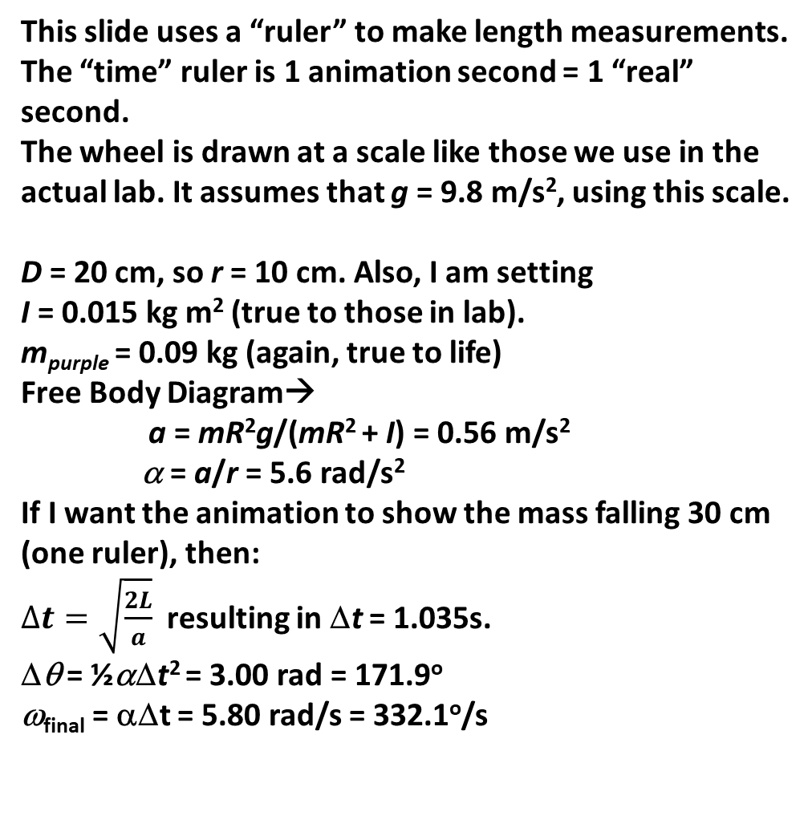
This slide uses a “ruler” to make length measurements. The “time” ruler is 1 animation second = 1 “real” second.
The wheel is drawn at a scale like those we use in the actual lab. It assumes that g = 9.8 m/s², using this scale.
D = 20 cm, so r = 10 cm. Also, I am setting
I = 0.015 kg m² (true to those in lab).
m_{purple} = 0.09 kg (again, true to life)
Free Body Diagram→
a = mR²g/(mR² + I) = 0.56 m/s²
α = a/r = 5.6 rad/s²
If I want the animation to show the mass falling 30 cm (one ruler), then:
$∆t=\sqrt{\frac{2L}{a}}$ resulting in Δt = 1.035s.
Δθ = ½αΔt² = 3.00 rad = 171.9º
ω_{final} = αΔt = 5.80 rad/s = 332.1º/s
10 cm
20 cm
30 cm
10 cm
20 cm
30 cm

Slide 6
Heating a metal plate with an energy source near one corner…
There are two rectangular plates. The colored one is invisible at the start of the slide, but “fades in”, eventually covering the gray one.

Slide 7
Triggers
Refers to ways of starting or restarting an animation.
Method:
Make an animation (like this blue motion path)
In the animation pane, right click, then select
Timing/Triggers.
Choose “Start effect on click of…”, and choose an
object to start it. Here, I picked the orange text
box.
4. It can be clicked any number of times!
Start

Slide 8
Arrive
Attack
Start
Bye!

