Slide 1

Excel is used to organize, analyze, and display data.
It was originally designed to analyze financial data, not scientific data.
Excel is a spreadsheet, which means it’s also a programming environment that mimics “BASIC”.
It also contains a second programming environment called Visual Basic, but that’s not for today.

Slide 2
Excel has an infinity of features.
We could talk about:
  Plotting in 2D and 3D
  Analysis tools like “Solver”
  User interface design features including “pivot tables”
But today, we’re only talking about using “regular” programming using formulas in cells.

Slide 3
Other important topics that you should know about, but which we are not covering today:
Opening files that did not originate in Excel
Making graph templates (because the graphing defaults are so bad and it takes a long time to fix every option)
Using Secondary axes on plots.
Using “Named” cells instead of references
(such as “g” instead of “A6” (which
might contain 9.80).

Slide 4
When “programming” in Excel, our goal is for the data manipulation to be automatic…
The user should not have to click on buttons or toolbars or otherwise need to review the data whenever one or more values are updated. The user starts by merely pasting some data into the spreadsheet, and then all their results are instantly available.

Slide 5
Task #1: Using text functions.
Big picture: I have text from some other source, and I want to extract specific info from it.
For example, I can get a text file from the college that looks like this for each class:
"Bechard, Hanna Mae",G99000000,hmb15@geneseo.edu,PHYS,228,1
"Becker, Ethan James",G99111111,ejb19@geneseo.edu,PHYS,228,1
…

Slide 6
Task #1: Using text functions.
This data comes to me as a “.csv” file, such as “228-Roster.csv”
This means “comma separated variables”.
Note: even though it is already there, you probably told your computer to hide the “.csv” part of the filename from you, because you value ignorance.

Slide 7

Task #1: Using text functions.
When I double-click on it, it opens in Excel…
unless it’s within quotes, each comma starts a new Excel column:
Becomes:
"Bechard, Hanna Mae",G99000000,hmb15@geneseo.edu,PHYS,228,1
"Becker, Ethan James",G99111111,ejb19@geneseo.edu,PHYS,228,1
…

Slide 8
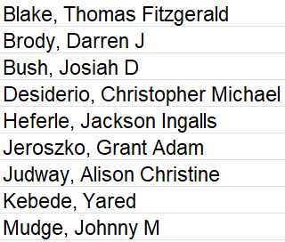
Task #1: Using text functions.
Today, we’re only looking column “A”.
It contains 2 or 3 things in this format:
Lastname [comma-space] Firstname [space] OptionalMiddleName
Our goal: extract a list of all
first names.
Suggest a method/algorithm?

Slide 9
Task #1: Using text functions.
A solution?
1. Locate the [comma-space].
2. Keep only the stuff to the right.
3. Locate the next [space].
4. Keep the text on the left.
Problem: what if there isn’t any
space in step 3?

Slide 10
Task #1: Using text functions.
Improved solution:
1. Locate the [comma-space].
2. Keep only the stuff to the right.
3a. If a space exists, determine its location
#… it should be one character after the
first name.
3b. If it doesn’t exist, write a number that is
one character after whatever does exist.
4. Keep the text on the left.

Slide 11
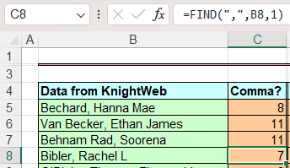
Task #1: Using text functions.
1. Locate the comma using the FIND function:
The comma is in position 7 because there are 6 characters in front of it.
The “1” at the end of the function means “start at the beginning”.

Slide 12
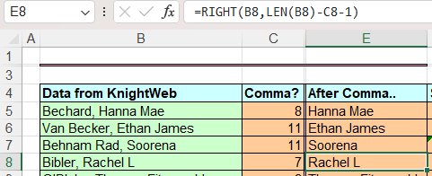
Task #1: Using text functions.
2. Keep the stuff to the right of the comma:
LEN(B8) = 16 total characters; so 16-7-1 = 8 is the number of characters we’re keeping. The “-1” eliminates the space after the comma.

Slide 13
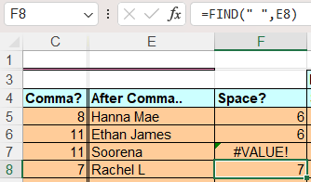
Task #1: Using text functions.
3. Locate the space:
Notice the #VALUE! Error “#VALUE!” for students with no middle name!
Notice I left out the last “1” in the FIND this time… 1 is the default.

Slide 14
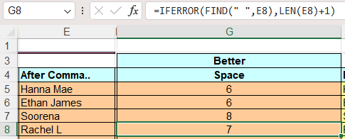
Task #1: Using text functions.
3a/b. Locate the space if it exists
The IFERROR function does the first thing if it can (it tells the number of the space). But, if it can’t, it does the second thing instead (LEN(E8)+1).

Slide 15
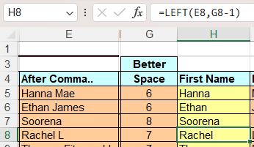
Task #1: Using text functions.
4. The first name is the text before this “better space”.
We now have a perfect column of first names!
Notice that the space is always 1 character AFTER the first name, which is why we are using G8 -1 instead of just G8.

Slide 16
Intermission

Slide 17
Task #2: Cleaning Data for later calculations and plots.
Problem: You made some measurements (perhaps 16 rows worth), plotted them, and used LINEST to determine the slope and intercept.
Now, you want to re-use that spreadsheet on a new data set.
But this time, you only have 13 rows of data. Or, maybe your instrument had a glitch and ruined line 7.

Slide 18
Task #2: Cleaning Data for later calculations and plots.
Why is this a problem?
LINEST only works if every selected cell contains a number… errors, text, or even blank cells all kill it!
You need to have contiguous, numeric data in every cell referenced by LINEST.
Some other functions have similar issues.
On plots, errors (or even blanks) in the middle of a column of data are interpreted as 0.0 rather than “none”, so trendline results are just wrong.

Slide 19
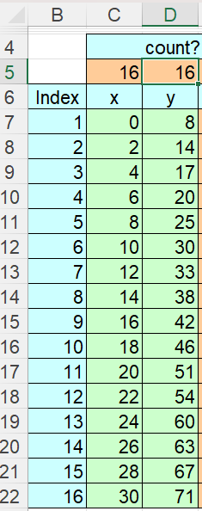
Task #2: Cleaning Data for later calculations and plots.
In this example, suppose that we know that whatever data set I get, it will have 16 or fewer measurements.
For this method, I will add an “index” column to the left of my data that counts from 1 to 16 (shown in light blue).

Slide 20
Task #2: Cleaning Data for later calculations and plots.
Next, I “count” how many numeric
data cells I have in each column.
So, for example, the highlighted orange cell D6 contains the formula:
=COUNT(D7:D22)
Right now, I have 16 numeric x values, and also 16 numeric y values.

Slide 21
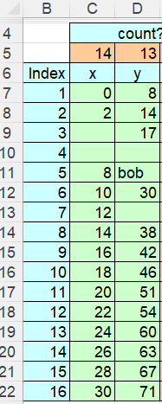
Task #2: Cleaning Data for later calculations and plots.
Here, I made some data cells blank, and entered “bob” in one of the cells. Notice that the count changed from 16 to 13.
The count would still be correct if a cell contained other garbage like “error”, or even “=sqrt(-1)”.
But our plot and LINEST are now both wrong!

Slide 22
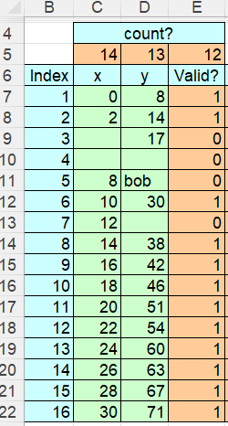
Task #2: Cleaning Data for later calculations and plots.
Next, we validate each row. In this example, my criteria are:
a) is x a number?, and
b) is y a number?, and
c) is y > 0? (just to show how)
If a row is “valid”, column E is 1, but invalid rows are 0.
You can imagine adding other criteria.

Slide 23
Task #2: Cleaning Data for later calculations and plots.
There are many ways to make the validation cells. Here, I did a couple of things. The formula in cell E7 is:
The IFERROR part isn’t even truly needed.
Since each COUNT is either 0 or 1, their product is 1 only if both are numbers.
=IFERROR(IF(D7<=0,0,COUNT(C7)*COUNT(D7)),0)

Slide 24
Task #2: Cleaning Data for later calculations and plots.
I SUM this column in cell E5.
=SUM(E7:E22)
Now I know exactly how many cells I need to apply LINEST to … it’s 12!
Next, I need to make sure that those 12 valid data rows are contiguous.

Slide 25
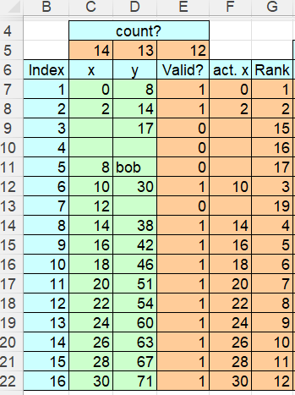
Task #2: Cleaning Data for later calculations and plots.
There are many ways to do this.
Here, I made a new column for x, called “actual x”. It only copies the original “x” (column C)
if a row is valid:
=IF(E7=1,C7,"")
The double-quote “” means otherwise “make this cell empty”.

Slide 26
Task #2: Cleaning Data for later calculations and plots.
The “IF” is the most important thing we’re learning today!
Summary: =IF(condition,
what to show if condition is true,
what to show if condition is false)

Slide 27
Task #2: Cleaning Data for later calculations and plots.
Column G is a “rank”. G7 says:
=IF(F7="",B7+E$5,RANK(F7,F$7:F$22,1))
If “actual x” (F7) is blank, then its rank is its original x value PLUS the total number of valid rows (so it’s always a number greater than 12).
But if “actual x” is a number, it’s ranked normally. So, all ranks are unique.
The “1” at the end means “low to high”.

Slide 28
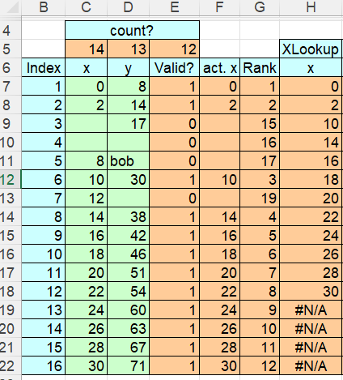
Task #2: Cleaning Data for later calculations and plots.
The XLOOKUP column places a new copy of each valid x value, in sequence.
=IF(B15<=E$5,XLOOKUP(B15,G$7:G$22,F$7:F$22,0),NA())
The “if” part says “only make new x values if the index of this row is less than or equal to the number of valid rows”, otherwise make it “#N/A”.

Slide 29
Task #2: Cleaning Data for later calculations and plots.
The “XLOOKUP” part says:
=IF(B15<=E$5,XLOOKUP(B15,G$7:G$22,F$7:F$22,0),NA())
We’re doing index row 9…(“B15”)…
So scan through the “Rank” column G until you see a “9”
Copy the “actual x” (Column F) value from this same row.

Slide 30
Task #2: Cleaning Data for later calculations and plots.
The “XLOOKUP” is the second most important thing we’re learning today!
Summary: =XLOOKUP(value to find,
where to look for it,
which column to take a result from,
{0 to 3 more optional parameters
about what to do with
unexpected results…} )

Slide 31
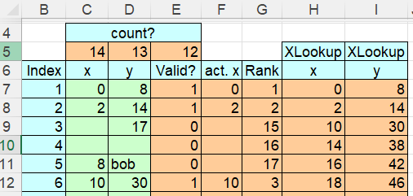
Task #2: Cleaning Data for later calculations and plots.
The next “XLOOKUP” part is for the “y” data…
=IF(B9<=E$5,XLOOKUP(B9,G$7:G$22,D$7:D$22,0),NA())
We’re doing row 3…(“B9”)
Scan through the “Rank” column until you see a “3”
Copy the “y” (Column D) value from this same row.

Slide 32
Task #2: Cleaning Data for later calculations and plots.
We now have contiguous, valid data in columns (H, I)
We can use the new x and new y columns to make a plot.
The plot will be error-free.
What about LINEST?
Our last step will be to make a LINEST result that knows to use only the validated data. We’ll use the function OFFSET.

Slide 33
Task #2: Cleaning Data for later calculations and plots.
=LINEST(OFFSET(I7,0,0,E5,1),OFFSET(H7,0,0,E5,1),1,1)
The function OFFSET returns a “range”… such as C7:C22.
The syntax is: OFFSET (top left cell of range
vertical adjustment to top cell?
horizontal adjustment to top cell?
Total rows of this range
Total columns of this range)

Slide 34
Task #2: Cleaning Data for later calculations and plots.
=LINEST(OFFSET(I7,0,0,E5,1),OFFSET(H7,0,0,E5,1),1,1)
LINEST first wants the column of “new y” data.
We only want to use the 12 new validated y values.
Since E5 holds our “12”, this y-data result is I7:I18.
Similarly, the x-data result is H7:H18.
So this LINEST is really =LINEST(I17:I18, H7:H18,1,1)
The only way to crash it is to have no data!

Slide 35
Intermission

Slide 36
Task #3: Binning and Compression.
Problem: We have a lot of data (in this example, there are 1000 rows). The data is somewhat noisy. We want to “compress” or aggregate the data into fewer rows. So, if we want to have only 50 new rows, then each row will be comprised of data from 20 different original rows.
Why? Random noise will be smoothed/reduced, and global trends will be easier to see.

Slide 37
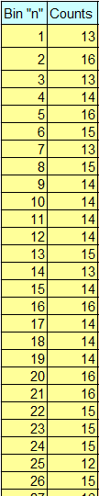
Task #3: Binning and Compression.
Data: Our raw data is 1000 lines from a Multi-Channel Analyzer. Each line is the number of counts returned over a one-minute duration by 1000 sensors. Each sensor is tuned to a different energy.
The data is output by sensor, or “bin” number.

Slide 38
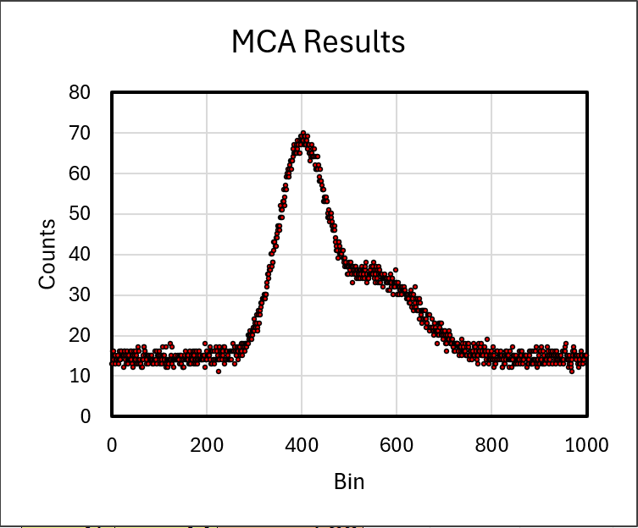
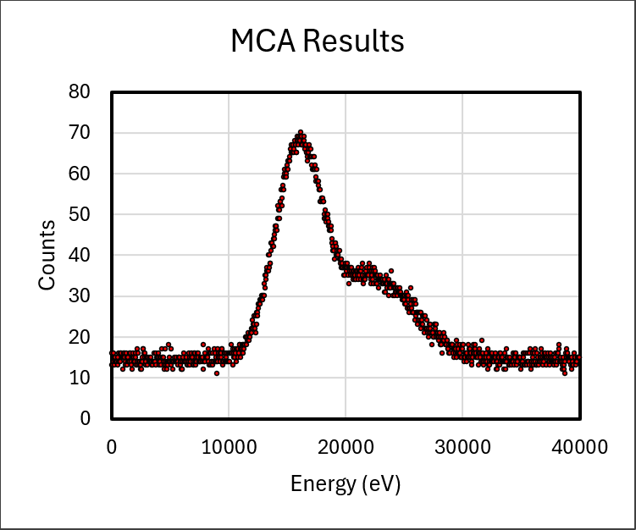
Task #3: Binning and Compression.
Raw data:

Slide 39
Task #3: Binning and Compression.
Unit Conversion: As an extra factor, each bin has an associated energy. Your very smart lab partner tells you that the energy measured by each bin number is given by:
Energy (in eV) = 40 × (bin number) +10

Slide 40
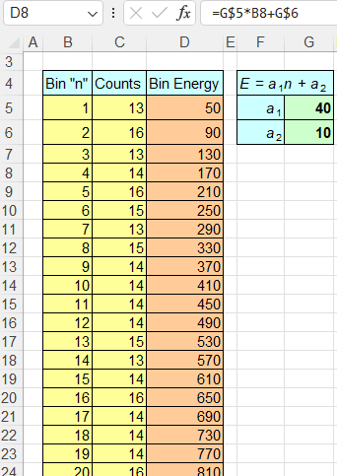
Task #3: Binning and Compression.
Before applying this formula to make a new column called “Bin Energy”, you wisely choose to put these values into their own cells as shown.
Using “$”, you easily create the energy values seen here in column D.

Slide 41
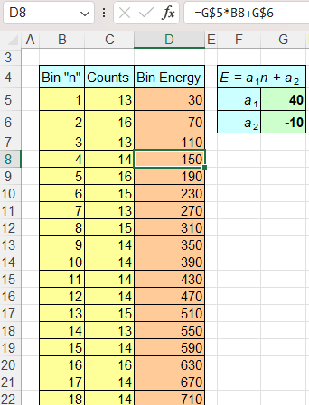
Task #3: Binning and Compression.
Oops! A week later, you find out that your lab partner is not so smart after all… the a₂ value was supposed to be negative!
But because you have a cell for it, you only need to adjust one cell to repair your spreadsheet… not thousands!

Slide 42
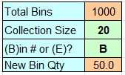
Task #3: Binning and Compression.
Let’s start aggregating. First, let’s determine some of the global aggregation values…
Even though I “know” there are 1000 data rows, I use the MAX function to actually count them. So, if my next data set has (up to) 2000 rows, this spreadsheet still works!
=MAX(B5:B2004)

Slide 43
Task #3: Binning and Compression.
Next, I have a “user input” cell. The human (maybe you!) can choose whether I want to aggregate 20 cells into each new bin (shown here), or 5, or 200.
The next cell is another “user input” relating to how the user wants to view the results…

Slide 44
Task #3: Binning and Compression.
Finally, I want to know how many new bins I expect to have. It’s just
New Qty = (Total Bins) / (Collection Size).
Notice that it can result in a non-integer, which we might have to think about later.

Slide 45
Task #3: Binning and Compression.
Next, for each of the (up to) 2000 original data rows, I want to determine which new bin the data will end up in.
Recall that column “B” is the original bin number, and cell J5 is the “collection size” (20 in this example)
=IF(B5="",NA(),ROUNDUP(B5/J$5,0))
So, if the original bin is blank, put in #N/A.
Otherwise, put in the (original bin #) / (20).

Slide 46
Task #3: Binning and Compression.
=IF(B5="",NA(),ROUNDUP(B5/J$5,0))
The “0” at the end of ROUNDUP turns the result into an integer.
So, for bin 1, we get (1/20) = 0.05 → part of new bin 1
for bin 20, we get (20/20) = 1.00 → part of new bin 1
for bin 21, we get (21/20) = 1.05 → part of new bin 2
for bin 1000, we get (1000/20) = 50.00 → part of new bin 50

Slide 47
Task #3: Binning and Compression.
Next, we need to list out the new bin numbers. In this case, we want to have 50 “new” bins, so we need a column that goes from 1 to 50. I’ll use the original 1000 bin names in column B to get started…
=IF(OR(B5>J$7,B5=""),NA(),B5)
If column B is blank, OR if column B is bigger than 50, then put #N/A, otherwise put the value 1 through 50.
The “or” conditions are separated by commas.

Slide 48
Task #3: Binning and Compression.
Next (and mostly just for sanity), for each new bin, I want to clearly show myself the full range of “original” bins that are included.
So, for new bin 1, I want to know that it goes from 1 to 20.
For new bin 2, I want to know that it goes from 21 to 40.
For new bin 50, I want to know that it goes from 981 to 1000.

Slide 49
Task #3: Binning and Compression.
Recall that cell J5 is 20, and column M is “new bin number”.
For the first (minimum) value: =(M5-1)*J$5+1
For the second (maximum) value: =M5*J$5
Example: new bin 2 goes from 21 to 40…
(2-1)(20) +1 = 21, and (2)(20) = 40
Example: new bin 50 goes from 981 to 1000…
(50-1)(20) +1 = 981, and (50)(20) = 1000

Slide 50
Task #3: Binning and Compression.
Let’s compute the “average” energy detected by each “new” bin. Since our Energy formula refers only to “original” bin numbers, I’ll find the average of the original bin numbers that were included inside our new bin:
=(N5+O5)/2*G$5+G$6
So, (N5+O5)/2 is the average original bin number, since N5 and O5 are the “min” and “max” original bins we just created for each new bin. G5 and G6 are our earlier unit conversion factors a₁ and a₂.

Slide 51
Task #3: Binning and Compression.
Next, I wanted the user to be able to choose the horizontal axis. It can be either “new bin number” or “average energy” of each new bin.
In cell Q4, I first generate a custom text label for the plot.
It’s either “Aggregated Bin” or “Average Energy”
=IF(J6="B", "Aggregated Bin", "Average Energy")
Recall that cell j6 was where “the human” entered a “B” or an “E”. Notice that the default is “Average Energy”.

Slide 52
Task #3: Binning and Compression.
Also, depending on the human’s choice, column Q is either a copy of all the values from the “new bin number” column (“M”) or from the “average energy” column (“P”).
=IF(J$6="B",M5,P5)
Again, if the user mistakenly types “z”, it default to column P (“Average Energy”).

Slide 53
Task #3: Binning and Compression.
Finally, we still have to do the hardest part. This is to actually aggregate the counts within each “new bin”.
Since our new bin” #1 includes “original bins” (#1 through #20), we need to add all those counts together to get the new count for the new bin.
But, it won’t always be twenty bins, since the user is free to choose whatever amount they like.

Slide 54
Task #3: Binning and Compression.
To add, we use the “SUM” function. It takes one argument that is a range. For example, =SUM(D11:D30). So we need to make a custom range that might include 20 cells, but might instead contain 1 cell or 100 total cells.
I’ll use our old friend OFFSET to create this range:
=SUM( OFFSET(start, 0,0, J$5, 1) )
Here, J$5 is 20 (or 1, or 100, etc.)

Slide 55
Task #3: Binning and Compression.
But I still need something for the “start” cell, such as “C5” for example. I know that all the counts start at cell C5 and stretch down to cell C1004.
I’ll use the TEXT function to convert the number part 5 into the string “5”, and I’ll also use the “&” function to join 2 strings like “C” and “5” into just “C5”.
start = “C” & TEXT(5+(M5-1)*J$5,"#")

Slide 56
Task #3: Binning and Compression.
start = “C” & TEXT(5+(M5-1)*J$5,"#")
The “#” just means “don’t include decimals”.
Recall that column M is the “new bin number”.
Specifically, M5 is “new bin number 1”.
So, 5+(1-1)* (20) = 5. Joined with “C”, this is “C5”
Or, for new bin number 10, which is in cell M14, would have:
5+(10-1)*(20) = 185, which become “C185”

Slide 57
Task #3: Binning and Compression.
Consider “new bin #10”. It was preceded by 9 new bins, each having 20 rows of data, or 180 total rows. The reason we add “5” is that because of headers, our first data point is in row 5 rather than in row 0 or row 1.
So, starting at “C185” seems correct!

Slide 58
Task #3: Binning and Compression.
Now that I have a string of text like “C5” or “C185”, I want to convert this into an actual cell reference.
The function “INDIRECT” converts strings into true cells references.
So putting together all the pieces:
=SUM(OFFSET(INDIRECT(“C” & TEXT(5+(M14-1)*J$5,"#")),
0,0,J$5,1))

