Slide 1
Engineering Research Team
(Part of LLE grant)
Summer 2025 Ryan McDonald
students: Maggie Smith
Delvin Ramos

Slide 2
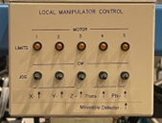
Engineering Research Team
(Part of LLE grant)
“Big” Picture: this control panel is attached to the 15R end station in the acceleration.
We want to replace it…

Slide 3
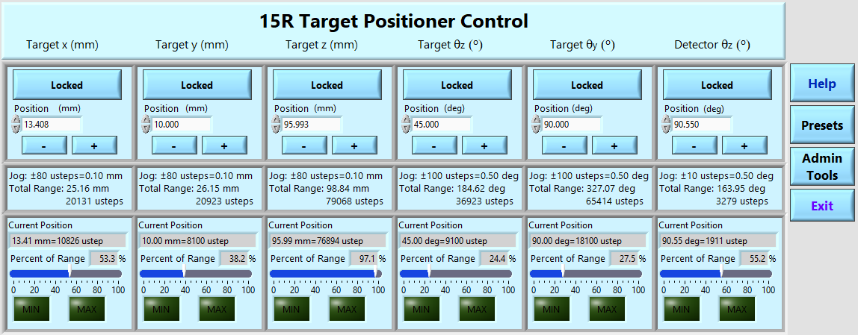
Engineering Research Team
(Part of LLE grant)
…with a new system:
Can be operated remotely
Provides feedback so the user knows what’s actually happening.
Provides accuracy & repeatability.

Slide 4
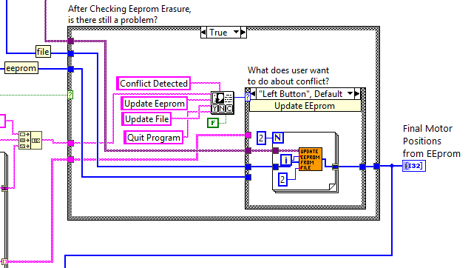
Engineering Research Team
(Part of LLE grant)
Stuff that students do…
Code/debug in LabVIEW.

Slide 5
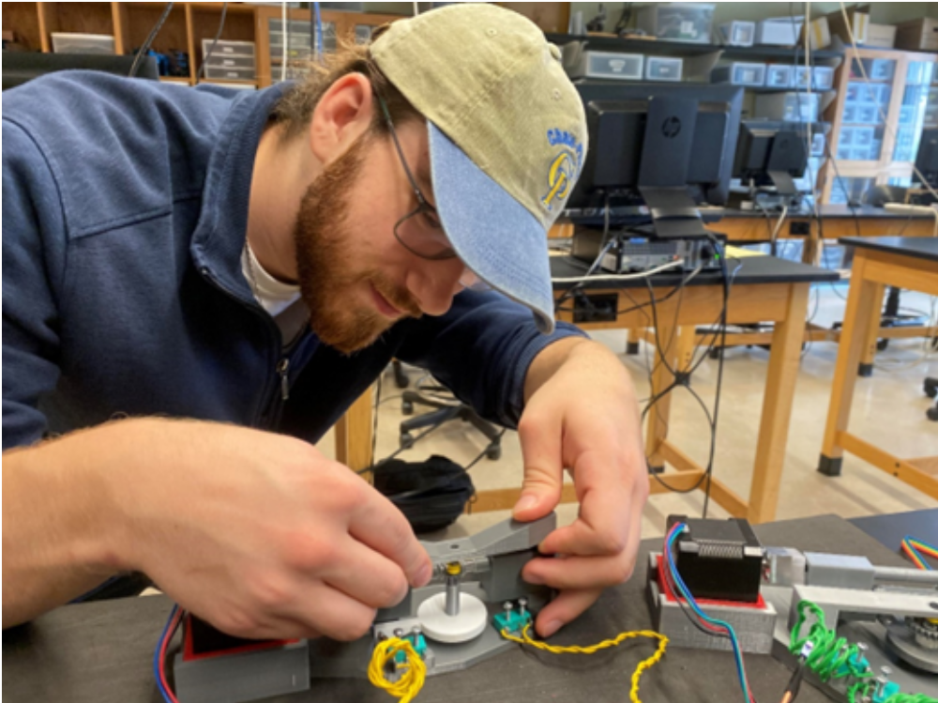
Engineering Research Team
(Part of LLE grant)
3D print prototypes.
Design hardware
with CAD.
Assemble hardware.

Slide 6
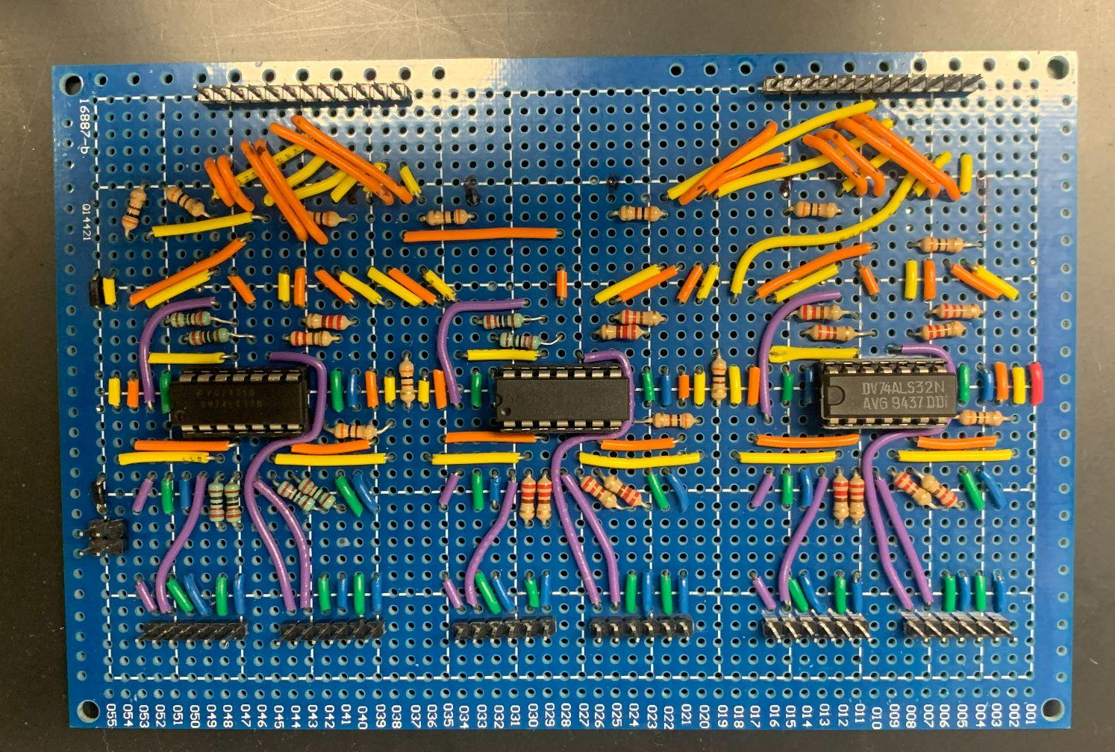
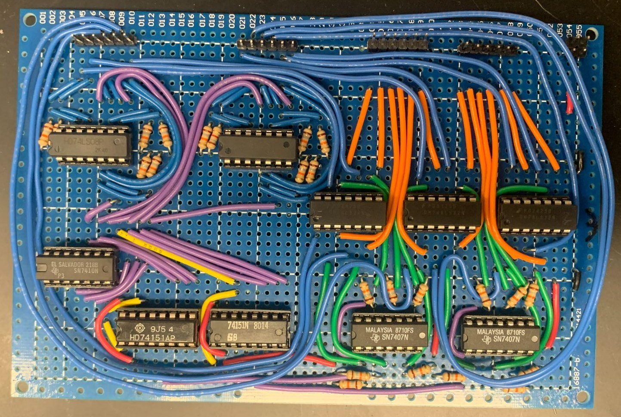
Engineering Research Team
(Part of LLE grant)
Design Circuits. Build Circuits.

Slide 7
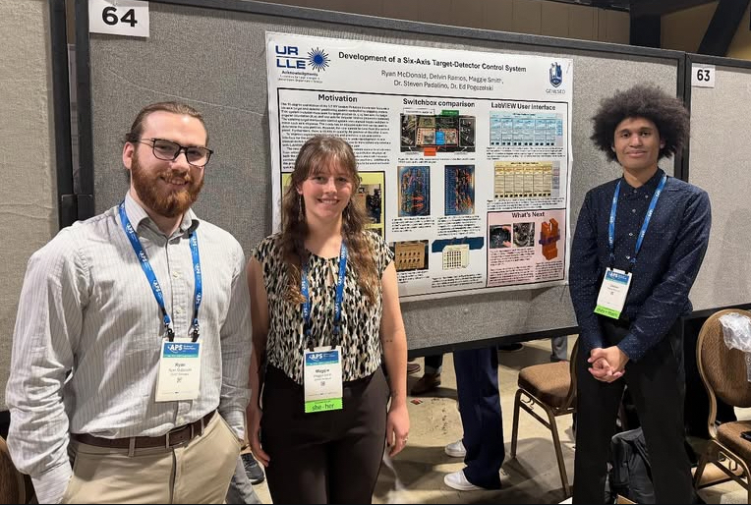
Engineering Research Team
(Part of LLE grant)
Attend national
meetings
& present work.

Slide 8
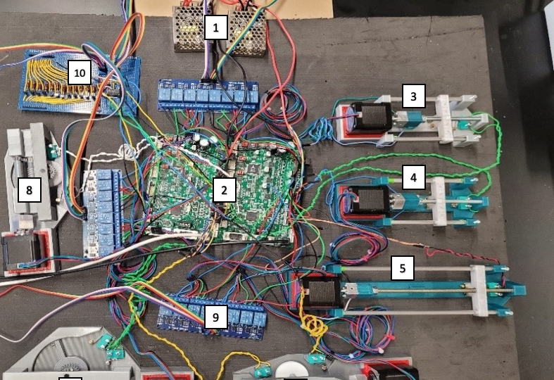
Engineering Research Team
(Part of LLE grant)
Current Status…
Version 0 works on a tabletop.
→ Connect to actual hardware…

Slide 9
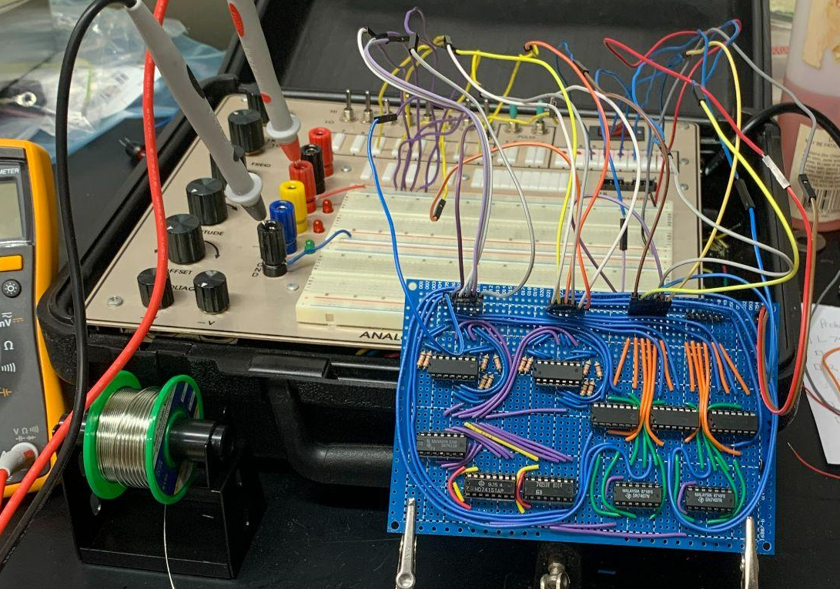
Engineering Research Team
(Part of LLE grant)
→ Modify some actual hardware:
* Connect to existing motors
* add limit switches to two axes

Slide 10
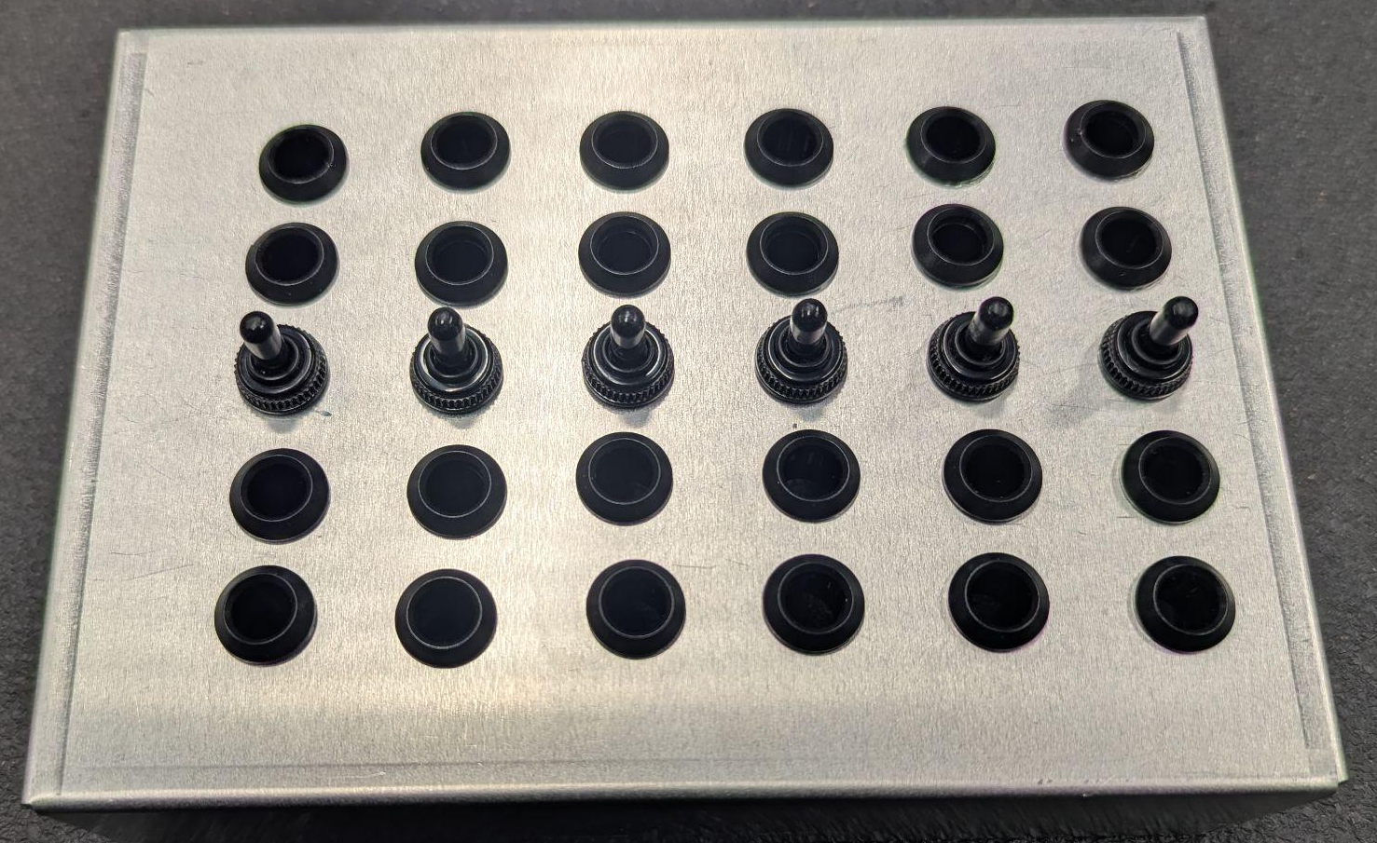
Engineering Research Team
(Part of LLE grant)
* Build a “backup” physical control system so the motors can operate even when the computers are down.
New physical control panel
(in progress)

