Slide 1
Animations
Method 1:
A series of slides that are almost identical.
The “animation” is just the difference between each successive image.
You’ll have to decide how to count page numbers…

Slide 2


Slide 7

Method 2:
Animations created using the PowerPoint “Animation Pane”.

Slide 9
Rotations occur about the geometric center of the object. To get this result, there is an “equal, opposite, and invisible pendulum attached to the visible one.
Sadly, the newest versions of PowerPoint insert un-editable time delays between successive animations that cause obvious delays at the top of the motion.

Slide 10


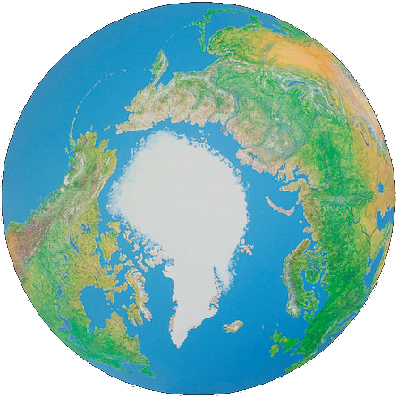
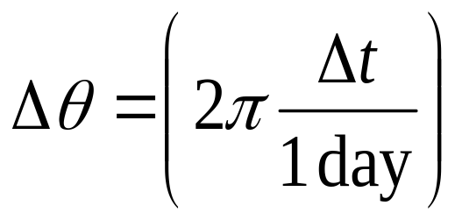
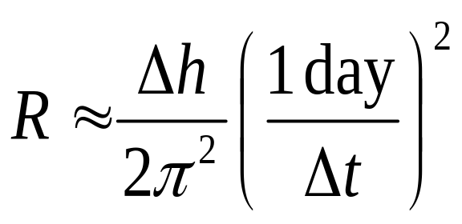
Δh
Δθ
Geometry:

Slide 11

This animation relies on complicated layering of objects. There are 6 or 7 white objects that are there only to cover portions of other objects…
I measured this diameter as a function of height…

Slide 12
Here, I’ve colored them brown, green, blue, yellow, pink, and light blue so you can see them.
The green one is the only “invisible” object that also has an animation…
I measured this diameter as a function of height…

Slide 13


“True” Physics Animations: “Rolling” Example
You can ONLY control displacement and duration.
I’m measuring the displacement with this green rectangle.
Right-click size and position… It has a width of Δx = 8 inches.
Similarly, the “wheel” has a diameter of D = 1.5 inches, so r = 0.75 inch.
This animation has a duration of t = 4 s.
Therefore v = Δx/Δt = 8/4 = 2 inches/second.
Physics: v = r ω. Therefore ω = v/r = 2/0.75 = 2.667 rad/s.
Therefore Δθ = ω Δt = 10.667 radians = 611 degrees.
These numbers are needed in your “spin” properties for the wheel.

Slide 14
The (final) rotation rate was set using the “eyeball” method… I just tried to make it look right.
Most PowerPoint slides are “cartoons”, not measurably accurate simulations.
This slide has 3 animations.

Slide 15

Linear motion:
Δt = 2s
L = 7.036 in (measured)
D = 1.13 in, or r = 0.565 in
a = 2L/Δt² = 3.518 in/s²
α = a/r = 6.227 rad/s²
Δθ = ½αΔt² = 12.454 rad = 713.5º
ω_{final} = αΔt = 12.454 rad/s = 713.5º/s
This slide has 4 animations.
PowerPoint keeps trying to adjust my second motion path so the two don’t really line up!
Use arrow keys at high zoom to adjust.
This “free fall” portion is not actually accelerating…

Slide 16
The two blocks have significant “white” sections attached to them.
The strings don’t lengthen or contract… they are non-animated.
The green block drags a white region over top of the horizontal string to keep it from becoming visible after the block passes.
The blue block pushes a white section over the vertical string.
This slide has 2 animations.

Slide 17
The two blocks have significant “white” sections attached to them.
The strings don’t lengthen or contract… they are non-animated.
The green block drags a white region over top of the horizontal string to keep it from becoming visible after the block passes.
The blue block pushes a white section over the vertical string.
This slide has 2 animations.

Slide 18
Layers (in order from the back):
Sky, then sun, then mountains, then green ground, then road.
Then small trees, then large trees, then car, then wheels.
Animations: Mountains, small trees, large trees, and wheels.
More distant objects move farther in the same amount of time.

Slide 19
Animated colors… Nothing changes color here!

Slide 20
Triggers: (these “buttons”).
Look at the timeline →
Arrive
Attack
Fire
Bye!

Slide 21
Method 3:
Animations that embed video or “animated gif” files that possess their own intrinsic animation.

Slide 22
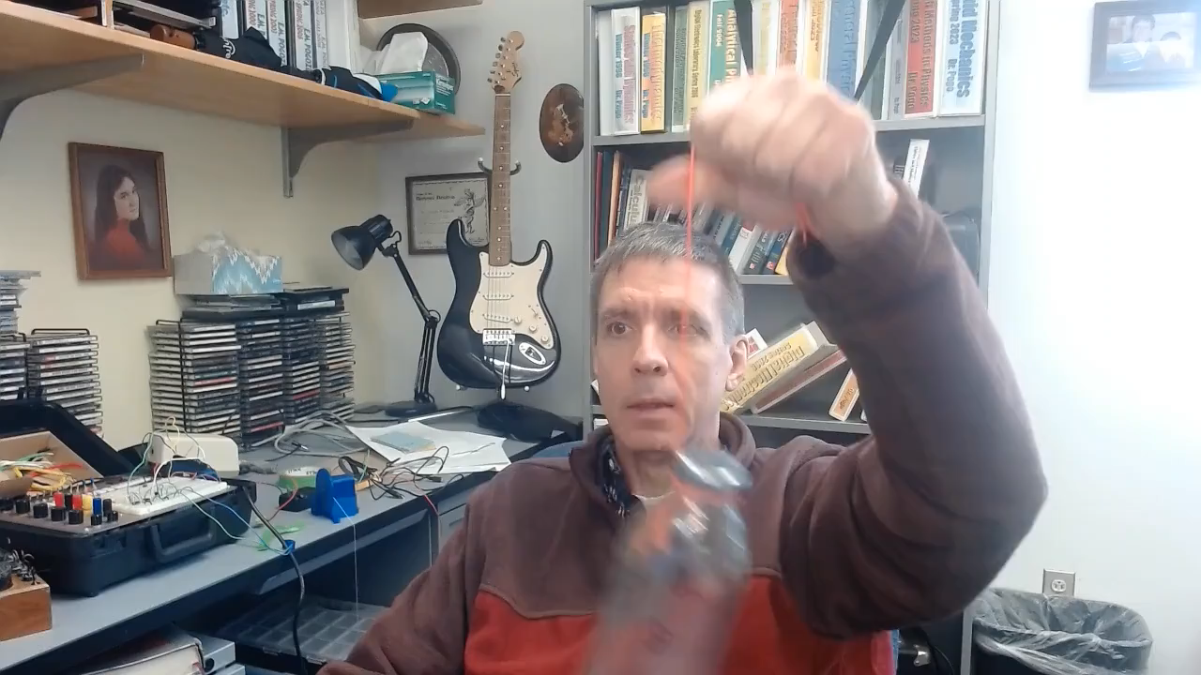
Here is an embedded .mp4…

Slide 23
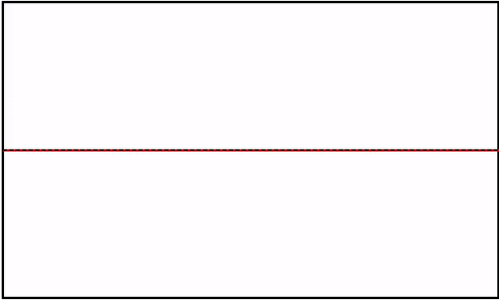
I made this plot in Excel, then used Excel animation tools, then did a screen capture of the animation, and saved it as a .gif…

Slide 24
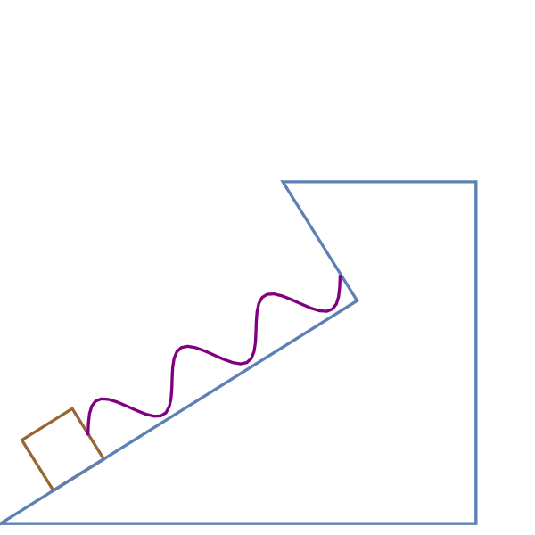
I made this animation in Mathematica and then saved it as a .gif right from inside Mathematica…

